Slide 1
SPORTS NUTRITION FOR TEAM SPORT ATHLETES
Lecture content provided by GSSI, a division of PepsiCo, Inc. Any opinions or scientific interpretations expressed in this presentation are those of the author and do not necessarily reflect the position or policy of PepsiCo, Inc.

Slide 2
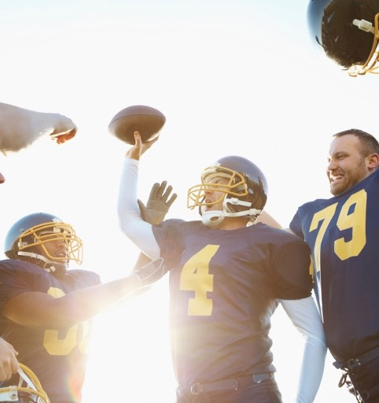

Lecture Outline
The Team Sport Athlete
Energy
Hydration
Structure
Key takeaways

Slide 3



The Team Sport Athletes
All Athletes
  Athletes use and need fuel for energy to train/compete
  Athletes sweat and need hydration
  Athletes use muscles and need to be strong
Team Sport Athlete Specific
  Mixture of high and low intense activity over specific duration
  Changes in pace/direction (“stop & go”, fast, slow, jumping, forward, backward, lateral)
  May have certain skill involvement (throwing, swinging, kicking, dribbling, catching)
  Can involve physical contests (guarding, pushing, pulling, tackling)
  May involve a ball/puck or other pieces of equipment
Notes:
There are commonalities in all athletes and that is:
-Athletes use and need fuel for energy to train and compete at a high level of performance
-Athletes sweat and need hydration to replenish these fluid losses and refrain from too high of increases in core body temperature
-Athletes use muscles and need to be strong in order to accel at their particular sport
Whereas team sport athletes specifically:
-Train and compete with a mixture of high and low intense activity spread out over a specific duration
-Involve changes in pace and direction fast & slow paces as well as accelerations and decelerations involved with starting, stopping, and jumping while also moving forward, backward, laterally, and diagonally.
-There may also be a specific skill involvement within the sport or even a specific position (throwing, swinging, kicking, dribbling, catching)
-Some team sports can involve physical contests (guarding, pushing, pulling, tackling)
-Lastly there is usually some sort of ball/puck and may be other pieces of equipment

Slide 4



ENERGY
HYDRATION
STRUCTURE
Notes:
The sport nutrition needs of any athlete can be divided into three categories; energy, hydration and structure.
Energy will be the first topic of discussion with regards to the team sport athlete.

Slide 5
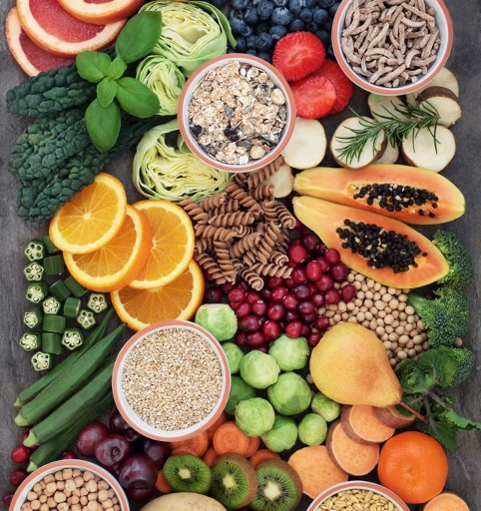
Carbohydrates and Performance
Carbohydrates= Muscle Fuel
During Endurance Exercise
Maintain high rates of carbohydrate oxidation
Reduce ratings of perceived exertion
Increase endurance capacity
Delay the onset of fatigue
Prevent hypoglycemia
What about for Team Sports?
Cermak & van Loon. Sports Med. 2018;43:1139-1155
Jeukendrup A. Nutrition. 2004;20:669-677
Notes:
Overall, in most activities most of the time, carbohydrate will be the predominant energy source to fuel muscle contraction.
Over the years, a large body of literature on carbohydrate intake has been developed around endurance exercise. These studies have shown when compared with placebo ingestion of carbohydrate during exercise longer than 2 hours will
-maintain high rates of carbohydrate oxidation
-reduce ratings of perceived exertion
-increase endurance capacity
-delay the onset of fatigue
-prevent hypoglycemia
However, due to the difficulties in measuring that exist in team sports, not as much research is available on the performance effect carbohydrate intake has within this setting.

Slide 6
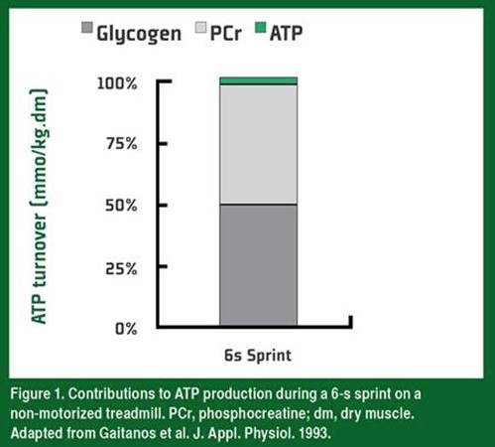

Energy Metabolism During High Intensity Exercise
Depending upon the team sport the duration of a sprint can last several seconds with recovery lasting a few seconds to several minutes during lower intensity periods or breaks.
Since sprinting is primarily reliant on the anaerobic system of ATP generation, phosphocreatine (PCr) and glycogen contribute in almost equal amounts to ATP turnover
SSE#140
Spencer M, Bishop D, Dawson B, et. al. Sports Med. 2005;35:1025-1044
Gaitanos GC, Williams C, Boobis LH, et. al. J Appl Physiol. 1993;75(2):712-719
Williams C and Rollo I. Sports Science Exchange. 2015;28(140)1-7
Notes:
But first let’s take a step back. Sprinting may play an important role in a lot of team sports. Depending upon the team sport and its demands, sprinting may take place several times through the activity. The duration of a sprint can last several seconds with recovery lasting a few seconds to several minutes during lower intensity periods or breaks. Since sprinting is primarily reliant on the anaerobic system of ATP generation, both phosphocreatine (PCr) and glycogen contribute in almost equal amounts to ATP turnover. Since glycogen makes up almost 50% of the contribution and is the storage form of carbohydrate, there are definite implications for the importance of carbohydrate to fuel team sport athletes.

Slide 7
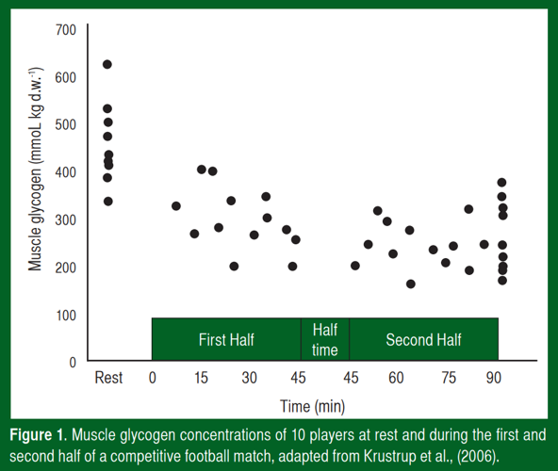
Glycogen Depletion from High Intensity Exercise
Muscle glycogen is used during team sport activities! (eg. soccer)
SSE#127
Rollo I. Sports Science Exchange. 2014;27(127)1-8
Krustrup P, Mohr M, Steensberg A, et. al. Med Sci Sports Exerc. 2006;38(6):1165-1174
Saltin B. Med Sci Sports and Exercise. 1973;5(3):137-146
Notes:
Furthermore, many soccer studies have been conducted with respect to sports performance parameters. Among them, researchers have taken biopsies of soccer athletes to track glycogen usage during match play. Following the analysis of an early 1973 study by Saltin, it was found that muscle glycogen concentrations were significantly lower after the match (pre: 96 mmol/kg w.w.; halftime: 32 mmol/kg w.w.; end: 9 mmol/kg w.w.) and that those players who began low muscle glycogen (45 mmol/kg w.w.) had almost depleted stores by half-time.
The following figure shows a similar study conducted by Krustrup in 2006 only with dry weight measurements. Similarly, as you can see post-match levels of glycogen are significantly reduced compared to pre-match rest levels.
Therefore, it has been proven that glycogen is a source for energy in producing ATP in team sport activities such as soccer.

Slide 8
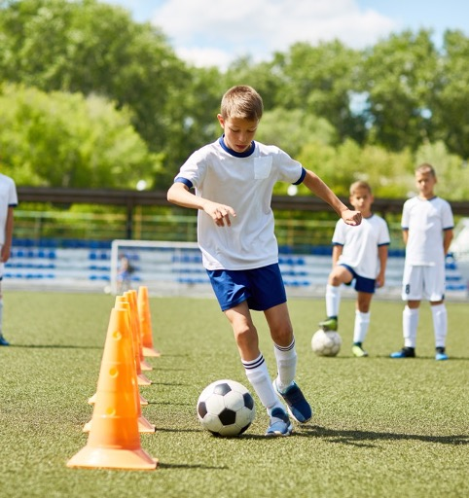
Carbohydrate Research in Team Sports
Studies showing benefits of carbohydrate in team sports:
Intermittent high-intensity exercise: 10 of 12
Sprinting: 5 of 17
Jumping: 1 of 5
Change of Direction/Agility: 4 of 9
Skill: 10 of 17
Baker LB, Rollo I, Stein KW, et. al. Nutrients. 2015;7(7):5733-5763
Notes:
In 2015 Baker et al published a review that set out to compile and analyze the available research on the effect of carbohydrate intake on team sports performance looking at various, specific aspects of different sports. It is interesting to note that most of the available research on this is in the sport of soccer.
Out of the studies gathered, multiple studies have been conducted on intermittent high-intensity exercise involving such sports as soccer, rugby, field hockey, basketball, and those termed “non specific”:
10 out of 12 studies found a “consistent performance enhancement” of intermittent high-intensity exercise capacity with carbohydrate intake versus a placebo
This finding is perhaps not surprising, given the well-established benefit of carbohydrate intake on endurance exercise capacity
Aside from intermittent high-intensity exercise, other team sport components were looked at such as sprinting, jumping, change of direction/agility, and skill.
With regards to sprinting, there have been mixed results:
Overall, of the 17 studies on sprinting, 5 showed a benefit of carbohydrate and 12 no benefit
Of the 13 studies in soccer, rugby, field hockey and American football, only 2 soccer studies showed benefit of carbohydrate ingestion on sprint performance
However, 3 out of 4 basketball studies reported a benefit of CHO ingestion on sprint speed in the 4th quarter of a simulated game
When talking about jumping, there are minimal effects seen:
1 out of 5 studies showed benefits from carbohydrate ingestion on jumping
Only 1 out of 4 reported studies involving basketball reported a benefit of carbohydrate ingestion and the 1 study on soccer showed no significant differences from the placebo
In reference to change of direction/agility, there are mixed results with the limited date on pre-planned change of direction speed:
Out of the 9 studies over different sports, 4 showed a benefit from carbohydrate intake
1 of the 3 soccer studies reported a benefit
The 1 tennis study reported a benefit
Neither of the 2 basketball studies reported a benefit
The 1 study in rugby reported no benefit
Both of the 2 non-specific studies reported a benefit
Some things to note are that agility is difficult to measure and more validation work is needed for sport-specific agility; also, there are no studies involving changes in direction in response to a stimulus
Lastly, specific skills are crucial for the success within certain sports:
There have been 17 studies conducted that have looked at carbohydrate ingestion and it’s effects on skill performance
In soccer, 6 of 8 studies have reported improved skill performance with carbohydrate ingestion. Soccer is also the sport with the most protocol/skill test validation work.
Mixed results were found in basketball since 1 study reported improved performance and the other study reported no effect
Out of the racket sports such of tennis, badminton, and squash, 3 studies reported improved performance and 4 studies reported no effect of carbohydrate intake
Similar to agility, skill is difficult to measure and many different tests have been used. More validation work is needed for measurement of skill in sports.

Slide 9
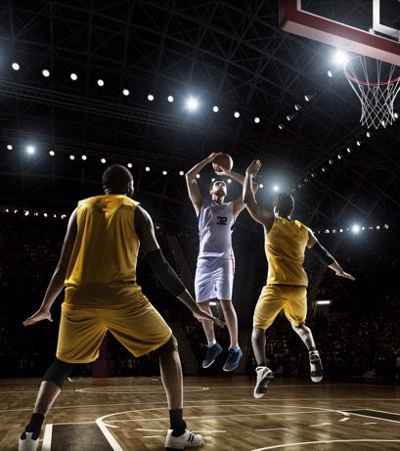
Compared to water, carb intake during a basketball protocol resulted in…
14%
Faster
20 m sprint (4th Q)
37%
Longer
Run time to fatigue
Improved
second-half motor skills
Decreased
second-half fatigue (POMS)
Welsh RS, Davis JM, Burke JR, et. al. MSSE. 2002;34(4):723-731
Notes:
Specifically, carbohydrate intake has an impact when athletes are fatigued. This slide highlights a study by Welsh et al using a simulated basketball game model. The study design consisted of:
Four 15-min quarters of intermittent shuttle running of various percentages separated by a 20 min half time
Athletes were provided with carb-electrolyte ingestion before the simulated game and after each quarter equating to ~41 g/h of carbohydrate
Various tests were performed throughout the trial including shuttle run to fatigue, 20-m maximal sprint, 10-repetition maximal vertical jumping, whole body motor skill test, profile of mood states (POMS), and Stroop Color-Word Test were
Carbohydrate intake resulted in:
37% longer run time to fatigue
Faster 20 m sprint time during the 4 quarter
Improved whole body motor skill test performance
Improved self-reported perceptions of fatigue

Slide 10

Carbohydrate and Team Sports
Field Sports
STRENGTH + POWER
Field Sports
ENDURANCE
Batting Sports
Court Sports
Short distances covered, many short bursts
Large distances covered, high speeds
Lower overall energy demands, long duration
Smaller area, shorter duration, tournaments, substitutions
CARBOHYDRATES ARE ESSENTIAL
Maintain short energy bursts
To maintain glycogen stores
To maintain
blood glucose
for attention & decision making
To maintain glycogen
over time
Holway & Spriet. J Sport Sci. 2011;29(1):S115-125
Notes:
Team sports can be divided into 4 different categories based on their characteristics of energy demands, intensity, distances covered, duration, among others.
Even though there is little research across all team sports and no research in batting sport, we can make some extrapolations from the research revealed from intermittent high-intensity exercise and apply them to team sports. That is- carbs will be important for all of them for different reasons. They are essential for maintaining short energy bursts that are common in the team sport realm, maintain glycogen stores, maintain blood glucose levels to for better cognitive performance including attention and decision making abilities, and to maintain glycogen over time.

Slide 11
Daily Carbohydrate Intake for Team Sports
Type of Activity
Daily Carbohydrate Targets
Low intensity or
skill-based activities
Moderate exercise
(~1h per day)
Endurance program
(~1-3 h/d mod-high intensity exercise)
Extreme commitment (>4-5 h/d mod-high intensity exercise)
3-5 g/kg
5-7 g/kg
6-10 g/kg
8-12 g/kg
  Recommendations based on body weight
  Team Sport Athletes (3-5 or 5-7g/kg)
  A wide range of carbohydrate is recommended since each team sport athlete's needs are different
  -position and/or intensity
  Choose a starting point and then alter within the range
  -tolerability and energy level
Burke LM, Hawley JA, Wong SHS, et. al. Journal of Sports Science. 2011;29(1):S17-S27
Notes:
Now that we have established the importance of carbohydrate within team sport performance, let’s focus on the daily recommended amounts. To support energy demands, recommendations are based on body weight. (Cue animation) Team sport athletes with generally fall within the low intensity to moderate exercise recommendations of 3-5g/kg/d or 5-7g/kg/d, respectively. A baseball player may fall under the low intensity category whereas a soccer player may fall on the higher end under the moderate exercise category.
Overall, a wide range of carbohydrate is recommended since each team sport athlete's needs are different. Also, within a particular team sport, the amount of carbohydrate may vary depending upon the position. Carbohydrates may also increase or decrease depending upon the intensity of the practice or training session
Determining the right amount is both an art and a science; for instance, choose a starting point based on the recommendations, and then alter within the range based tolerability and how energized the athlete feels during their workout.

Slide 12
Carbohydrate Recommendations for Team Sport Performance
1-4 Hours Before
1-4 g/kg
During
30-60 g/h
≥ 60 min duration
Performance goal
After
1.0-1.2 g/kg
< ~8 h until next training or competition
1 Hour Before
~25-30g
Thomas DT, Erdman KA, Burke LM. Med Sci Sports Exerc. 2016;48(3):543-68
Burke LM, Hawley JA, Wong SHS, et. al. Journal of Sports Science. 2011;29(1):S17-S27
Howlett K, Angus D, Proietto J, et. al. J Appl Physiol. 1998;84(4):1413-1417
Notes:
There are also some acute strategies to promote high carbohydrate availability within the hours before, during, and after training or competition.
About 1-4 hours before practice/competition, consume 1-4 g/kg of bodyweight in the amounts during times that are tolerable for your stomach; this may often be a included within the “Pre-game” meal for team sport athletes
Within about an hour of exercise, intake begins to meet the “during” exercise needs of the athlete. Consuming CHO during this time period is particularly important if the athlete cannot or will not consume fuel during their training or competition. Many athletes do well with 25-30 g of CHO during this time period and even immediately before the warmup to blunt the release of glucose from the liver, thus sparing the hepatic store of glycogen (Howlett et al., 1998).
During practice/competition consume 30-60 g/h when going for 60 min or longer
After practice/competition consume 1.0-1.2 g/kg every hour for the first 4-6 hours post-exercise in order to quickly replenish glycogen stores especially if the athlete has a short time to recover (<8 hours); then the athlete can resume regular dietary habits. Although consuming carbohydrate post-exercise is a good habit, for those athletes who have a greater amount of recovery time, meeting daily CHO needs should be adequate to restore muscle glycogen since stores can generally be normalized within 24 hours

Slide 13
Types of Carbohydrate Before Activity
  1-4 Hour Prior to Exercise (“Pre-game Meal”)
    Higher glycemic carbohydrate-rich food foods
      Cereals, breads, potatoes, rice, pasta, etc
    Minimal fiber, fat, and protein
    What works for the athlete! (Trial and error best while training vs games)
    <1 Hour Prior to Exercise
    Same rules as above but may come in form of gels, gummies, and/or sports drinks (falls in line with “During” types)
Burke LM, Hawley JA, Wong SHS, et. al. Journal of Sports Science. 2011;29(1):S17-S27
Jeukendrup & Killer. Ann Nutr Metab. 2010;57(2):18-25
Wee SL, Williams C, Tsintzas K, et. al. J Appl Physiol. 2005;99(2):707-714
Notes:
Not only are the timing and amount of carbohydrate important, but the types of carbohydrates consumed are also crucial.
In the 1-4 hours prior to practice or competition (aka the “Pre-game Meal” athletes should choose higher glycemic carbohydrate-rich food foods with minimal fiber, fat, and protein since these can slow the digestion and absorption process and can potentially cause gastrointestinal distress during exercise. Wee et al demonstrated when consuming energy-matched high and low glycemic carbohydrate carbohydrate meals (2.5 g/kg BM) after an overnight fast, only the high glycemic breakfast increased muscle glycogen by 11–15% 3 hours later (Wee et al., 2005).
On the contrary, lower glycemic index choices may be more appropriate for those athletes involved in team sports where carbohydrate is not as available during activity. Essentially, all athletes should find the best timing, type, and amount that will work for them and test these strategies before training sessions.
Within about an hour of exercise or immediately before the warmup, athletes should still choose carbohydrate-rich food foods with minimal fiber, fat, and protein for the same reasons mentioned before. However, this window of opportunity starts to cross over into the “During” category of timing which we will get into on the next slide. These choices may come in the form of gels, gummies, or sports drinks. All athletes should practice pre-exercise nutrition strategies to find the best timing and amount that will work for them during competition

Slide 14
Types of Carbohydrate During Activity
Choose mostly Fast vs Slow Carbs
Fast = carbohydrate that is easily digested, rapidly absorbed and oxidized
Slow= carbohydrate that is slowly digested and not as rapidly absorbed and oxidized
A high rate of carbon oxidation = better performance
Fructose is appropriate in small amounts when combined with Fast Carbs
The form in which CHO is consumed (gel, drink, gummy) does not influence oxidation rates and athletes should choose the form that works best for them
Fast
Glucose (dextrose)
Maltose
Sucrose
Maltodextrins
Amylopectin
Rapid
Digestion
1.0 g/min
(60 g/h)
Slow
Fructose
Galactose
Trehalose
Isomalatulose
Amylose
Slow
Digestion
.06 g/min
(35 g/h)
Baker LB, Rollo I, Stein KW, et al. Nutrients. 2015;7:5733-5763
Pfieffer B, Stellingwerff T, Zaltas, E et al. Medicine & Science in Sports & Exercise. 2010;42:2030-2037
Thomas DT, Erdman KA, Burke LM. Medicine & Science in Sports & Exercise. 2016;48:543-568
Notes:
For durations of >60 minutes, the type of carbohydrate is important DURING training and competitions as well. Choose a carbohydrate that is easily digested, rapidly absorbed and oxidized. This is known as a “fast carbohydrate” versus a “slow carbohydrate”. A high rate of carbon oxidation can result in better performance. Choose fast carbohydrates such as glucose (dextrose), sucrose, maltodextrin and amylopectin. Fructose, among others, while oxidized more slowly, is appropriate in small amounts when combined with the sources listed above. The form in which CHO is consumed (gel, drink, gummy) does not influence oxidation rates and athletes should choose the form that works best for them.

Slide 15


Fast and Slow Carbs
GLUCOSE
SGLT1
GLUCOSE
~60 g/h
max
INTESTINAL
LUMEN
GLUT5
FRUCTOSE
FRUCTOSE
~30 g/h
max
BLOODSTREAM
Notes:
The reason for these fast and slow carbs are due to their different transporters.
A fast carb such as glucose is absorbed via the SGLT1 transporter which can sustain a rate of 1.0 g/min.
The slower carb like fructose has a separate transporter, the glut 5 transporter, which has a slower rate of absorption at .06 g/min.
That doesn’t mean there isn’t a role for a slow sugar, like fructose since it can be absorbed in addition to the 60g/h of glucose thereby maximizing overall carbohydrate absorption. However, you wouldn’t want to intake more than 30 g/hr since this can cause GI disturbances.
This is why carb recommendations aren’t based on body weight​, but are standard amounts based on your exercise duration

Slide 16
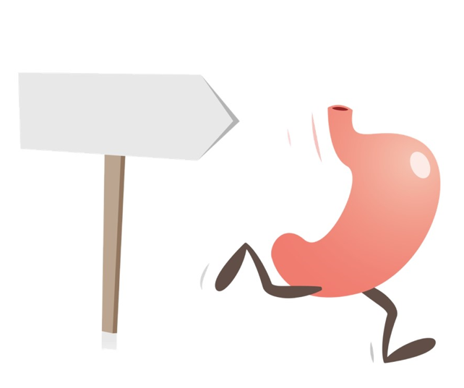
GI issues with carb intake
Train your gut
The stomach is an organ that can be trained
It is important that an athlete gradually increase the amount of fuel intake during exercise to meet the recommendations
Consuming more carbohydrates than an athlete is used to can result in a “sloshy” stomach and other more intense gastrointestinal (GI) discomfort
Stellingwerff & Jeukendrup. JAP. 2011
Murray R. Curr Sports Med Rep. 2006;5(3):161-164

Slide 17
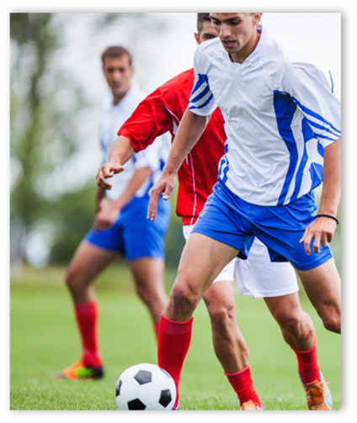
Types of Carbohydrate After Activity
  Types may vary, depending on next exercise bout
  Higher glycemic vs lower glycemic carb foods (within 24 hours/same day)
    Adding protein while equating calories result in a similar rate of glycogen resynthesis
Gunnarsson T, Bendiksen M, Bischoff R, et. al. Scand. J. Med. Sci. Sports. 2013;23(4):508-515
Burke LM, Collier GR, Hargreaves M. J Appl Physiol. 1993;75(2):1019-1023
Notes:
Since the importance of post-activity intake of carbohydrate is dependent on the period of time until the next training session or competition, types of carbohydrates may vary. Consume higher glycemic carbohydrate-rich foods vs lower glycemic immediately after if training sessions/competitions are within 24 hours or same day. Also, adding protein with carbohydrates may increase the rate of glycogen resynthesis versus carbohydrate alone although this is not altogether conclusive. However, since 1.2g/kg of carbohydrate following exercise may be intolerable to athletes, adding protein while equating calories result in a similar rate of glycogen resynthesis but with less carbohydrate.

Slide 18
Summary: Carbohydrate Energy
Team sports, although very diverse, contain commonalities including:
  a mixture of high and low intense activity over specific duration
  changes in pace/direction
  rely on skill
  can involve physical contests
  may involve a ball/puck or other pieces of equipment
Glycogen is a major energy source during sprinting as well as overall team sport activity
Carbohydrate is well known to improve aspects of team sports performance
Daily feeding of carbohydrates depending on the activity and body size are crucial
Acutely, feeding carbohydrate before and during can top off fuel supply and improve performance
Types of carbs in addition to amount and timing are also important (fast and slow)
It is imperative that the athlete personalize their carb intake based on recommendations and tolerance with trial and error in a practice/training setting

Slide 19
ENERGY
HYDRATION
STRUCTURE
Notes:
Now that we talked about energy for team sport athletes, let’s talk hydration.

Slide 20
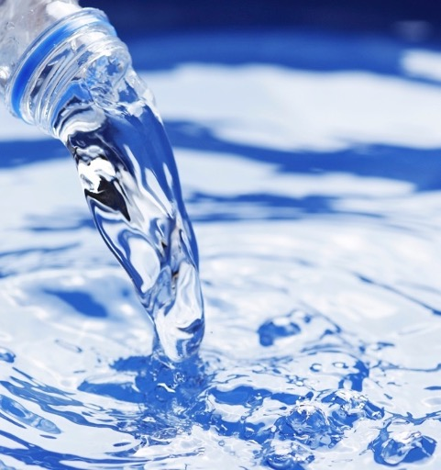
Hydration and Performance
Water ~ 60% of body weight
Roles in numerous physiological processes
Evaporation of sweat cools the body
Performance suffers with fluid/sweat losses >2% body weight
Sawka MN, Burke LM, Eichner ER, et. al. Med Sci Sports Exerc. 2007;39(2):377-390
Notes:
It has already been established that water is the largest component of the human body ~ 60% of body weight in the average adult and that water plays an important role in numerous physiological processes. One of these roles is the regulation of core body temperature and cooling the body through the evaporation of sweat. In addition, we have learned that performance decrements are seen fluid losses exceed 2% of body weight.

Slide 21
Consequences of Dehydration
Dehydration impairs the ability to remove heat
Increased cardiovascular strain
Altered metabolic & CNS function
Increased glycogen use
Decreased fluid absorption
Risk of heat illness
Thomas DT, Erdman KA, Burke LM. Med Sci Sports Exerc. 2016;48(3):543-568
Notes:
Improper hydration, such as dehydration can have many consequences if severe. The lack of body fluid can increase the strain to your heart and cardiovascular system, there are ramifications to the metabolic and nervous system, it can also increase the use and need for glycogen. To make matters worse, dehydration can actually impair your body’s ability to absorb and use fluid that you take in. And of course, dehydration impairs thermoregulation and can put you at higher risk for heat related illnesses.

Slide 22
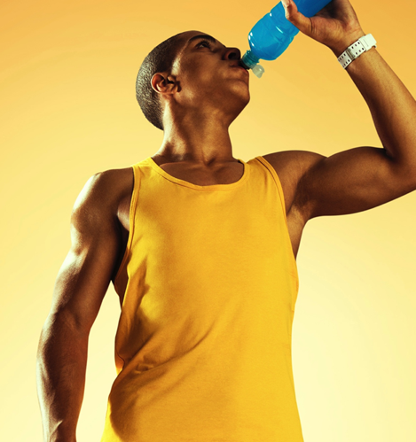
Dehydration and Performance
2% dehydration = decreases in endurance performance
Performance decrements also seen in:
  Anaerobic/high intensity performance
  Muscle strength
  Muscle power
  Cognition
So does this mean it affects team sport athletes too?
Judelson DA, Maresh CM, Farrell MJ, et. al. Med. Sci. Sports Exerc. 2007;39(10):1817–1824
Grandjean AC & Grandjean NR. J Am Coll Nutr. 2007;26(5):549S–554S
Casa DJ, Stearns RL, Lopez RM, et. al. J Athl Train. 2010;45(2):147–156
Judelson DA, Maresh CM, Anderson JM, et. al. Sports Med. 2007;37(10):907–921
Notes:
Dehydration of 2% body mass has consistently been found to be a threshold to which impairments of endurance performance can be detected
(Casa et al., 2010). In addition, these performance decrements can be seen in anaerobic/high intensity performance, muscle strength, muscle power (Judelson et al., 2007a, 2007b) and cognition (Grandjean & Grandjean, 2007).

Slide 23
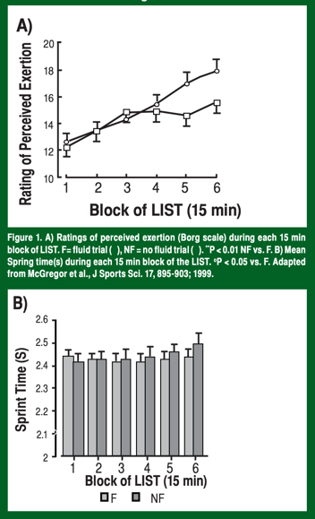
Effects of Dehydration on Soccer Performance
Fluid either was or was not provided during a 90-min LIST test
Resulted in dehydration of 1.4% and 2.5%, respectively
For 2.5% dehydration:
  RPE was higher (panel A)
  Sprint time was slower at the end of LIST (panel B)
  Also, football-specific skill performance (i.e., dribbling skill) decreased by 5% (was maintained with 1.4% dehydration)
SSE#128
Laitano O, Runco JL, Baker L. Sports Science Exchange. 2014;27(128)1-7
McGregor SJ, Nicholas CW, Lakomy, HK, et. al. J Sports Sci. 1999;17(11):895-903
Notes:
To answer this question, let’s take a look at some studies done on dehydration in the team sport setting. A study conducted by McGregor et al. (1999) on soccer athletes found that ratings of perceived exertion (RPE) were higher toward the end of a 90-min Loughborough Shuttle Running Test (LIST; a stop-go sport activity replication test) when no fluid was given to the players versus when fluid was given (resulted in 2.5% vs 1.4% dehydration, respectively) (Figure 1, panel A). Likewise, 2.5% dehydration slowed sprint time at the end of LIST in comparison to 1.4% dehydration (Figure 1, panel B) and football-specific skill performance (i.e., dribbling skill) decreased by 5% from pre to post-LIST with 2.5% dehydration, but was maintained with 1.4% dehydration.

Slide 24

Effects of Dehydration on Basketball Performance
2% Dehydration vs. Euhydration
Repeated sprint times
Defensive slide times
Shooting %
SSE#165
Baker L. Sports Science Exchange. 2016;28(165)1-4
Dougherty KA, Baker LB, Chow M, et. al. Med Sci Sports Exerc. 2006;38(9):1650-1658
Notes:
With regards to other team sports, Dougherty et al compared the effect of 2% dehydration vs. euhydration on basketball skill performance assessed during four quarters of basketball drills (field-goal shooting, free-throw shooting, repeated sprints, vertical jumps, and defensive slides). They found, 2% dehydration resulted in significantly slower total sprinting (83 ± 10 s vs. 78 ± 9 s) and lateral movement (73±8 s vs. 68±8 s) times compared to the euhydration trials as well as a lower shooting percentage (45±9% vs. 53±11%) over the course of the entire simulated game.

Slide 25
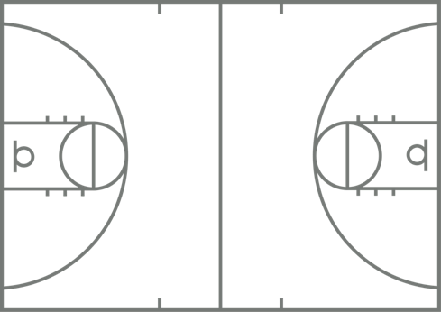
Effects of Progressive Dehydration
FULLY HYDRATED
2% DEHYDRATED
4% DEHYDRATED
FEWER SHOTS MADE and SLOWER SPRINT SPEED as level of dehydration increases
Baker LB, Dougherty KA, Chow M, et. al. Med Sci Sports Exerc. 2007;39(7):1114-1123
Notes:
Another study by Baker et al went a little further on basketball players using a similar protocol showing the effect of progressive dehydration (1% to 4%) vs. euhydration on performance. Overall, performance suffered as dehydration progressed from 1%, ,2%, 3%, and 4% dehydration compared to euhydration:
total number of shots made during the simulated game were 5, 6, 8, and 10 fewer, respectively
(cue animation) and total time to complete sprinting and lateral movement drills were 7, 20, 26, and 57 sec slower, respectively
Therefore, as one becomes more and more dehydrated, performance in short bursts of running and skill performance suffers.

Slide 26
Current Behaviors
Some team sport athletes (soccer, basketball, football) tend to show up to training or competition already dehydrated (USG > 1.020). For example, in specific studies it was found:
  89% soccer – could lead to significant fluid losses during (~3.4% loss in bodyweight)
  15 out of 29 basketball
  Prevalent in football players due to large daily sweat losses with inadequate replenishment
Arnaoutis G, Kavouras SA, Kotsis YP, et. al. Int J Sport Nutr Exerc Metab. 2013;23(3):245-51
Aragón-Vargas LF, Moncada-Jimenez J, Hernandez-Elizondo J, et. al. Eur J Sport Sci. 2009;9(5):269–276
Duffield R, McCall A, Coutts AJ, et. al. J Sports Sci. 2012;30(10):957-965
Osterberg KL, Horswill CA, Baker LB. J Athl Train. 2009;44(1):53-57
Brandenburg JP & Gaetz M. Int J Sport Nutr Exerc Metab. 2012;22:347-352
Godek SF, Bartolozzi AR, Burkholder R, et. al. J Ath Train. 2008;43(2):184–189
Notes:
As we see how dehydration affects performance in team sport athletes, it is important to note current hydration behaviors of these athletes to combat dehydration both on and off the field/court.
For instance, Arnaoutis et al. (2013) found that 89% of youth soccer players were showing up in the morning during a training camp dehydrated according to USG measurements (USG; USG > 1.020 g/ml= dehydrated). To add to this, USG measurements indicated 96% of players were dehydrated after practice even though they had access to fluids. In another study by Aragón-Vargas et al assessed players professional male soccer players showed up dehydrated before a match and finished the match with an average of 3.4 ±1.1% and similar finding were found by Duffiled et al after game simulation of 100 minutes but in a cooler environment than the previous study (3.4 ±0.7%). Osterberg et al also found that male professional basketball players showed similar habits in that 15 out of 29 players showed up to games during NBA summer league dehydrated according to USG measurements. However, this was not shown in female basketball players in Brandenburg & Gaetz study that assessed two pre-game USGs and found all 17 female Canadian national-level players showed up well hydrated to both games (average USG of 1.005 ± 0.002 and 1.010 ± 0.005).
Other studies, in particular one from Godek et al. looked at sweat rates of collegiate and professional football players. Average sweat rates ranged from 1.6-2.3 L/hr with compared to combo and skill players. More importantly, it was found over several days of monitoring, these players were unable to replace these fluids either in practice or outside of practice to return to their normal baseline hydration levels. Therefore, they would show up to subsequent practices dehydrated. In combining this with poor hydration habits outside of practice, this can put the athlete behind even before the commencement of training/competition increasing the likelihood of performance decrements.
According to the Table, even if football players consume 75% of their fluid losses, they should still achieve adequate hydration levels of <2%.

Slide 27
Current Behaviors
Athletes do not necessarily replenish the fluids needed during exercise
  Soccer- only 50% replenishment
  Thirst is not a reliable indicator
  Limited availability?
  Football- gastric emptying to replenish unable to keep up with sweat losses
However, some sports hydrate adequately
  Basketball-<10% (2% loss) ~50%—70% (<1%loss)
  More fluid availability?
SSE#128
Da Silva RP, Mundel T, Natali AJ, et. al, J Sports Sci. 2012;30(1):37-42
Shirreffs SM, Sawka MN, Stone M. J Sports Sci. 2006;24(7):699-707
Broad EM, Bure LM, Cox GR, et. al. Int J Sport Nutr. 1996;6:307-320
Laitono O, Runco JL, Baker L. Sports Science Exchange. 2014;27(128):1-7
Notes:
What’s even more interesting is that Da Silva et al found during match play that those soccer players who sweat more did not necessarily drink more fluid; specifically players consumed 50% of their sweat losses resulting in 1.6±0.7%. This same 50% fluid replenishment during soccer training and competition was also found by Aragón-Vargas et al and Shirreffs et al. Therefore, drinking from thirst is not the best indicator of dehydration for soccer players who may already have limited availability.
With regards to basketball, most of the literature has revealed players hydrate adequately during play to prevent significant fluid deficits. For instance, Broad et al found that <10% reached 2% dehydration during training or competition throughout a training session or game and ~50%—70% were <1% dehydrated. This may simply be due to fluid availability during games/training from frequent breaks in play (halftime, timeouts, substitutions, etc.).
Regardless, it is important for practitioners to recognize these behaviors and urge athletes to practice good hydration habits both on and off the field/court.

Slide 28



Sweating Rate – Normative Data by Sport
c
b
a
a
a
Whole-Body Sweating Rate (L/h)
Sports sharing same letter are not different (p>0.05)
n=161
n=268
n=196
n=255
n=271
Barnes KA, Anderson ML, Stofan JR, et. al. J Sports Sci. 2019;37(20):2356-2366
Notes:
Here is a graph of normative data for sweat rates across different sports including endurance sports. Sweat rate typically falls in the range of 1-2 liters per hour, but can be lower or higher. Individual sweat rate is determined mostly by genetics, but also by environmental and exercise conditions. Overall sweating rate is highly variable both between athletes and for the same athlete depending on the conditions (environment, intensity, clothing, etc.). Notice that football athletes lose more fluid than several other sports most likely due to their larger stature among other variables. But endurance sports are right behind them. Since sweat rate is so variable, it’s important that athletes measure their individual sweat rate (by measuring body weight change from before to after one exercise session) since this can establish individual needs to minimize fluid losses and avoid decrements in performance.

Slide 29
Sweat Sodium Loss – Normative Data by Sport
c
c
ab
b
a
Sports sharing same letter are not different (p>0.05)
Sweat Sodium Loss (mmol/h)
n=161
n=268
n=196
n=255
n=271
Barnes KA, Anderson ML, Stofan JR, et. al. J Sports Sci. 2019;37(20):2356-2366
Notes:
The composition of sweat lost is also important. Like has been mentioned in previous lectures, sodium is the electrolyte in the most abundance in sweat. Here is a graph of normative data for rates of sweat sodium losses across different sports including endurance sports. Rates of sodium loss can fall within the range of 20-60mmol/h (450-1400mg/h), but can be lower or higher. Like sweat rates, loss of sodium rates are highly variable both between athletes and for the same athlete depending on the conditions (environment, intensity, clothing, etc.). Notice again, like was seen for the normative date for sweat rates across different sports, football athletes lose more sodium than several other sports. Again, endurance sports are a close second. However, unlike sweat rates, sodium rates of loss may be hard to assess since this requires certain pieces of equipment and expertise. If a full sweat test is not available to assess sweat sodium composition and rates of loss, then athletes should look for white streaks on face, hats, clothes which can indicate higher sweat sodium compositions.

Slide 30
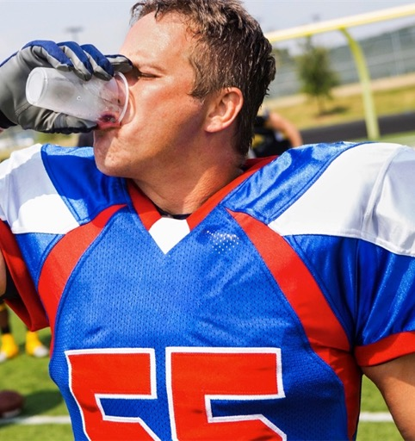
Example Hydration Strategy
Example of a football player that underwent a fluid balance assessment during training:
Pre weight- 100kg Post weight- 97kg
1L fluid consumption (96kg corrected)
Sweat test exercise duration: 120 minutes
Sweating rate: 100-96=4 L / 2 hours = 2 L / hour
3-hour game = 6 L or 6 kg body mass loss
(in similar conditions at similar intensity as sweat test)
Drinking volume (sweat loss – 2% window):
6L-2L = 4 L
Hydration strategy: 4 L/3 h = 1333 ml/h OR 445 ml/20 min; 1 L per quarter
Notes:
Putting the sweat rate into practice we can then create a hydration plan or strategy to ensure that the football player will not sustain fluid losses of over 2%.
For instance, the sweat test exercise was 120 minutes and 4L was lost in sweat after food/fluid intake and urine/stool output was accounted for. So the sweating rate is 2 L/hr or about 67 fl oz of sweat per hour. Since games last about 3 hours in the same exercise intensity and the same temps, it is projected the player will lose 6 L or about 200 fl oz of sweat.
The recommendation is to stay within 2% of our body mass which at the players weight of 100 kg (~220 lbs), that is 2 L or about 67 fl oz. Subtract 2 L from the 6 L total over the game which equals 4 L that this athlete will need to consume throughout that 3 hour duration or about 1333 mL /h (~45 fl oz/h) which is 445 ml (~15 fl oz) every 20 minutes. Or quite simply, the player should drink at a rate of 1 L per quarter during timeouts, when sitting on the bench, and at halftime.

Slide 31
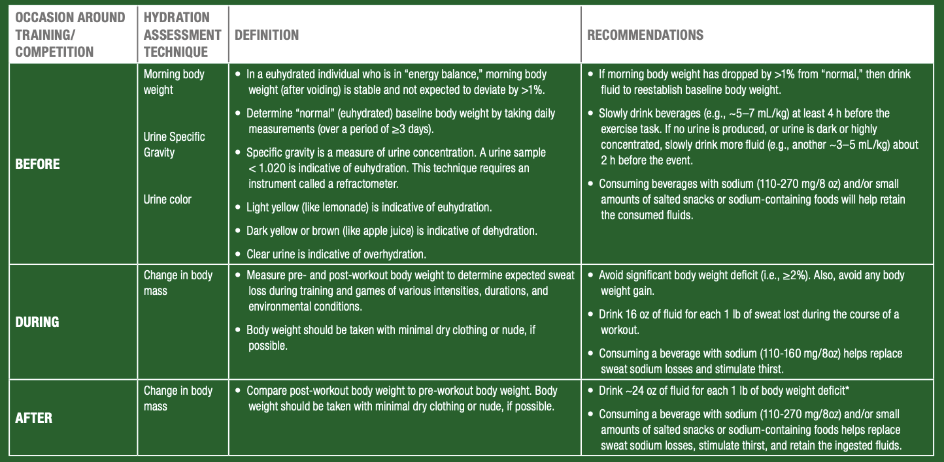

Baker L. Sports Science Exchange. 2016;28(165):1-4
Notes:
Putting it altogether here is a table outlining techniques to assess hydration status before, during, and after training/competition as well as recommendations of strategies to make sure team sport athletes maintain optimal hydration to ensure optimal performance.

Slide 32
Summary: Hydration
During Exercise
Dehydration can decrease performance within the team sport setting
Efforts to hydrate should be made to avoid fluid losses of ≥ 2% of body mass
Risk for fluid imbalances vary among sports because of differences in fluid availability or opportunity for hydration breaks
Sweat rates and sodium losses vary between and within sports, so you need to know your losses whenever possible throughout a season
Take advantage of assessment techniques and use collectively (thirst, urine color, body weight changes, USG)
Drink 16-20 fl oz for every pound lost after activity
Include sodium with fluids to improve palatability, stimulate drinking, and retain fluid

Slide 33
ENERGY
HYDRATION
STRUCTURE
Notes:
Sport nutrition needs of any athlete can be divided into three categories; energy, hydration and structure

Slide 34
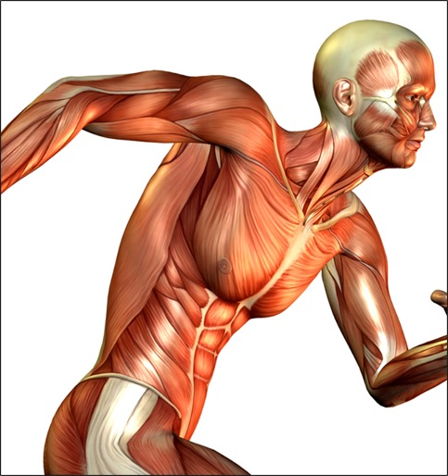
Protein and the Body
Protein ~ 45% of body
Numerous roles in the body
Important component of recovery nutrition and muscle repair
Important component of injury rehabilitation
Team sport athletes sustain eccentric loads + plyometrics + physical contact = increased muscle damage/CK levels
Medina D, Lizarraga A, Drobnic F. Sports Science Exchange. 2014;27(132):1-5
Kraemer WJ, Looney DP, Martin GJ, et. al. J Strength Cond Res. 2013;27(2):434-441
Notes:
It has already been mentioned in previous lectures that the human body is about 45% protein. The primary function of proteins in the human body are:
Structure – example, collagen
Movement – contractile proteins
Immune function – Antibodies
Transport – hemoglobin
Hormones
Enzymes – facilitate biochemical reactions
Cell signaling, or communication pathways in cells
Some the branched chain amino acids can enter the energy producing pathways. However, providing energy is not one of the primary roles of protein as it is for carbohydrate and fat.
Protein is an important component of recovery nutrition as it relates to muscle tissue repair as well as injury rehabilitation.
Specifically, the team sport athlete sustains large amounts of eccentric and plyometric loads in combination with player contact which are extremely damaging to muscle as evidenced in rising blood creatine kinase levels in certain team sports (football) making protein a crucial nutrient for recovery.

Slide 35
Incorporating Protein into a Strategic Recovery Plan
Consider the following when it comes to protein intake:
Amount:
  How much protein to be effective?
Timing:
  What is the best time after exercise to eat protein?
Type:
  Which source of protein is most beneficial for recovery?
Notes:
So in order to maximize recovery from protein, much like carbohydrate intake, we can focus on 3 main components: amount, timing, and type of protein. Those questions to answer are:
How much protein to be effective?
What is the best time after exercise to eat protein?
Which source of protein is most beneficial for recovery?

Slide 36
Protein Amount- Daily
Recommended dietary allowance: 0.8 g/kg/d
TEAM SPORTS
STRENGTH
POWER
ENDURANCE
1.2-1.7
G/KG/D
1.6-1.7
G/KG/D
1.5-1.7
G/KG/D
1.2-2.1
G/KG/D
Slater & Phillips. J Sport Sci. 2011;29(1):S67-77
Thomas DT, Erdman KA, Burke LM. Med Sci Sports Exerc. 2016;48(3):543-68
Notes:
With regards to the daily needs of protein, we have mentioned in previous lectures that the recommended dietary allowance for adults is 0.8 g/kg/day, which is about 0.4 g/lb, or 58 g of protein for a 160 lb individual. But remember this is the minimum, not optimum. Due to increased demands of exercise, the recommended intake for athletes is slightly greater than the RDA for adults, the amounts depending on the type of athlete and their goals. For team sport athletes specifically, it has been recommended that a range of 1.2-1.7g/kg body mass to optimize protein synthesis. However, this range is highly variable depending upon the individual, the type of sport, they time of season, as well as the athletes goals. In addition, the majority of athletes have no problem meeting these numbers and do so on a regular basis. In a recent study conducted by GSSI, in a population of high school athletes 100% of male athletes and 35% of female athletes met the recommendation for protein, and the average intake was 2 g/kg.

Slide 37


Protein Amount - Recovery
~0.25-0.30
g/kg
185 LBS
X 0.25 (g/kg)
260 LBS
X 0.25 (g/kg)
30G PROTEIN
21G PROTEIN
Moore DR, Robinson MJ, Fry JL, et. al. Am J Clin Nutr. 2009;89(1):161-168
Witard OC, Jackman SR, Breen L, et. al. Am J Clin Nutr. 2014;99(1):86-95
Notes:
Taking the recommended amount of 0.25- 0.3g/kg body mass of protein, here is an example of the difference in protein needs between a center and a point guard post-exercise. Because the amounts are based on weight of the athlete, recommendations become more individualized to help meet the needs that are backed by research.

Slide 38
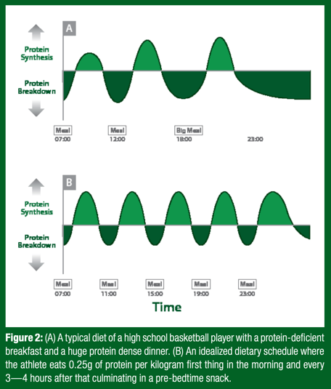
Protein Timing-Behaviors
SSE#166
Eating patterns found in high school basketball players:
small, protein-deficient breakfast
moderate-protein lunch
large-protein dinner
spread out 5-6 hours
negative protein balance
Same eating pattern for other team sport athletes?
Either way, protein spread evenly every 3-4 hours= more positive protein balance!
Areta JL, Burke LM, Ross ML, et. al. J Physiol. 2013;591(9):2319-2331
Baar K. Sports Science Exchange. 2016;28(166):1-4
Notes:
Next, timing is also important. But before tackling this component, it is important to recognize typical behaviors of eating as it relates to protein intake.
For some team sport athletes (in this case, high school basketball players) typical eating habits are characterized by normally eating a small, protein-deficient breakfast, a moderate-protein lunch, and a large-protein dinner spread out 5-6 hours apart as seen in part A of the figure. When this happens, over time athletes spend less time in a state of positive protein balance and more towards the negative as evidenced in the larger darker green sections of the graph. This type of eating pattern MAY implicate other team sport athletes in practicing the same regimen.
However, if spread protein intake is spread evenly throughout the day every 3-4 hours, these darker green sections representing negative protein balance shift towards the lighter green sections of positive protein balance as seen in part B of the figure.

Slide 39
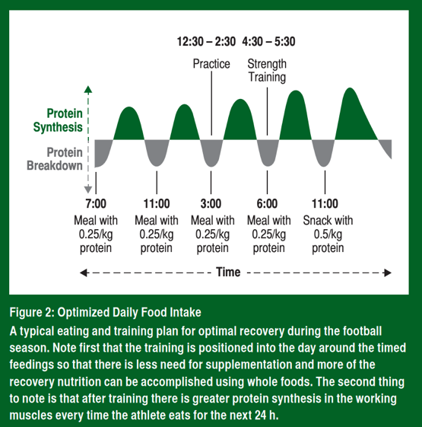
Protein Timing- Amount and Timing
What about if we combine dosage and timing?
Team sport athletes should:
consume 0.25 g/kg body mass protein
immediately after training
every 3-4 h through the day
SSE#144
Areta JL, Burke LM, Ross ML, et. al. J Physiol. 2013;591(9):2319-2331
Moore DR, Robinson MJ, Fry JL, et. al. Am J Clin Nutr. 2009;89(1):161-168
Baar K & Heaton L. Sports Science Exchange. 2015;28(144):1-6
Notes:
If athletes keep in mind that 0.25 g/kg is an optimal dosage for post exercise protein intake and consistent protein intake 3-4 hours throughout the day creates a positive protein balance, with these two components taken together (dosage and timing- anabolic window or not) team sport athletes should consume 0.25 g/kg body mass protein immediately after training and every 3-4 h throughout the day to maximize protein synthesis and enhance recovery. Notice the 11pm snack of 0.5g/kg- we will talk about this on the next slide.
The figure is an example of this recommendation for a football player taking into account scheduled practices/training to create an optimal daily meal pattern thereby enhancing recovery. Therefore, it is best to set yourself up for success and schedule strategic protein feedings.

Slide 40

Protein and Sleep
Protein intake right before bed can boost muscle repair
Casein (slow-digesting protein)
  Higher amount (30-40 g; 0.5g/kg)
Could be beneficial especially as an in-season protocol
  Frequent games (baseball, basketball)
  High muscle damage (football, rugby, hockey)
Res PT, Groen B, Pennings B, et. al. Med Sci Sports Exerc. 2012;44(8):1560-1569
Snijders T, Res PT, Smeets JSJ, et. al. J Nutr. 2015;145(6):1178-1184
Snijders T, Trommelen J, Kouw IWK, et. al. Frontiers in Nutrition. 2019
Notes:
Protein intake right before bed can boost muscle repair even more since it delays the sleep (fasting)-induced shift toward negative protein balance, saving muscle from breakdown. Casein, a milk protein, has been shown to be beneficial for a pre-bedtime snack, as it is a slow-digesting protein because it clumps in the acid of the stomach. This makes it available during a longer portion of the night where we certainly don’t intend to wake up every 2-3 hours to consume more protein (Res et al., 2012). Most have shown benefits with higher intake amounts of 30-40 g (0.5g/kg) with more consistent results at 40g before bed.
This may be beneficial to team sports athletes during the season especially for sports that have frequent games in close proximity to each other (baseball, basketball, etc) or for sports that have high amounts of muscle damage from eccentric exercise and physical contact (football, rugby, hockey).
Dairy food items are high in casein protein. For example, cottage cheese, which is high in casein, would be an ideal snack for team sport athletes before sleep.

Slide 41
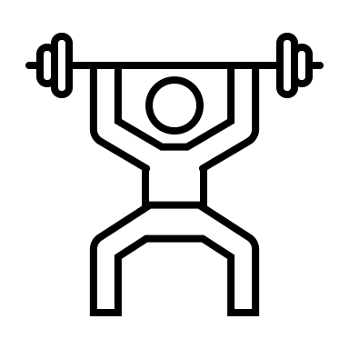
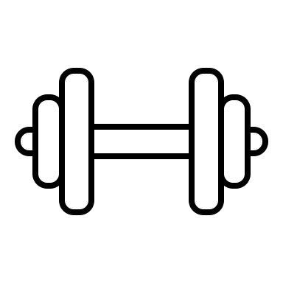
Protein Type- Behaviors
Resistance trained athletes compared to endurance athletes get more of their total protein from dairy, meat, and eggs (animal-based protein sources)
Adapted from Burke et. al. Int J Sport Nutr. 1991
Notes:
Like with dietary protein intake timing patterns, we should look at the types of dietary proteins athletes typically take in. These data, taken from elite Australian athletes shows resistance trained athletes get their protein from primarily meat, eggs, and dairy based sources whereas endurance based athletes get more protein from plant based sources.

Slide 42
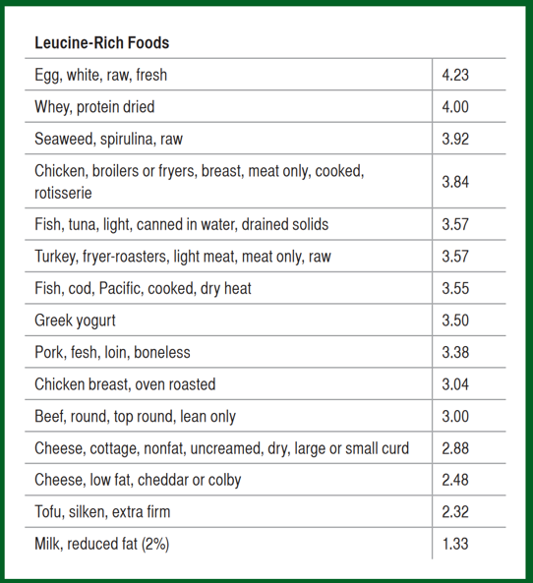
Protein Type- How does this translate to food?
The best protein for recovery will have these three critical components to drive muscle protein synthesis:
A complete protein
Rapidly digested & absorbed
Rich in leucine
While egg and whey have the highest leucine values, from a practical standpoint all foods on this list are appropriate. For vegetarian and vegan athletes, blend foods for complete amino acids. Vary the sources!
SSE#144
Baar K & Heaton L. Sports Science Exchange. 2015);28(144):1-6
Notes:
We can talk about leucine all we want but how does this translate to food? (Cue animation) Both egg white and whey protein are rich in leucine and provide ≥4g leucine per 200kcal serving.
Also, whey is considered to be superior with regards to post workout proteins since it is a complete protein, rapidly digested, and contains a high amounts of leucine. However, the team sport athlete should focus on consuming a variety of protein sources.
Other examples of leucine rich foods and there amounts are shown in the table listed here from most to least.

Slide 43
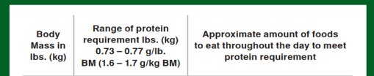
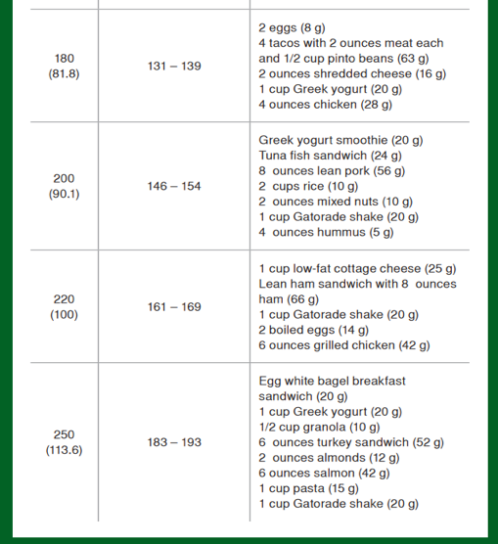
Protein Type- How does this translate to food?
SSE#146
High quality protein sources= animal products
Exceptions are quinoa and soy
Low quality protein sources= plant products
Can be paired together to obtain all essential amino acids
Berning J. Sports Science Exchange. 2015;28(146):1-7
Notes:
Overall, the team sport athlete should focus on protein coming from high quality sources that supply all of the essential amino acids need for protein synthesis (complete proteins). These high quality sources mostly come from animal products such as poultry, seafood, red meat, and dairy which also contain more leucine. There are some exceptions to this coming form plant sources such as quinoa and soy.
However, plant sources are for the most part are considered low quality sources since any one item does not contain all of the essential amino acids (incomplete proteins) and contain less leucine than animal products. Instead, specific plant sources must be paired together as to complement each other. But this will be the focus of other lectures.
Here are some examples of different protein sources that athletes can consume in a given day. These are based off of a 1.6-1.7 g daily intake and are divided according to different body masses. Notice how the lists become longer with greater body masses but with the same 1.6-1.7 g/d intake. Overall, this will help to illustrate how to put the recommendations into practice.

Slide 44
Summary: Protein
Protein is a critical nutrient for muscle repair and recovery especially for team sport athletes who sustain high amounts of muscle damage
Daily amounts vary between athletes but 0.25-0.3g/kg body weight has been found to be an optimal per meal dose.
Timing is crucial as well but more so as it relates to spreading protein intake every 3-4 hours throughout the day and before sleep
Types of protein should include foods that contain complete protein sources that are quickly digested and absorbed and rich in leucine (whey and animal products
If the team sport athlete consistently eats the right amounts, timing, and types of protein, the athlete may be able to achieve optimal recovery especially during the season where physiological demands are high

Slide 45
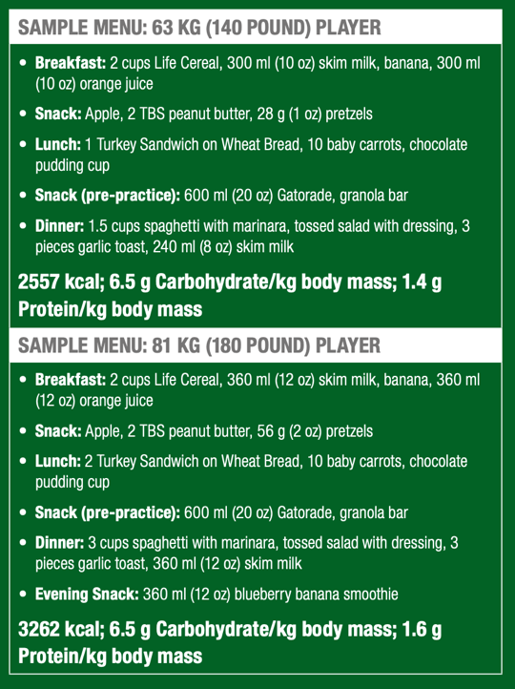

Putting it all together
Daily carbohydrate intake = 5-7g/kg
Daily protein intake = 1.2-1.7g/kg
Carbohydrates from fruits, vegetables, and whole grains for fuel.
Protein from high quality source animal products for recovery.
Meals/snacks spread throughout the day and evening for optimal energy and recovery
SSE#168
Osterberg K. Sports Science Exchange. 2016;28(168):1-4
Notes:
Here are a couple of examples of menus for basketball players of different sizes. The second menu builds off of the first menu. Both menus help to satisfy the needs of the individual and the energy demands of their sport with respect to training and competition.
Notice the carbohydrate intakes of 6.5 g/kg are of the Moderate Exercise category falling in between 5-7g/kg and protein intakes of 1.4g/kg and 1.6 g/kg falling within the Team Sport Category of 1.2-1.7g/kg mentioned earlier.
In terms of actual food, carbohydrates from fruits, vegetables, and whole grains will fuel the athlete and fill glycogen stores in the muscle and the liver. Protein from high quality source animal products will help build and repair muscle for optimal recovery.
Also, these meals/snacks are spread out throughout the day and into the evening to help maintain optimal energy levels, replenish fuel, and optimize recovery.

Slide 46

Pre-Game Meal Example
    An NFL outside linebacker who weighs 220 lbs (100kg) is getting ready to play a game with a 1pm kickoff. He stays at the team hotel the night before the game and wakes up at 8:30am. He notices his urine is fairly dark. Like every gameday, he decides to take advantage of the spread of food planned by their team’s sports dietitian. He takes the elevator down to the team’s designated meal room at the hotel by 10am (3 hr prior). He consumes a large, low-fat, moderate protein, higher carb meal (300g or 3g/kg) consisting of:
    Few pieces of French toast (90g)
    Small stack of pancakes (90g)
    Maple syrup (60g)
    Piece of fruit (30g)
    Couple scoops of scrambled eggs
    Low-fat milk (12)
    100% fruit juice (30g)
    He ends up consuming about 312g of carbohydrate and leaves the hotel for the stadium at about 10:30am.
SSE#146
Berning J. Sports Science Exchange. 2015;28(146):1-7

Slide 47
Before Warmups and Game
    The player arrives to the locker room, weighs himself in the bathroom wearing compression shorts (219lbs)and then gets taped and dressed. He goes to the bathroom and notices even though his urine is not as dark, his USG was 1.021 so he continues to drink fluids steadily.
    At 12pm the whole team heads out for warmups and he decides to eat a banana before going out. When he arrives back to the locker room from warm-ups he takes a 20 oz sports drink that the team sports dietitian is handing out to the team.
    Overall, the player ingested ~60 g carbohydrates from the banana and sports drink within 1 hr leading up to kickoff. He’s ready to go!

Slide 48
During Game and Half-time
    The ball is kicked off a little after 1pm. Because there are many breaks in play, the player has ample opportunity to consume fluids and carbohydrates in amounts and products that he tolerates. He has undergone a sweat test during practice so he and the sports dietitian know how much fluid, sodium, and carbohydrate he needs during the game.
    He takes advantage of the times he is on the bench between each series to drink a combination of sports drinks and water.
    When he arrives back in the locker room during halftime, he adds a salt packet to a sports drink and also eats some gummies to refuel.
    For the second half of the game, he continues to drink a combination of sports drinks and water during his breaks on the bench.

Slide 49
Post-Game Nutrition and Meal
    After winning the game, the player arrives back in the locker room at about 4pm where a ready-to-drink carbohydrate and protein shake (25g) is provided by the team sports dietitian. He decides to drink this right away while he weighs out at 217 lbs (~1% wt loss)
    After the coach’s speech, seeing the athletic trainer, taking a shower, and getting dressed, he leaves the locker room at around 5pm.
    On the way out, he finds a post-game buffet from a local restaurant in the hallway set up by the team sports dietitian. He grabs a pre-packaged meal in a to-go container consisting of a deli sandwich, baked chips, and a fruit salad (120 g carbs, 30 g protein or 0.3g/kg) to eat a little later when his stomach can tolerate food a little more.

Slide 50
Summary
Team sport activities involve high and low intensity activity over specific duration combined with skill performance
Carbohydrate energy, hydration, and protein needs will be quite different compared to those seen with endurance type sports.
Carbohydrates are the primary fuel during high intensity training and competition and should therefore be emphasized at many points during the day and around activity for glycogen replenishment and to meet energy demands
Hydration should be tailored to individual needs based on sweat losses and be encouraged outside of activity with team sport athletes since many may show up to training or competition already dehydrated.
Protein also plays a key role in many functions of the body and should be strategically incorporated with respect to time, amount, and type to help enhance recovery from highly damaging team sports

