Slide 1
ANTIOXIDANTS & POLYPHENOLS
Lecture content provided by GSSI, a division of PepsiCo, Inc. Any opinions or scientific interpretations expressed in this presentation are those of the author and do not necessarily reflect the position or policy of PepsiCo, Inc.

Slide 2
ANTIOXIDANTS

Slide 3
What is an antioxidant?
Does it help exercise performance?

Slide 4
FIRST: Oxidants
*First, we need to understand what an oxidant is before we can understand antioxidants
What is an OXIDANT?
Any atom/molecule that “steals/accepts” electrons from other molecules
Molecules that promote oxidation
What is oxidation?
The removal of electrons
Note: It is a relative term depending on the redox state of what it is reacting with. Chemicals always work as “REDOX PAIRS”.

Slide 5
You Might Have Heard Of…
Reactive Oxygen Species (ROS):
“A form of oxygen or an oxygen rich molecule that acts as either a powerful oxidant or reductant.”
Oxidants that contain oxygen (parent: superoxide)
Reactive Nitrogen Species (RNS):
Oxidants that contain nitrogen (parent: nitric oxide)
*NO can be considered a reactive nitrogen or a reactive oxygen species but is generally referred to as a RNS.
Not very reactive except with metals.
•
•
N ≡ O or N=O
Other reactive N species:
ONNO⁻, NO₂, NO₂•, etc.
NO or NO•
Halliwell and Gutteridge. Oxford University Press. 2006

Slide 6
What is an Antioxidant?
“Substance that prevents or delays oxidation.”
Anti-oxidants prevent or limit the actions of free radicals usually by removing their unpaired electron and thus converting them into something far less reactive.
Jeukendrup & Gleeson. Champaign, IL. Human Kinetics. 2004

Slide 7
What is a “Free” Radical?
Paired Electrons
Any atom (or atom within a molecule) with at least one unpaired electron in its outermost shell/ orbital
Why do we want to limit their actions?
Highly reactive
Free radicals damage membranes (lipids), proteins, & DNA
Can result in mutations
Stable Molecule
Unpaired Electron
Free Radical
NOTE:
Radicals are produced as a part of normal metabolism and are necessary to life!
Excessive amounts of radicals are harmful because of their reactivity.
Also produced by processes outside of normal metabolism (e.g.-radiation, smoking, pollutants, herbicides, pesticides)
Jeukendrup & Gleeson. Champaign, IL. Human Kinetics. 2004
Maughan & Gleeson. Oxford University Press. 2010

Slide 8
How Antioxidants Reduce Free Radicals
Unpaired Electron
Electron Donation
ANTIOXIDANT
FREE RADICAL

Slide 9
What happens During Exercise?
Skeletal muscle continuously produces ROS and NO
↑ dramatically during exercise
Repetitive contractions ↑ ROS content
Buffered by endogenous antioxidants in the muscle:
Superoxide Dismutase (SOD)
Catalase
Major antioxidant pathway in the muscle:
Glutathione/glutathione peroxidase system
  Buffers an array of oxidant species
Reid M. J Physiol. 2016;594:5125-5133

Slide 10
ROS Generation During Exercise
NO
ROS
Cytosolic, interstitial, & intravascular compartments
Repetitive Contractions
Glutathione/ Glutathione Peroxidase System
SOD
H₂O₂
OH∙
O₂^{∙-}
Catalase
Buffered by:
Endogenous AOX: SOD & Catalase
Glutathione/glutathione peroxidase system

Slide 11

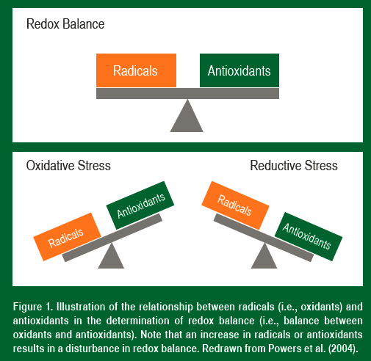
Redox Balance
SSE #137
Exercise can alter “redox balance” and result in oxidative stress
  Imbalance between radical production and muscle antioxidants
  Muscle cells contain endogenous antioxidants to scavenge radicals
Regular bouts of endurance exercise result in increased endogenous antioxidant enzymes in trained skeletal muscles
  Improved ability to protect against exercise-induced oxidative stress in skeletal muscles
  Highly trained endurance athletes have well-adapted endogenous buffer systems
Powers and Sollanek. Sports Science Exchange. 2014;27(137):1-4

Slide 12
Oxidative Stress Mechanisms
Elevated oxidants disrupt potassium regulation
  ↓ Skeletal muscle Na+/K+ pump
  ↑ K+ concentration
Exercise associated oxidants:
  Limit the bioavailability of circulating NO
  Restrict blood flow
  Depress changes in hematological indices
Oxidative stress:
  Lessen endurance exercise
    K+ regulation and perfusion
Elevated oxidants:
  ↓ fat oxidation & circulating glucose while ↑ lactate
Reid M. J Physiol. 2016;594:5125-5133

Slide 13
Antioxidant Mechanisms
Enzymatic and nonenzymatic antioxidants prevent oxidation initiated by ROS by:
Preventing ROS formation
Scavenging reactive metabolites and converting them to less reactive molecules
Binding transition metal ion catalysts and preventing initiation of free radical reactions
  E.g. copper to iron
Preventing continued hydrogen abstraction from fatty acid chains
Providing a favorable environment
  Effective functioning of other antioxidants
  Regenerating nonenzymatic antioxidant molecules
REMEMBER: *Exercise TRAINING INCREASES the levels of antioxidant enzymes
Jeukendrup & Gleeson. Champaign, IL. Human Kinetics. 2004

Slide 14
ROS Does Contribute to Fatigue
Despite these protective mechanisms high rates of ROS production can exceed the antioxidant capacity of myofibers, promoting oxidative stress and depressing the force of muscle contraction
So Why Not Supplement with Antioxidants?
Reid M. J Physiol. 2016;594:5125-5133

Slide 15
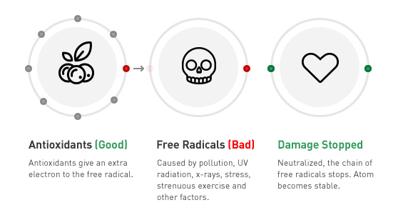
Antioxidants Good & Radicals Bad???
The familiar dichotomy that free radicals are bad, and antioxidants are good is pervasive in popular culture. Athletes believe that antioxidants improve performance.
Is it True?
https://www.drinkbai.com/whats-inside
Reid M. J Physiol. 2016;594:5125-5133

Slide 16
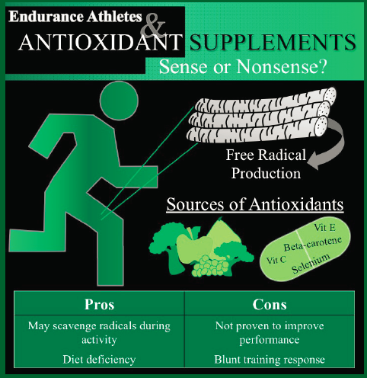
Sense or Nonsense?
Should Athletes Supplement with Antioxidants?
Why might this be beneficial?
May scavenge free radicals during activity
May be important for those that are deficient
Why might this be detrimental?
Not proven to improve performance
May blunt the training response
SSE #138
Powers and Sollanek. Sports Science Exchange. 2014;27(138):1-4

Slide 17
Antioxidant Supplementation & Exercise
Many antioxidants do not improve exercise performance
Including: Vitamin C, Vitamin E, Resveratrol, Coenzyme Q10, Quercetin
Little evidence that nutritional supplementation improves either strength or endurance exercise
Increase antioxidant markers without ergogenic effects
May blunt biomarkers for oxidative stress during exercise
Exercise performance is usually unaffected, sometimes impaired
Reid M. J Physiol. 2016;594:5125-5133

Slide 18
Findings from NAC Research
The drug N- acetylcysteine (NAC) effectively opposes oxidative stress when administered systemically and is approved for use in humans (smells, mild side effects)
*First antioxidant shown to inhibit experimental muscle fatigue
Effective at submaximal but not during near maximal contractions
  DEMONSTRATING: Oxidants contribute to low but not high frequency fatigue
NAC does not alter short term recovery of force immediately after muscle fatigue
  DEMONSTRATING: Oxidants do not influence recovery from fatigue
NAC increases cycling endurance
  Time to task failure
Delays fatigue in repeated bouts of damaging exercise
Reid M. J Physiol. 2016;594:5125-5133

Slide 19
Findings From Dietary Nitrate Research
Can increase exercise efficiency and improve performance
Mechanisms include:
  Greater ATP supply via altered mitochondrial respiration
  More efficient ATP utilization during muscle contraction
Increase bioavailability of NO derivatives
  Promotes NO signaling
Buccal flora convert nitrate to nitrite
  Via bacterial nitrate reductase
Circulating Nitrite is converted to NO
Central nervous system
  Modulation of cortical function
Reid M. J Physiol. 2016;594:5125-5133

Slide 20
Take Homes: NAC & NO
Thiol antioxidants (like NAC) and dietary nitrates appear to improve endurance exercise
Safe for human use
  Laboratory doses
  Both effective as a single dose shortly before exercise
  Both work via redox mechanisms
Thiols are not practical for widespread use
Thiols preserve contractile function of myofibers
  Buffer exercise induced ROS
Dietary nitrates increase exercise efficiency
  Augment NO actions on mitochondrial metabolism, blood flow distribution, or both
Reid M. J Physiol. 2016;594:5125-5133

Slide 21
Risks of High Dose Supplementation
ROS are important intermediate messengers in apoptosis pathways
  Antioxidants may inhibit apoptosis
    Necessary defense mechanism to inhibit tumor development/ mutated cells
Prevents effective removal of damaged cells
Side effects of excessive vitamin intake
Can impair athlete’s exercise induced training adaptations
Jeukendrup & Gleeson. Champaign, IL. Human Kinetics. 2004

Slide 22
High Dose Supplementation Can Hurt!
Muscle recovery from damaging exercise is mediated in part by oxidant signaling
Antioxidants can blunt:
  Signaling events
  Repair mechanisms
Training responses to exercise can be depressed
  ↓ mitochondrial biogenesis
  ↓ insulin sensitivity
One dose can:
  ↓ exercise induced vasodilation
  Inhibit post exercise increases in HSPs
Reid M. J Physiol. 2016;594:5125-5133

Slide 23
It’s a Balance!
ROS is necessary! ROS play an important role in the regulation of signaling pathways that are required to promote skeletal muscle adaptation in response to both exercise and physical activity
Carbonate Radicals
ROS
Nutritional Antioxidants
Oxidative Stress
Homeostatic Range
Reductive Stress
Thioredoxin
NOx
Glutathione Cycle
Hydro-peroxides
Lipid peroxides
SOD
Catalase
Reid M. J Physiol. 2016;594:5125-5133
Notes:
Redox homeostasis reflects the balance between cellular antioxidant buffers and endogenous antioxidant buffers. Changes in either category alter redox balance. Small shifts within homeostatic range mediate physiological responses (differentiation, growth, adaptation, cell signaling, etc.). Large shifts produce oxidative stress (inflammation) or reductive stress (e.g. vitamin E deficiency) and can cause cellular injury or death.

Slide 24
ROS: A New View
OLD VIEW: ROS are by-products of metabolism and have only deleterious effects on muscle function
NEW VIEW: Specific ROS are generated in a controlled manner by skeletal muscle fibers in response to physiological stimuli and play important roles in the physiological adaptations of muscle to contractions that result in muscle adaptation!
Maughan & Gleeson. Oxford University Press. 2010​

Slide 25
Micronutrients as Antioxidants
Vitamins that act as antioxidants include:
Vitamin A
Vitamin C
Vitamin E
Beta carotene
Vitamin E:
Free radical scavenger
Prevents initiation and propagation of lipid peroxidation in cellular membranes
Maintains membrane stability
Vitamin C:
Capable of regenerating vitamin E in the antioxidant cascade
Jeukendrup & Gleeson. Champaign, IL. Human Kinetics. 2004

Slide 26
Micronutrients as Antioxidants
Minerals
Several minerals are components of antioxidant enzymes involved in the defense of free radicals:
Selenium
  Cofactor of glutathione peroxidase
  Influences quenching of ROS
Copper
Manganese
Jeukendrup & Gleeson. Champaign, IL. Human Kinetics. 2004

Slide 27
POLYPHENOLS

Slide 28
Polyphenols
A compound containing more than one phenolic hydroxyl group
Scavenge peroxyl, superoxide, and NO radicals
Flavonoids are a subclass of polyphenols that include:
  Flavanols, flavanones, and anthocyanidins
  Contain phenolic hydroxyl groups attached to their ring structures that give antioxidant activity
Jeukendrup & Gleeson. Champaign, IL. Human Kinetics. 2004

Slide 29
Name foods that contain polyphenols.

Slide 30
Polyphenols: Intake
Can be classified into flavonoids and non-flavonoids
Food sources rich in polyphenols include:
  Onions
  Apples
  Tea
  Red wine
  Red grapes
Average polyphenol intake is relatively undetermined
  Dutch estimated to eat 23 mg/day of flavones and flavanols
  Small amount may have significant effects
  Strawberries
  Raspberries
  Blueberries
  Cranberries
  Certain nuts
Jeukendrup & Gleeson. Champaign, IL. Human Kinetics. 2004

Slide 31
Polyphenols
Nonflavonoids | Sources
Ellagic acid | Strawberries, blueberries, raspberries
Coumarins | Bell peppers, bok choy, cereal grains, broccoli
Flavonoids | Sources
Anthocyanins | Red fruits
Catechins | Tea, wine
Flavanones | Citrus
Flavones | Fruits and vegetables
Flavanols | Fruits, vegetables, tea, wine
Isoflavones | Soybeans
Jeukendrup & Gleeson. Champaign, IL. Human Kinetics. 2004

Slide 32
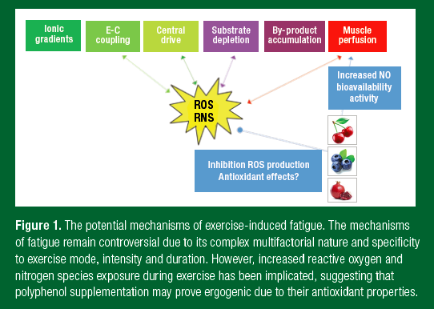
Polyphenol Protection?
≈500 mg/day of total flavonoids or
300 mg/day procyanidins
Unlikely that plasma phenolics are direct antioxidants in vivo
May increase endogenous antioxidant capacity
In vitro anti-inflammatory properties
Improvement in flow mediated dilation
SSE #195
Bowtell et al, Sports Science Exchange (2019) Vol. 29, No. 195, 1-5

Slide 33
Polyphenol Supplementation?
Preliminary studies suggest:
≈300 mg of polyphenol 1 h prior to exercise
  Recreationally active
  Enhance endurance performance
  Enhance repeated sprint performance
  Mediated via vascular mechanisms
Recovery of muscle strength and performance may be enhanced
  Optimal dose & blend unknown
  Suggested consumption:
    ≈1200 mg/d Montmorency cherry or pomegranate polyphenols for >3 days prior to exercise
SSE #195
Bowtell et al. Sports Science Exchange. 2019;29(195):1-5

Slide 34
Polyphenol Supplementation?
“Evidence is insufficient to make recommendations for or against the use of polyphenol supplementation (neither specific polyphenols nor specific doses) for either recreational, competitive or elite athletes.”
Myburgh KH. Sports Med. 2014;44(1):57-70

Slide 35
Summary
Antioxidants:
Antioxidants limit the action of free radicals
Exercise training improves antioxidant capacity
Little to no evidence for supplementation
ROS play an important role in adaptation to exercise
Polyphenols:
Scavenge radicals
May provide protection through multiple mechanisms
More research is needed

