Slide 1
SUPPLEMENT SAFETY AND REGULATION
Lecture content provided by GSSI, a division of PepsiCo, Inc. Any opinions or scientific interpretations expressed in this presentation are those of the author and do not necessarily reflect the position or policy of PepsiCo, Inc.

Slide 2
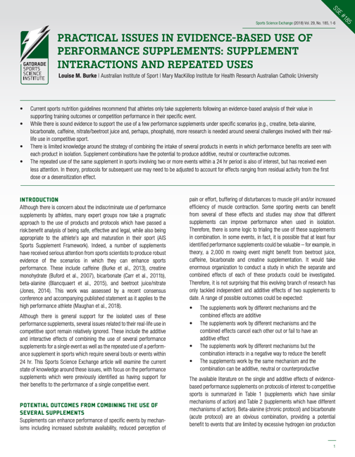
Related Resource
SSE #185
Burke L. Sports Science Exchange. 2018;29(185):1-6
Notes:
SSE #185 is a good resource to accompany this lecture. There are many related components and considerations to supplement the content we will cover.

Slide 3
SUPPLEMENT SAFETY

Slide 4
What is a supplement?
Classified by the US Food and Drug Administration
Vitamins
Minerals
Herbs or other botanicals
Amino acids
Other dietary substances
Any concentrate, metabolite, constituent, extract, or combination of these ingredients
https://www.fda.gov/food/dietary-supplements/dietary-supplement-products-ingredients

Slide 5
~$40 Billion Industry in the United States
https://www.grandviewresearch.com/industry-analysis/dietary-supplements-market
Notes:
Globally the dietary supplement market was estimated at ~$124 billion in 2019. Within the United States, the dietary supplement industry is estimated at ~$40 billion as of 2019.

Slide 6
Athlete Supplement Use
58-62% of athletes use some variety of dietary supplement
Top Supplements Used
Multivitamins
Vitamin C
Protein Products
Sports Drinks
Sports Bars
Energy Drinks
Knapik JJ, Steelman RA, Hoedebecke SS, et. al. Sports Med. 2016;46:103-123
Notes:
In a systematic review of dietary supplement use across athlete groups – after reviewing studies, 61 were included in reviewing all dietary supplements use. Including both males and females, the review found usage of 58-62% usage of any dietary supplement. The top supplements used were MVM (35-36%), Vitamin C, protein, Sports drinks, sports bars and energy drinks. Depending upon the athlete group surveyed, these numbers may be significantly higher. Either way, it is important to understand what are the risks vs. benefits that athletes may face when it comes to taking a supplement.

Slide 7
Positive Drug Tests can result in:
Loss of scholarship
Ban from play
Stripping of medals
Monetary fines
Notes:
Athlete safety must be the 1st priority whenever working with athletes, especially when evaluating and potentially recommending supplements. A positive drug test can have a lasting negative impact on an athletes career.

Slide 8
Supplement Regulation
1994: Dietary Supplement Health and Education Act Passed
https://ods.od.nih.gov/About/DSHEA_Wording.aspx
Notes:
Dietary supplements are regulated, but not as rigorously as you might think. The U.S. Food and Drug Administration (FDA) is the regulatory body for dietary supplements. This includes weight loss and bodybuilding products, among others. In 1994 the Dietary Supplement Health and Education Act (DHSEA) was passed.
Transition: This includes 3 key details that are significant importance when considering supplement safety.

Slide 9
Safety Issue #1
Supplements do not need to be proven safe or effective before entering the market
US Food and Drug Administration. Consumer information. http://www.fda.gov/Food/DietarySupplements/ConsumerInformation/ucm191930.htm.
Harel Z, Harel S, Wald R, et. al. JAMA Intern Med. 2013;173(10):929-930
Notes:
Supplement manufacturers are responsible for determining that their products are safe and their label claims are truthful and not misleading, although they are not required to provide this evidence to FDA before marketing their products. The FDA permits dietary supplements to contain only “dietary ingredients,” such as vitamins, minerals, amino acids, herbs, and other botanicals. It does not permit these products to contain pharmaceutical ingredients, and manufacturers may not promote them to diagnose, treat, cure, or prevent any disease

Slide 10
Safety Issue #2
Good manufacturing practices are difficult to enforce
US Food and Drug Administration. Consumer information. http://www.fda.gov/Food/DietarySupplements/ConsumerInformation/ucm191930.htm.
Harel Z, Harel S, Wald R, et. al. JAMA Intern Med. 2013;173(10):929-930
Notes:
GMPS are difficult to enforce: which may increase risk of cross-contamination and jeopardize the purity and/or potency of products. This is especially true when the facilities producing either ingredients or the product itself exist outside of the US.

Slide 11
Safety Issue #3
Supplement must be proven unsafe before the FDA can require its removal from the market
US Food and Drug Administration. Consumer information. http://www.fda.gov/Food/DietarySupplements/ConsumerInformation/ucm191930.htm.
Harel Z, Harel S, Wald R, et. al. JAMA Intern Med. 2013;173(10):929-930
Notes:
If FDA finds a supplement to be unsafe, it may remove the product from the market or ask the manufacturer to voluntarily recall the product. The FDA and Federal Trade Commission (FTC) may also take regulatory actions against manufacturers that make unsubstantiated physical-performance or other claims about their products. Identification of dietary supplements for recall by the FDA may occur through multiple mechanisms, including spot inspection of manufacturers, tips of potentially adulterated products from retailers, and adverse event reports generated by consumers and physicians to name a few.

Slide 12
Dietary Supplement Recalls – Top 3 Categories
Muscle Building → steroids
Weight loss → prescription appetite suppressants, stimulants & laxatives
Sexual Enhancement → active ingredients in several commonly prescribed medications
https://www.accessdata.fda.gov/scripts/sda/sdnavigation.cfm?sd=tainted_supplements_cder
Aschenbrenner DS. Am J Nurs. 2019;119(5):22-23
Harel Z, Harel S, Wald R, et. al. JAMA Intern Med. 2013;173(10):929-930
Notes:
Data from the FDA on tainted products being marketed as dietary supplements reported 966 records of products being recalled. The top reasons for recall included illegal muscle building, weight loss and sexual enhancement ingredients.
Steroids were one of the most common contaminants in products recalled by the FDA related to muscle building. This could cause serious issues for a competitive athlete as well as military personnel.
Weight loss – ranged from prescription appetite suppressants, stimulants to laxatives
Sexual enhancement – these supplements contained the active ingredients in several commonly prescribed medications.

Slide 13
237 Class I recalls
Class I: there is reasonable probability that the use or exposure to a product will cause serious adverse health consequences or death.
Harel Z, Harel S, Wald R, et. al. JAMA Intern Med. 2013;173(10):929-930
Notes:
Between Jan 2004-Dec 2012 – 237 Class I supplement recalls were made – with most occurring after 2008.
In a follow-up independent work looking specifically at 10% of theses class I recalls (~27 products) researchers found that approximately 2/3 of those products were still available on the market with the banned ingredients.

Slide 14
HEALTH CONCERNS

Slide 15
Cardiovascular issues
Hypertension, cardiac issues and death have all been reported with dietary supplement use
Ronis MJJ, Pedersen KB, Watt J. Annu Rev Pharmacol Toxicol. 2018;58:583-601
Karnatovskaia LV, Leoni JC, Freeman M. Clin J Sports Med. 2015;25(1)
Cohen PA, Travis JC, Keizers PHJ, et. al. Clin Toxicol. 2018;56(6):421-426
Notes:
Ephedra use, particularly when combined with caffeine increase the risk for cardiac issues.
DMAA (often listed as geranium extract/ fat burning and exercise enhancement) supplementation has resulted in serious cardiovascular events and even death (Ronis et al + Karnatovskaia et al)

Slide 16
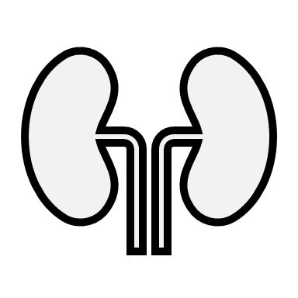
Renal Issues
Kidney damage can occur, especially with supplements that contain herbs
Brown AC. Food Chem Toxicol. 2017;107:449-471
Cohen PA, Travis JC, Keizers PHJ, et. al. Clin Toxicol. 2018;56(6):421-426

Slide 17
Hepatic Issues
~20% of drug induced liver injuries are from dietary supplements
Cohen PA, Travis JC, Keizers PHJ, et. al. Clin Toxicol. 2018;56(6):421-426
Notes:
The 20% value is based off of emergency room reports.

Slide 18
Seizures
Acute neurotoxicity can occur after ingestion of dietary supplements with sympathomimetic properties
Giampreti A, Lonati D, Locatelli C, et. al. Clin. Toxicol. 2009;47(8):827-829
Notes:
Yohimbe extract and seizure in a body builder due to sympathomimetic properties (Giampreti A, Lonati D, Locatelli C, Rocchi L, Campailla MT. 2009 Acute neurotoxicity after yohimbine ingestion by a body builder. Clin. Toxicol. (Phila) 47:827–29)

Slide 19
Medication Interactions
Athletes are not always truthful with healthcare providers when discussing supplements. There can be potential interactions between supplemental ingredients and medications
Ronis MJJ, Pedersen KB, Watt J. Annu Rev Pharmacol Toxicol. 2018;58:583-601
Karnatovskaia LV, Leoni JC, Freeman M. Clin J Sports Med. 2015;25(1)
Cohen PA, Travis JC, Keizers PHJ, et. al. Clin Toxicol. 2018;56(6):421-426

Slide 20
Exceeding micronutrient ULs
Tolerable Upper Limits (UL) are the highest level of nutrient intake that is likely to pose no risk of adverse health effects for almost all individuals in the general population.
As intake increases above the UL, the risk of adverse effects increases.
https://www.nal.usda.gov/fnic/dri-glossary#:~:text=Tolerable%20Upper%20Level%20Intake%20(UL,individuals%20in%20the%20general%20population.

Slide 21
Exceeding micronutrient ULs
Water-Soluble Vitamins | Fat-Soluble Vitamins
Vitamin C | Vitamin A
Thiamin (B1) | Vitamin D
Riboflavin (B2) | Vitamin E
Niacin (B3) | Vitamin K
Pantothenic Acid (B5)
Vitamin B6
Biotin
Vitamin B12
Folic Acid
Excess intake of the water soluble vitamins is less of a concern because generally excess is excreted in the urine
In some instances, supplementation with certain water soluble vitamins can be toxic
Fat soluble vitamins as well as minerals are not as easily cleared by the body and can become toxic at high levels
Symptoms of toxicity include but are not limited to: changes to vision, bone and joint pain, skin changes, muscle weakness, diarrhea, increased risk of bleeding, skin flushing, heart arrythmias

Slide 22
2019 FDA Commissioner statement
Communicate more quickly when unlawful or potentially dangerous products are marketed as dietary supplements
Balance Safety and Innovation in the regulatory framework
Work closely with industry partners to protect public health and safety and support evaluation of new products
Take action to protect public health and develop new enforcement strategies
Engage in public dialogue around additional steps to modernize DSHEA are necessary
https://www.fda.gov/news-events/press-announcements/statement-fda-commissioner-scott-gottlieb-md-agencys-new-efforts-strengthen-regulation-dietary
Notes:
The FDA is aware of the shortcomings of the current program and in 2019 released a statement with plans on how to improve the program. Changes require congressional support and may be slow to be approved and enacted
Communicate more quickly when we have concerns that an ingredient is unlawful and potentially dangerous and should not be marketed in dietary supplements.
ensure that our regulatory framework is flexible enough to adequately evaluate product safety while promoting innovation
critical that the FDA continue to work closely with our partners in industry to achieve our primary goal of protecting public health and safety. As the dietary supplement industry develops new products and ingredients, advances new delivery systems and innovates in other ways, the FDA must do more to leverage its existing resources and authorities to evaluate these products. This requires collaborative research and a shared understanding.
Fourth, we’ll continue to take actions to protect public health and develop new enforcement strategies, as a key element of our approach to protecting consumers as the risks evolve.
engage a public dialogue around whether additional steps to modernize DSHEA are necessary.

Slide 23
WHICH SUBSTANCES ARE BANNED?

Slide 24
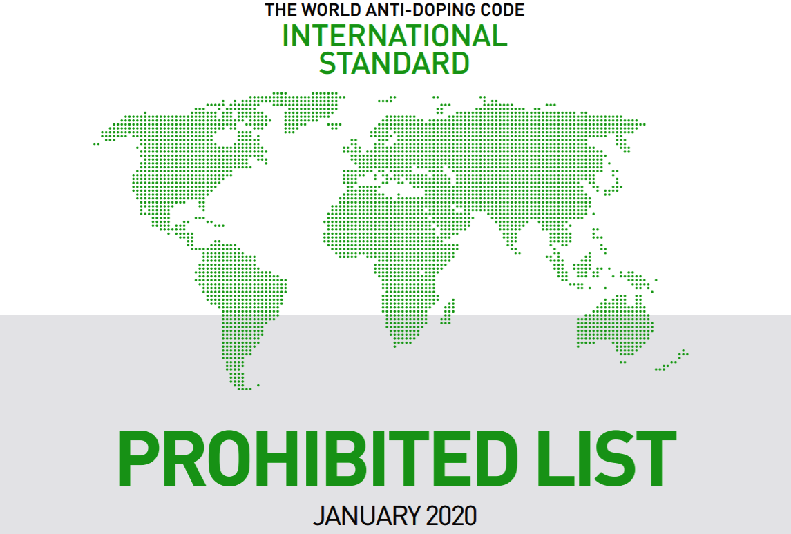
https://www.wada-ama.org/en/content/what-is-prohibited
Notes:
USADA follows the WADA prohibited list annually. There are over 660 organizations across the globe that have accepted the WADA code. Most professional sports leagues in the US have not though, several of which have their own prohibited substance list.
Understand the regulations of your sport organization regarding dietary supplements. Learn from organizations that provide dietary supplement guidance specific to athletes
WADA regulates ingredients/substances as well as potential doping methods. The next few slides will focus on banned substances specifically.

Slide 25
WADA Prohibited at all times
Anabolic Agents
Anabolic androgenic steroids
Other anabolic agents
Peptide hormones, growth factors, related substances or mimetics
Erythropoietins (EPO) & agents affecting erythropoiesis
Peptide hormones & releasing factors
Growth factors & growth factor modulators
Beta-2 agonists
Hormone and metabolic modulators
Aromatase inhibitors
Selective estrogen receptor modulators
Anti-estrogenic subtances
Agents preventing activin receptor IIB activation
Metabolic modulators
Diuretics or masking agents
https://www.wada-ama.org/en/content/what-is-prohibited/prohibited-at-all-times/diuretics-and-masking-agents
Notes:
The number of ingredients that fall into each of these categories are too numerous to fit onto a slide. Recommend visiting the site to show how many different ingredients can fall into each category and sub-category

Slide 26
WADA Prohibited in Competition
Stimulants
Specified and non-specified ingredients
Narcotics
Cannabinoids
All natural and synthetic cannabinoids except cannabidiol
Glucocorticoids
https://www.wada-ama.org/en/content/what-is-prohibited/prohibited-in-competition/stimulants

Slide 27
Prohibited in Particular Sports
Beta-Blockers – 19 substances
Sports
Acebutolol, alprenolol, atenolol
Betaxolol, bisoprolol, bunolol
Carteolol, carvedilol, celiprolol
Esmolol, labetalol, metipranolol
Metoprolol, nadolol, oxprenolol
Pindolol, propranolol
Sotalol, timolol
Archery
Automobile
Billiards
Darts
Golf
Shooting
Skiing/Snowboarding
Underwater sports
https://www.wada-ama.org/en/content/what-is-prohibited/prohibited-in-particular-sports
Notes:
Substances are not listed with the expectation that a student would memorize every kind of beta-blocker but to show the challenge when it comes to evaluating substances and the various names they can go by.

Slide 28
Drug Free Sport International
Drug testing
Education
300
https://www.drugfreesport.com/
Notes:
Previously National Center for Drug Free Sport – merged into drug free sport International
This organization does a significant amount of comprehensive drug testing but they also provide a number of educational resources for professionals and athletes around the topics of supplement safet, illegal drugs, stimulants and performance enhancing drugs.. Around the world they work with over 300 sports and athletic organizations.

Slide 29
Drug testing
Supplement 411
Education
Testing policies, procedures & exemptions
Bringing attention to the impact inadequate drug testing and/or punishment for doping has on clean athletes
United States
Anti-Doping Agency
(USADA)
https://www.usada.org/
Notes:
USADA makes available a number of publications, policies, and procedures to help athletes and others understand anti-doping responsibilities such as USADA’s testing program, the World Anti-Doping Code, the World Anti-Doping Agency (WADA) Prohibited List, the International Standards, Therapeutic Use Exemptions (TUEs), Whereabouts responsibilities, and the sample collection process.
USADA also has been working with international partners to bring attention to the impact inadequate drug testing and/or punishment for doping impacts clean athletes.

Slide 30
Additional Resources
NIH Office of Dietary Supplements
https://ods.od.nih.gov/
Medline Plus for Herbs and Supplements
https://medlineplus.gov/druginfo/herb_All.html
Natural Medicines Database
https://naturalmedicines.therapeuticresearch.com/

Slide 31
SUPPLEMENT EFFICACY

Slide 32
Notes:
Assuming the supplement functions as intended, does the function of the supplement and goal of the athlete match the performance needs of the sport?
Do the athlete goals match the performance goals of the sport?

Slide 33
What are the demands of the athletes sport vs. Athlete goals?
Athlete goals
vs.
Demands of the athletes’ sport
Notes:
Are the individual goals of the athlete in line with the physical demands of the sport they play? Will the type of supplement and what the athlete hopes to achieve impact his or her play? Or does the evidence for that supplement support usage in that capacity.

Slide 34
Generally, a well-balanced diet that meets caloric needs allows the athlete to get adequate macro and micro-nutrients from whole foods

Slide 35
Is the athlete meeting basic needs?
What does the overall diet looks like?
Can the training program be optimized further to meet goals?
Is the athlete getting adequate sleep to support recovery?
Notes:
Certain dietary supplements may enhance performance, but the athlete needs a solid foundation in order to truly see those benefits. Supplements should not be considered band aids or quick fixes, rather something that can be added after the basic needs have been met.

Slide 36
POTENTIAL BENEFITS

Slide 37
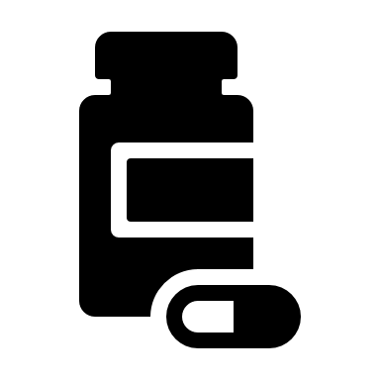
Micronutrient Deficiencies
Supplementation is recommended when the athlete has or is attempting to prevent a diagnosed micronutrient deficiency
Thomas DT, Erdman KA, Burke LM. Med Sci Sport Exer. 2016;48:543-568​
Notes:
A few examples are vitamin D and iron. Vitamin levels are chronically low in many athletes and supplementation with Vitamin D can help to raise levels. Similarly with iron, if measured ferritin is low or HMB/HCT are low iron supplementation is critical to raise levels in conjunction with adjustments to dietary intake.

Slide 38
Performance Supplements
Caffeine
Creatine monohydrate
Nitrate
Sodium bicarbonate
Beta-alanine
Maughan RJ, Burke LM, Dvorak J, et. al. Br J Sport Med. 2018;52(7):439-45
AIS Sports Supplement Evidence Map https://ais.gov.au/nutrition/supplements/tiles/group_a
Notes:
Supplements identified by the International Olympic Committee (IOC) and the Australian Institute of Sport (AIS) that have enough evidence to recommend their usage are caffeine, creatine (in the form of creatine monohydrate), nitrate, sodium bicarbonate and possibly also Beta-alanine. The AIS also identifies glycerine. The mechanisms of action, typical dose, potential performance benefits and known side effects of each of these supplements vary and dosage and timing should be tailored to the needs of the individual athlete.

Slide 39
Label Reading
Be aware of the FDA’s dietary supplement labeling laws
Watch out for “proprietary blends”
Check serving size
Examine amount per serving of desired ingredient(s)
“Filler” or cheaper ingredients may be used
https://www.fda.gov/food/dietary-supplements-guidance-documents-regulatory-information/dietary-supplement-labeling-guide-chapter-iv-nutrition-labeling
Notes:
Label reading
With proprietary blends, it is difficult or impossible to determine how much of each ingredient is included in the product. There may be very little of the desired ingredient but that is not apparent when it is hidden within a “proprietary blend.

Slide 40
IDENTIFYING SAFER SUPPLEMENTS

Slide 41
Red Flags
Big claims
Promise quick and unrealistic results
“Alternatives” to prescription drugs
Proprietary blends
Notes:
These are a few potential red flags based on the marketing language that the product may not be safe for an athlete to use.

Slide 42
Recommendations for 3rd party supplement testing
Certifying program and labs accredited to ISO 17065
Certifying program controls their certification mark
Impartiality and written conflict of interest policies
Methods to revoke certification and inform consumers
Complaint and appeals process for clients
Program certifies against NSF/ANSI 173
Eichner AK, Coyles JE, Fedoruk M, et. al. Curr Sports Med Rep. 2019;18(5):178-182
Notes:
International Standard Organization 17065 – conformity assessment – requirements for bodies certifying products. NSF/ANSI 173 is the standard for evaluating dietary supplements. ANSI is the US representative of the ISO.
(a) is legally responsible for its certification activities; (b) has very specific criteria that dietary supplement companies have to adhere to in order to have products certified; (c) has marks, logos, or brandings that allow consumers to identify the certified products; (d) tightly controls the use of those mark and what batches, lots or products are certified; (e) is impartial; (f ) is insured against liabilities arising from the certification program; (g) properly maintains confidential information; h) has an organizational structure that safeguards impartiality;
(i) trains and supports staff so they can effectively carry out the certification processes; (j) evaluates products to a standard; (k) has ongoing surveillance of certified products; (l) has a way to revoke certification and inform consumers; (m) keeps records of all decisions; and (n) has a complaint and appeals process for clients. In other words, the third-party certification program has the capability and infrastructure to carry out a meaningful certification program to a level that meets international consensus standards (Table).
Second, it is essential that third-party certification programs evaluate dietary supplements to the consensus standard “ANSI/NSF 173 — Dietary Supplements.” For starters, evaluating a product to clearly identified criteria is a requirement of ISO 17065
Is it a high-quality product? Check supplement labels for a third-party certification (e.g. NSF, Informed Choice, USP, or Consumer Labs). These independent third parties evaluate dietary supplements for purity, quality, and banned substances that may cause a positive drug test.

Slide 43
3rd Party testing
Testing programs that certify ingredients, batches of products, and/or manufacturing facilities
Athletes or athletic staff can send samples to independent labs for testing

Slide 44
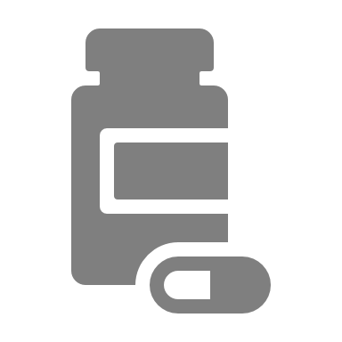
Example 1: NSF Certified for Sport
Products do not contain any of approximately 270+ substances banned by major athletic organizations.
The contents of the supplement actually match what is printed on the label.
There are no unsafe levels of contaminants in the tested products.
The product is manufactured at a facility that is GMP registered and audited twice annually for quality and safety by NSF International.
https://www.nsfsport.com/
Notes:
NSF International led the development of the nation’s first truly independent testing standard and product certification program strictly for dietary supplements, NSF/ANSI 173.
NSF International’s Certified for Sport® program meets the growing demands of athletes, coaches and all those concerned about banned substances in dietary supplements and functional foods. We verify that these products do not contain unsafe levels of contaminants, prohibited substances or masking agents, and that what is on the label matches what is in the product. By doing so, the Certified for Sport® certification program provides consumers with safer choices when selecting dietary supplements and functional foods.
The Certified for Sport® certification is the only independent third-party certification program recognized by the United States Anti-Doping Agency (USADA), Major League Baseball, the National Hockey League and the Canadian Football League. Certified for Sport® is also recommended by the NFL, NBA, PGA, LPGA, CCES, CPSDA, iNADO, Ironman, NASCAR, Taylor Hooton Foundation and many other organizations seeking to mitigate the risks of contaminated dietary supplements.

Slide 45
Example 2: Informed Choice
Certified finished products – full manufacturing audit and regularly tested for a wide variety of WADA banned substances
Certified raw ingredients – full manufacturing audit and every batch is pre-market tested for a wide variety of WADA banned substances
Certified sites – assurance that facilities are equipped with adequate critical control procedures
https://www.informed-choice.org/

Slide 46
Summary
Supplement safety is a huge issue for any athlete
A positive drug test can have serious consequences on an athlete’s health and career
A dietary supplement with illegal or harmful ingredients can cause serious health issues
Dietary supplements are not well regulated within the US although steps are being taken to improve regulation
There are scenarios when dietary supplementation may be beneficial for athletes from either a health or performance standpoint
There are 3rd party testing organizations that help practitioners and athletes identify supplements that meet strict quality controlled standards

