Slide 1
RECOVERY NUTRITION: Beyond the Post-Exercise Window
Lecture content provided by GSSI, a division of PepsiCo, Inc. Any opinions or scientific interpretations expressed in this presentation are those of the author and do not necessarily reflect the position or policy of PepsiCo, Inc.

Slide 2
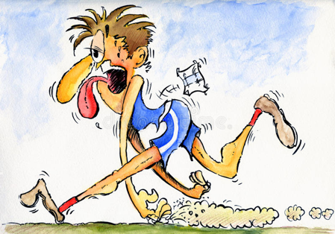
Recovery
What is recovery?
“An inter-individual and intra-individual multi-level (e.g., phycological, physiological, and social) process in time for the re-establishment of performance abilities. Recovery includes an action-oriented component, and those self-initiated activities (proactive recovery) can be systemically used to optimize situational conditions and to build up and refill personal resources and buffers.”
Avoiding overtraining and achieving optimal performance can only be realized when athletes are able to balance training stress and recovery
Long term imbalance of training stress, non-training stress factors, and recovery can lead to a state of overtraining
Kellmann M. Scand J Med Sci Sports. 2010;20(2):95-102
Kellmann M & Kallus KW. Champaign, IL: Human Kinetics, 2001
Lehmann M, Foster C, Gastmann U, et. al. Boston, MA: Springer, 1999

Slide 3
Why is Recovery Important?
Adequate recovery has been shown to result in the restoration of physiological and psychological processes so that an athlete can train or perform at the desired level
This lecture will address recovery related to:
Energy
Muscle tissue repair
Hydration
Immunity
Injury prevention
Inflammation
Sleep
Halson SL. Sports Science Exchange. 2014;27(135):1-6

Slide 4
ENERGY: Carbohydrate

Slide 5
Energy: Carbohydrate & Recovery
A goal during a competitive season is to maintain "full" glycogen stores
Muscle damage can impair glycogen synthesis after exercise
Consume 1-1.2 g of CHO/kg post exercise for the first 4-6 hours followed by regular dietary habits
Carbohydrate intake also support immune function
Bendiksen M, Bischoff R, Randers MB, et. al. Med Sci Sports Exerc. 2012;44(8):1595-1603
Jeukendrup AE. Biochem Soc Trans. 2003;31(6):1270-1273
Rollo I. Sports Science Exchange. 2014;27(127):1-8

Slide 6
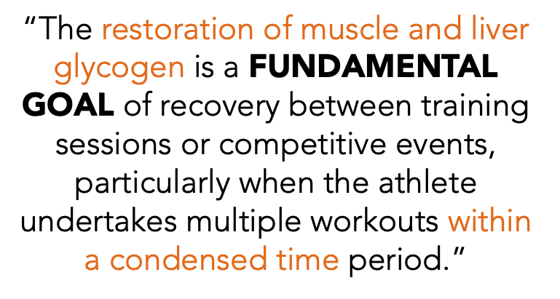
Energy: Carbohydrate & Recovery
Burke L, Hawley JA, Stephen H. et. al. J Sport Sci 2011;29(1):S17-S27

Slide 7
MUSCLE TISSUE REPAIR: Protein

Slide 8
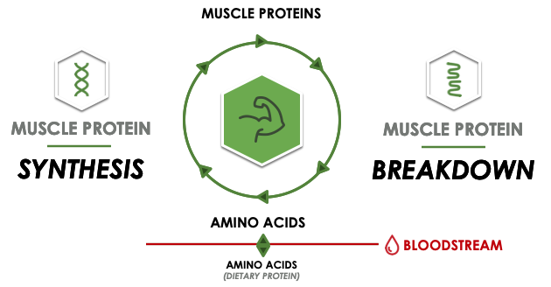
Muscle Tissue Repair: Protein

Slide 9
Muscle Tissue Repair: Protein
SSE# 129
Both muscle protein breakdown and muscle protein synthesis are initiated by exercise
Dietary protein is necessary to keep net protein in balance
A negative protein balance will reduce muscle mass, thus negatively impacting performance
Muscle hypertrophy and repair of exercise induced muscle damage are dependent on positive muscle protein balance
Protein intake
Muscle damage
Recovery
Dalleck LC. American Council on Exercise. 2018:1-14
Res P. Sports Science Exchange. 2014;27(129):1-5

Slide 10
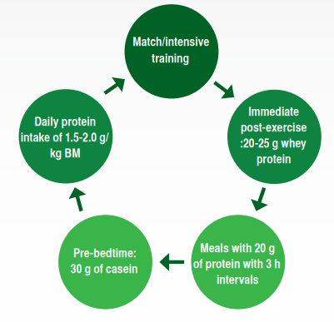
Protein & Recovery
SSE# 129
Research has been found that muscle protein synthesis has been elevated for up to 24 hours in response to a meal
Meals that contain protein should be consumed every ~3 hours with a meal containing protein right before bed
Areta JL, Burke LM, Ross ML, et. al. J Physiol. 2013;591(9):2319-2331
Burd NA, West DW, Moore DR, et. al. J Nutr. 2011;141(4):568-673
Res PT, Groen B, Pennings B, et. al. Med Sci Sport Exerc. 2012;44(8):1560-1569
Res P. Sports Science Exchange. 2014;27(129):1-5

Slide 11
Branched-Chain Amino Acids & Recovery
Branched-chain amino acids (BCAA) are an essential amino acid (EAA) that play an important role in muscle metabolism
BCAA, especially leucine are necessary for stimulation of molecular signaling that lead to muscle protein synthesis and breakdown
BUT ingestion of BCAA without co-ingestion of a source of the other EAA will not stimulate a maximal muscle protein synthesis response
BCAA supplements should not be used to reduce exercise-induced muscle damage or stimulate muscle protein synthesis
SSE# 170
Dalleck LC. American Council on Exercise. 2018:1-14
Tipton KD. Sports Science Exchange. 2017;28(170):1-6

Slide 12
HYDRATION & RECOVERY

Slide 13
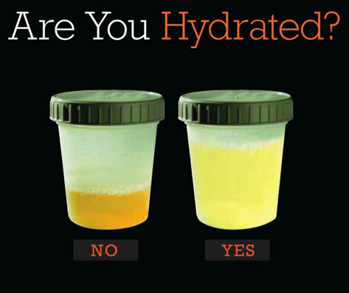
Hydration and Recovery
Athletes should aim to drink fluids throughout the day to recover from a training session and start their next session hydrated
Foods with high water content (ie: watermelon, soups, etc) contribute to meeting daily hydration needs
Consuming a beverage with sodium, or eating salty foods, can help retain fluid if athletes have an issue with hydration
While not a perfect technique, checking urine color can be an indication of hydration (aim for a light, lemonade color)

Slide 14
IMMUNE FUNCTION

Slide 15
Immunity
Adequate recovery won't prevent illness, but can help an athlete stay healthy
Periods of prolonged and strenuous exercise or training can result in depression of white blood cell functions, during which the risk of developing an infection increases
Psychological stress, lack of sleep, and malnutrition can also depress an athlete’s immunity and increase the risk of infection

Slide 16
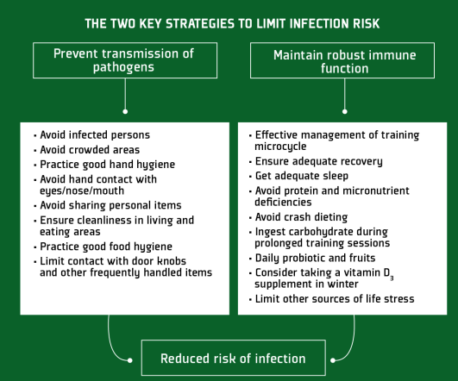
Immunity
SSE# 151
Suggestions to maintain immune health during intensified training
An athlete should focus on getting adequate recovery and sleep
Consume sufficient amounts of protein and micronutrients
Iron, zinc, Vitamins A, D, E, B6, and B12
Consume sufficient amounts of carbohydrates
Consume plant-based polyphenols and probiotics
Consider Vitamin D supplementation
Many athletes are Vitamin D deficient and are at greater risk during winter months
Gleeson M. Sports Science Exchange. 2015;28(151):1-6

Slide 17
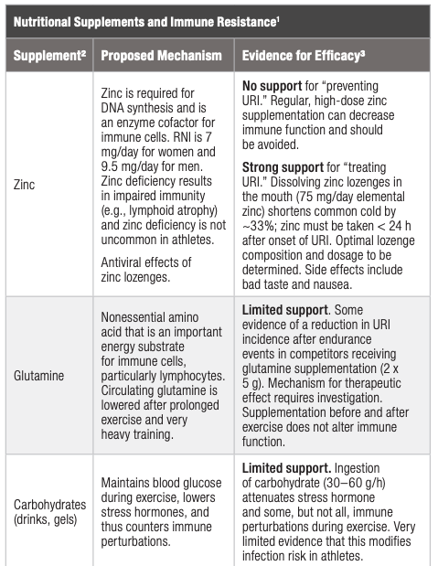
SSE# 198
Walsh NP. Sports Science Exchange. 2019;29(198):1-7

Slide 18
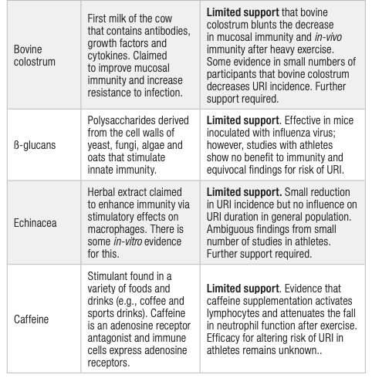
SSE# 198
Walsh NP. Sports Science Exchange. 2019;29(198):1-7

Slide 19
INJURY PREVENTION

Slide 20
Injury Prevention
SSE# 142
Soft tissue injuries to the musculoskeletal system are the most common injury for American football athletes
Accounting for ~70% of physical therapy visits
Strength, power, and speed are dependent on stiff connective tissues, which results in high rates of injury
The stiffness of connective tissue is dependent on the collagen content of the tissue
Consuming gelatin and Vitamin C 30-60 minutes prior to training may promote greater collagen production
Baar K. Sports Science Exchange. 2015;28(142):1-6

Slide 21
INFLAMMATION

Slide 22
Nutrients to support inflammation
Some level of inflammation supports recovery and adaptation
Chronic inflammation impairs recovery
Consumption of Tart Cherry Juice, due to its polyphenol content, may support recovery via decreased inflammation, oxidative stress and pain.
Aim for ~8-12 oz/d
Some evidence supports Omega-3 consumption, along with decreased Omega-6
Omega 3 from fatty fish or supplements
Decrease fried foods, saturated fats
Vitale KC, Hueglin S, Broad E. Curr Sports Med Rep. 2017;16:230-239
Tipton, K. Sports Med. 2015;45:93-104

Slide 23
SLEEP & RECOVERY

Slide 24
Sleep & Recovery
SSE# 113
Sleep plays an important role in an athlete’s recovery plan
It is essential for both preparing for and recovery from training/competition
Restricting an athlete’s number of sleep to less than 6 hours for 4 or more consecutive nights…
Impairs cognitive performance and mood
Disturbs glucose metabolism, appetite regulation, and immune function
It appears that lack of sleeps has more of a negative impact on prolonged, sub-maximal exercise compared to short, maximal efforts
Napping can be effective in making up for shortened sleep duration
Athletes should focus on good sleep hygiene
Cool, dark, quiet bedroom
Good sleep routine – Going to bed and waking up at the same time
Avoid screens (tv, phone, computer) before going to bed
Avoid caffeine 4-5 hours prior to sleep
Avoid consuming too much fluid prior to sleep as it may result in waking up to use the bathroom
Halson SL. Sports Science Exchange. 2013;26(113):1-4

Slide 25
Enhancing Sleep & Nutrition
SSE# 116
Some nutritional interventions may have an effect on neurotransmitters that are involved in the sleep-wake cycle, and may enhance sleep
Diet may influence the central nervous system and through the production of serotonin and melatonin
High glycemic index (GI) foods sch as white rice, pasta, breads may promote sleep
Should be consumed more than an hour prior to bed
Diet high in CHO may result in shorter sleep latencies
Diets high in protein may results in better sleep quality
Diets high in fat may negatively influence the total sleep time
Sleep quality may be disturbed if total caloric intake is decreased
1 g of tryptophan may improve sleep latency and quality
Melatonin may decrease sleep onset time
Buscemi N, Vandermeer B, Hooton N, et. al. J Gen Intern Med. 2005;20:1151-1158
Halson SL. Sports Science Exchange. 2013;26(116):1-5
Morin CM & Benca R. Lancet. 2012;379:1129-1141
Orr WC, Shadid G, Harnish MJ, et. al. Physiol Behav. 1997;62:709-712
Porter JM & Horne JA. Clin Neurophys. 1981;51:426-433

Slide 26
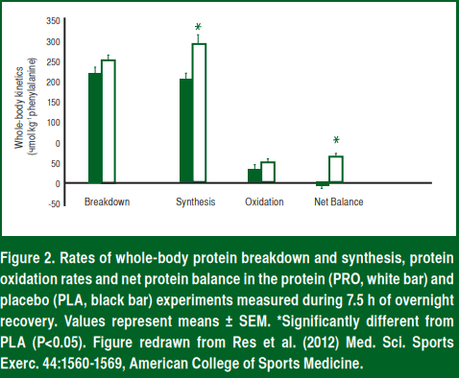
Protein & Sleep
SSE# 117
During sleep, muscle protein synthesis is low
This occurs even if dietary protein is consumed after exercise
Dietary protein consumed prior to bed is easily digested and absorbed during the night
This increases plasma amino acid availability
Stimulates post-exercise muscle protein accumulation during sleep
Consuming dietary protein prior to sleep may be an effective strategy to help the skeletal muscle adaptation to training
In addition to consuming sufficient amounts of protein with each meal, consuming ~20 g of protein after exercise/training, athletes should consume 20-40 g of protein prior to sleep
Res PT, Groen B, Pennings B, et. al. Med Sci Sports Exerc. 2012;44:1560-1569
Van Loon LJC. Sports Science Exchange. 2013;26(117):1-5

Slide 27
MONITORING FATIGUE & RECOVERY

Slide 28
Monitoring Fatigue & Recovery
Some definitions first:
Overreaching
An increase in training load followed by a temporary decrease in performance and with improved performance after rest, is known as functional overreaching
Decreased performance for days to weeks
Intense training leading to a longer decrease in performance but with full recovery after rest, is known as non-functional overreaching
Decreased performance for weeks to months
Often accompanied with increased psychological and/or neuroendocrinological symptoms
Overtraining
Consistent with extreme non-functional overreaching
Longer decreases in performance
More severe psychological and physiological symptoms
Additional stressors not explained by other disease
Kreher JB & Schwartz JB. Sports Health. 2012;4(2):128-138

Slide 29
Monitoring Fatigue & Recovery
SSE# 135
Modifications to an athlete’s training load are not only normal, but required to ensure an athlete stays healthy
Modifications include frequency, duration, and intensity
Monitoring an athlete’s training load is important to determine if an athlete is responding to the training program and to avoid and minimizing the risk of non-functional overreaching
Internal vs External Load
When monitoring training load, the load units can be thought as either internal or external
Internal – The physiological or psychological stressors
Perceived exertion, fatigue state of an athlete
External – The work completed by the athlete, independent of their internal characteristics
Amount of power produced, time trials
Methods to monitor an athlete’s fatigue and recovery
Internal: RPE, heart rate, HR:RPE ratio, TRIMP, lactate, hear rate recovery, sleep, questionnaires
External: Time motion analysis, GPS, neuromuscular tests (countermovement jump), isokinetic dynamometry
Halson SL. Sports Science Exchange. 2014;27(135):1-6
Halson SL & Jeukendrup AE. Sports Med. 2004;34:967-981

Slide 30
RECOVERY TECHNIQUES

Slide 31
Recovery Techniques
SSE# 120
In addition to diet, rest, sleep, athletes use a variety of other recovery techniques. Research is varied on the physiologic benefits, but athletes often report they help them “feel good”. Newer research is investigating the combination of nutrition + modality post-exercise.
Some common recovery techniques:
Hydrotherapy
Cryotherapy
Pulsed Compression
EMG Muscle Stimulation
Active Recovery
Stretching
Compression Garments
Massage
Barnett A. Sports Med. 2006;36:781-796
Halson SL. Sports Science Exchange. 2013;26(120):1-6
Weerapong P, Hume PA. Kolt GS. Sports Med. 2005;35:235-256

Slide 32
Summary
Appropriate recovery is crucial for an athlete’s health and performance
Restore glycogen stores by consuming carbohydrates after training or competition
Muscle hypertrophy and repair of exercise induced muscle damage are dependent on positive muscle protein balance
Consuming a beverage with sodium or salty foods can help the body retain fluids if an athlete is having issues with hydration
Periods of prolonged stress or intense training can suppress an athlete’s immunity, maintaining a balanced diet and adequate sleep can help support an athlete’s immunity
Consuming gelatin and Vitamin C 30-60 minutes prior to training may promote greater collagen production
Some level of inflammation supports recovery and adaptation, but chronic inflammation impairs recovery
Sleep is critical to recovery
Understand fatigue and monitor an athlete’s fatigue levels to ensure they are properly recovered

