Slide 1
NUTRITIONAL SUPPORT FOR INJURY RECOVERY
Lecture content provided by GSSI, a division of PepsiCo, Inc. Any opinions or scientific interpretations expressed in this presentation are those of the author and do not necessarily reflect the position or policy of PepsiCo, Inc.

Slide 2
Lecture Outline
Muscle tissue – minimize atrophy
Connective tissue
Bone
Inflammation & Pain
Energy

Slide 3
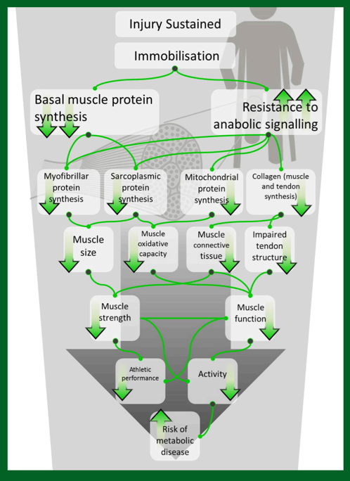
Metabolic and Functional Consequences of Immobilization Following an Exercise-Induced Injury
SSE #169
Tipton K. Sports Science Exchange. 2017;28(169):1-6

Slide 4
Mechanical load
Muscle Proteins
Muscle Protein Synthesis
1-2%/d
(300-600 g)
Muscle Protein Breakdown
Amino Acids
Amino Acids
Notes:
1-2% turnover per day
Daily 300-600 g muscle broken down and resynthesized
Food (protein) increases synthesis in healthy muscle and inhibits breakdown

Slide 5
How much muscle do you think can be lost per day when your leg is in a cast?

Slide 6
1-2 Weeks of Immobilization:
Healthy, inactive muscle atrophies ~0.5% per day
150-400 g muscle can be lost
Strength decreases at 3x the rate muscle tissue is lost
Wall BT, Morton JP, van Loon LJC. EJSS. 2015;15(1):53-62.

Slide 7
Resulting In:
⬇ MPS
Anabolic resistance (decreased response to protein)
⬇ Calories accelerates muscle loss
Wall BT, Morton JP, van Loon LJC. EJSS. 2015;15(1):53-62.

Slide 8
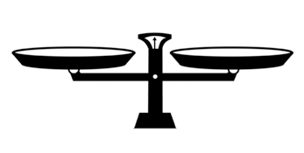
Promoting Return to Play
Immediate need for countermeasures to decrease atrophy & support rehabilitation
Usually little/no exercise intervention
Need non-exercise strategies
Alleviate anabolic resistance through nutrition
Tipton, K. Sports Med. 2015; 45:93-104, doi: 10.1007/s40279-015-0398-4.

Slide 9
Protein Intake to Help Manage Anabolic Resistance
1.6-2.5 g/kg/d protein
20-40 g every 3-4 h
Pre-Sleep (casein?)
Leucine
Wall BT, Morton JP, van Loon LJC. EJSS. 2015;15(1):53-62
Notes:
Insufficient protein will increase inflammation and impair wound healing
Every 3-4 hours allows for maximal protein anabolism for 6-12 hours of the day
High quality, leucine rich proteins probably more important than regular diet, since not eating as much – make their protein intake really count
it has been shown that fortifying sub-optimal amounts or types of dietary protein with only 2– 3 g of leucine can amplify the anabolic response in elderly men

Slide 10
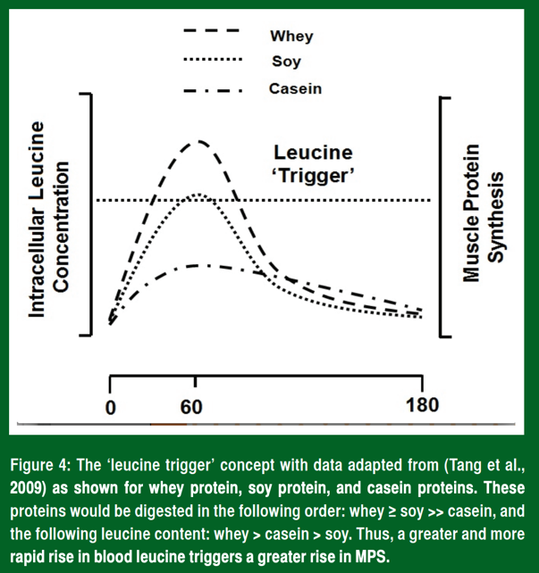
Leucine
Building block for new muscle
Also a signaling molecule to initiate the process
SSE #107
Phillips, S. Sports Science Exchange (2013) Vol. 26, No. 107, 1-5.

Slide 11
Other Nutritional Considerations
HMB? (3 g/d)
Creatine? (20 g/d)
Fish oil? (4-5 g/d)
Wall BT, Morton JP, van Loon LJC. EJSS. 2015;15(1):53-62

Slide 12
HMB
β-hydroxyl-β-methylbutyrate
Metabolite of leucine
May increases MPS, decrease breakdown
Preserved muscle mass during bed rest in older adults
Likely not beneficial for healthy athletes; more research needed during injury
Creatine
Slowed loss of muscle during 7 d upper arm immobilization
Did not preserve muscle or strength during 7 d leg immobilization
Fish Oil
May promote anabolism by increasing sensitivity to amino acid ingestion
In one study, slowed decreases in muscle thickness, arm girth and BMC during arm immobilization
Backx EMP, Hangelbroek R, Snjiders T, et. al. Sports Med. 2017;47:1661-1671
Bostock EL, Morse CI, Winwood K, et. al. J Nutr Health Aging. 2017;21:51-58
Rawson ES, Miles MP, Larson-Meyer DE. Int J Sport Nutr Exerc Metab. 2018;28(2):188-199
Wall BT, Morton JP, van Loon LJC. EJSS. 2015;15(1):53-62

Slide 13
Treat rehab like training…
20-40 g (~0.25-0.3 g/kg)protein shortly after each rehab session
Leucine-rich, complete protein
Regular protein intake pattern
Limit/avoid alcohol
Macnaughton LS, Wardle SL, Witard OC, et. al. Physiol Rep. 2016;4(15)
Moore DR, Robinson MJ, Fry JL, et. al. AJCN. 2009;89(1):161-8
Witard OC, Jackman SR, Breen L, et. al. AJCN. 2013;99(1):86-95,2013

Slide 14
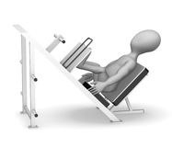
Example Study:
Post-exercise protein improved:
Quadriceps CSA
Peak torque
*With only 10 g protein!
3x/week
12 weeks
PRO (10 g)
30 individuals
ACL injury
Holm L, Esmark B, Mizuno M, et. al. J Orthop Res. 2006;24(11):2114-23

Slide 15
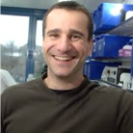
Ligament Healing
Vitamin C
+
Amino Acids (proline, lysine, hydroxyproline, hydroxylysine)
=
collagen synthesis
48 mg
Gelatin (15 g)
Dr. Keith Baar
UC Davis
1 hour prior to 6 min rope skipping
Shaw G, Lee-Barthel A, Ross MLR, et. al. Am J Clin Nutr. 2017;105(1):136-143

Slide 16
Ligament Healing
Consuming Vitamin C-enriched gelatin or a collagen supplement prior to rehab exercises may help promote healing of connective tissue
Dr. Keith Baar
UC Davis
SSE #142
SSE #187
Baar K. Sports Science Exchange. 2015(142): 1-6
Baar K. Sports Science Exchange. 2018;29(187):1-6

Slide 17
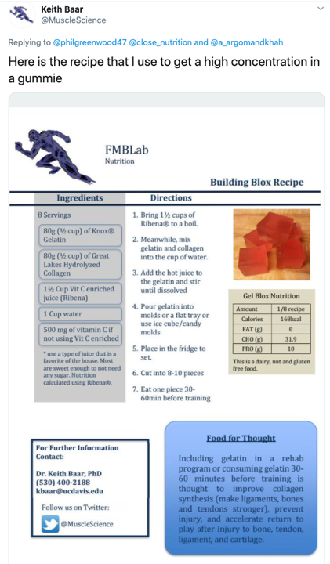
How to Deliver Gelatin: Gummie Recipe from Dr. Baar

Slide 18
Bone Injury
Ensure consumption of the RDA for calcium (1000 mg/d)
Consider assessing Vitamin D status
Consume adequate calories
Sale C & Elliot-Sale K. Sports Science Exchange. 2020;29(201):1-7

Slide 19
MANAGING INFLAMMATION

Slide 20
Managing Inflammation
Acute inflammation important for wound healing
Chronic inflammation impairs recovery
Analgesics target inflammatory pathways
Tipton, K. Sports Med. 2015; 45:93-104, doi: 10.1007/s40279-015-0398-4.

Slide 21
Managing Inflammation
In an otherwise healthy athlete, an injury is unlikely to cause uncontrolled inflammation
Use caution and judgement when suggesting anti-inflammatory foods in the acute phase post-injury
Tipton, K. Sports Med. 2015; 45:93-104, doi: 10.1007/s40279-015-0398-4.

Slide 22
Do you think an athlete should restrict calories when injured? Why or why not?

Slide 23
Energy Needs
Ensuring the right energy balance promotes healing
Measure RMR if possible
Monitor for significant changes in body weight
Tipton, K. Sports Med. 2015; 45:93-104, doi: 10.1007/s40279-015-0398-4.

Slide 24
Energy Needs
Resting EE may increase ~15-50% with injury
Crutching increases EE 2-3x
Energy needs of healing
Reduced activity
Tipton, K. Sports Med. 2015; 45:93-104, doi: 10.1007/s40279-015-0398-4.

Slide 25
Summary
“The single most important nutritional consideration during reduced muscle activity and/or immobility is to avoid nutrient deficiencies. Deficiencies of energy, vitamins, minerals and macronutrients—particularly protein—will impair wound healing and exacerbate loss of muscle and tendon mass and function. Whereas healthy exercisers and athletes are unlikely to suffer from malnourishment, choices made during recovery from an injury need to be carefully considered to optimize recovery and return to training.”
Tipton, K. Sports Med. 2015; 45:93-104, doi: 10.1007/s40279-015-0398-4.

