Slide 1
NUTRITION AND IMMUNE HEALTH: Considerations for Athletes
Lecture content provided by GSSI, a division of PepsiCo, Inc. Any opinions or scientific interpretations expressed in this presentation are those of the author and do not necessarily reflect the position or policy of PepsiCo, Inc.

Slide 2
Lecture Outline
Outline functions of the immune system
Discuss dietary constituents needed for immune support
Describe lifestyle factors associated with immune health
Review key nutrition education concepts to best promote health and immune function

Slide 3
IMMUNE SYSTEM: Support vs Boost
Physiological Support of Immunity
Immune Boosting
Dietary strategies
Energy & protein
Vitamins & minerals from food
Adequate sleep
Limit alcohol
Strategic supplementation
A marketing term for supplements
The immune system can only be “boosted” if there is a nutrient deficiency or lifestyle alternation leading to immunosuppression
vs
Notes:
Physiological support of the immune system is best achieved with lifestyle modifications
Dietary strategies
Adequate energy and protein
Adequate vitamins and minerals from quality food sources
Adequate sleep
Limiting alcohol
Strategic supplementation as needed
Immune boosting supplements is a marketing term since the immune system can only be “boosted” if there is a nutrient deficiency or lifestyle alteration contributing to immunosuppression
ATCs and sports dietitians are the primary source of education in helping athletes avoid fraud, waste of resources and possible positive drug tests

Slide 4
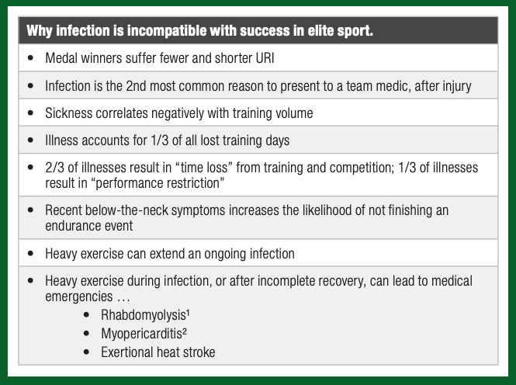
SSE #198
Walsh N. Sports Science Exchange. 2019;29(198):1-7

Slide 5
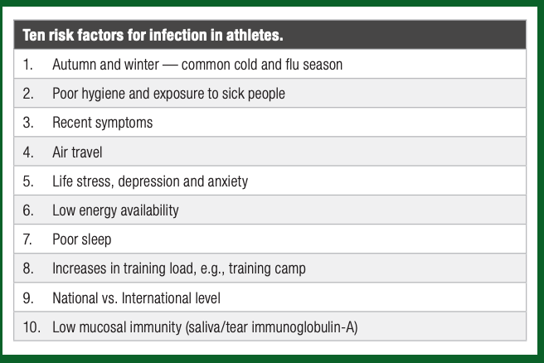
SSE #198
Walsh N. Sports Science Exchange. 2019;29(198):1-7

Slide 6
Severe Calorie Restriction
Protein Calorie Malnutrition
Increases risk of infection
Severe Energy Restriction
Increased stress hormones (cortisol)
Impacts immunity
Most athletes don’t have a severe restriction but may have low energy
Paradoxically, athletes with frank anorexia nervosa do not have immunosuppression unless the condition is severe
Notes:
Research has demonstrated that protein calorie malnutrition increases risk of infection secondary to decrease in natural killer cells and antigen specific immune cells. Protein restriction may be the driver.
Additionally, in protein-energy malnutrition the T-lymphocyte CD4+/CD8+ (helper/suppressor cell) ratio is markedly decreased and phagocytic cell function, in response to infection are all impaired
Severe energy restriction may also influence immunity via activation of the hypothalamic-pituitary-adrenal axis and increases in stress hormones as cortisol.

Slide 7
Low Energy Availability (LEA)
and Infection
URI illness reported by athletes during training & competition
~50%
Elite female athletes experiencing LEA (via LEAF-Q)
~40%
4-8x
Risk of URI in female athletes with LEA
Identifying athletes at risk for LEA may be helpful to assess illness risk in team sports
Restrictive eating, fasting and strict diets may be a risk factor for illness
Notes:
Research by Drew, et al have demonstrated that upper respiratory illnesses are responsible for ~50% of illnesses reported by athletes during training and competition phase
Assessment, via the LEAF-Q ( questionnaire) indicated that ~40% of elite female athletes experience LEA.
Low energy availability in female athletes was highly associated with illness. Athletes with LEA have a 4-8 x greater risk of URI
Identifying athletes at risk for LEA may be helpful in illness risk in team sports
Restrictive eating, fasting and strict diets may be a risk factor for illness

Slide 8
CARBOHYDRATE INTAKE IS RELATED TO THE IMMUNE FUNCTION OF AN ATHLETE

Slide 9
Suboptimal CHO may alter the Immune Response to Exercise & Inflammation
Exercising on a low CHO diet (<10% of calories) elevates stress hormones and may cause a fall in white blood cells
Consuming 30-60 grams of CHO during exercise can prevent a decrease in T-lymphocytes as well as the reduction of stress hormones
Adequate CHO is essential for proper immune function and levels of stress hormones
Notes:
Athletes exercising on a low carbohydrate diets (<10% of calories from CHO) have elevation in stress hormones compared with those consuming adequate or higher CHO diets
Exercising in a CHO depleted state can also cause a greater fall in white blood cells when compared to those with adequate carbohydrate intake
Consuming 30-60 grams of CHO during exercise can prevent a decrease in T-lymphocytes as well as the reduction of stress hormones
Reduction in dietary CHO, may be a factor in altering the immune response as well as inflammation
Adequate CHO is essential to have a favorable effect on immune function and stress hormones

Slide 10
Very low CHO diets = low FIBER
Microbiota diversity
No agreement on risk-benefit of CHO on commensal bacteria in the gut
Best guidance is to continue to eat whole grain, complex carbohydrate diets
(High saturated fat diets can also alter gut bacteria ratios)
Notes:
Very low carbohydrate (CHO) diets are by definition low in fiber
In general, there is a decrease in microbiota diversity when carbohydrates are limited
No universal agreement on risk-benefit of CHO on commensal bacteria in the gut
High saturated fat diets can alter gut bacteria ratios
Best guidance is to continue to eat whole grain, complex carbohydrate diets until more evidence becomes available

Slide 11
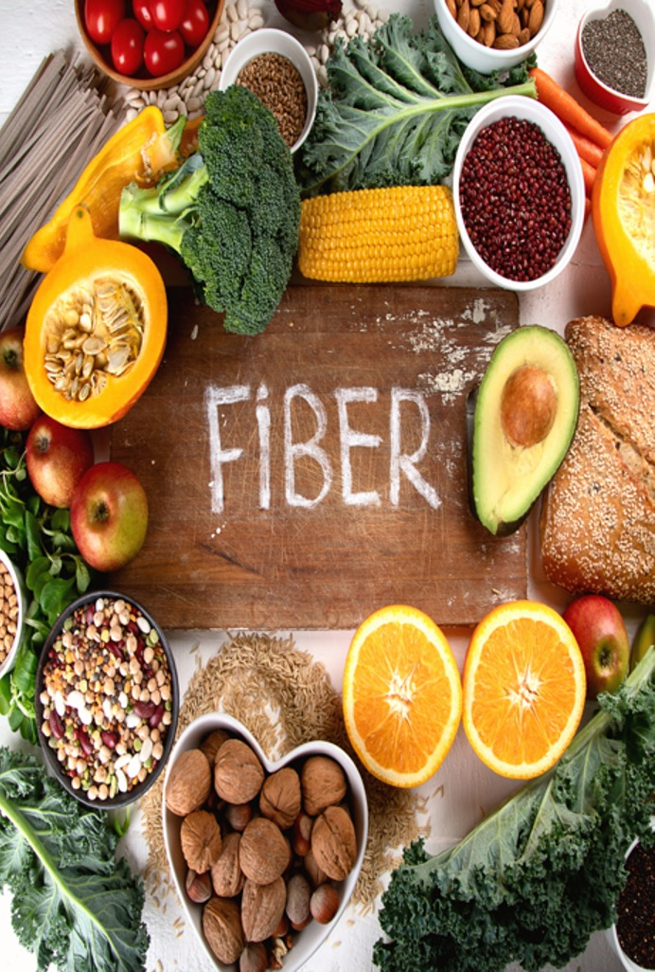
Fiber Requirements
39 g/d
The average American only eats 10 - 13 g/d!
25 g/d
14 g per 1000 calories
Increase gradually!

Slide 12
Fiber Content of Foods (g/serving)
9-
14 g
High fiber bran cereal
7.5 g
Black beans, cooked
4.4 g
Apple, medium
4.9 – 5.5 g
9.6 g
Navy beans
Wheat bran flakes
4.1 g
Chia seeds
5-9 g
Shredded wheat
5.5 g
Pear, medium
3.8 g
Sweet potato (w skin)
8.1 g
Chickpeas
5.2 g
Pumpkin seeds
3.6 g
White potato (w skin)
7.8 g
Lentils, cooked
5.2 g
Edamame, shelled
2.6 g
Quinoa
5.0 g
Avocado

Slide 13
Microorganisms on/within the body
Short chain fatty acids ( SCFA) result when gut bacteria work on undigested CHO
SCFA from high fiber have been shown to reduce the inflammation in the colon and dampen allergic airway disease
Diets should be rich in fiber and prebiotics; the food needed for probiotic survival
The Gut Microbiome
& Immune Health
Notes:
A collection of microorganisms that live on and within you orchestrating a variety of metabolic processes including immune health.
Short chain fatty acids ( SCFA) are formed from the action of the gut bacteria on undigested carbohydrate
Short chain fatty acids from high fiber have been shown to reduce the inflammation in the colon and dampen allergic airway disease
The average American eats between 10-13 gram of fiber per day and increasing dietary fiber has the potential to impact immune health
Diets should be rich in fiber and prebiotics; the food needed for probiotic survival

Slide 14
Probiotic-Containing Foods
Yogurt
Kefir
Sauerkraut (refrigerated)
Pickles (refrigerated)
Kimchi
Tempeh
Miso
Prebiotic-Containing Foods
Asparagus
Banana
Barley
Beets
Chicory
Garlic
Honey
Onion
Tomato
Rye
Soybean
Wheat
Cow’s Milk
Peas
Beans
Seaweed
Microalgae
Jerusalem Artichoke

Slide 15
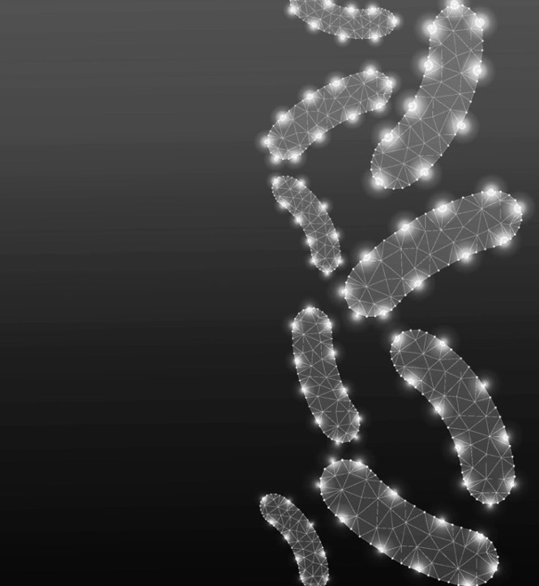
Probiotics
Probiotics can bolster the gut barrier and prevent bacterial migration
May be able to reduce the time of inflammatory response
Supplementation may reduce the incidence of upper respiratory illness by 50% and reduce the duration, if infected by approximately 2 days
Associated with a decreased demand for antibiotics
Notes:
Probiotics can bolster the gut barrier and prevent bacterial migration
May be able to reduce the prolonged inflammatory response
Evidence that probiotic supplementation can reduce the incidence of upper respiratory illness by 50% and reduce the duration, if infected by approximately 2 days.
Supplementation is also associated with a decreased demand for antibiotics

Slide 16
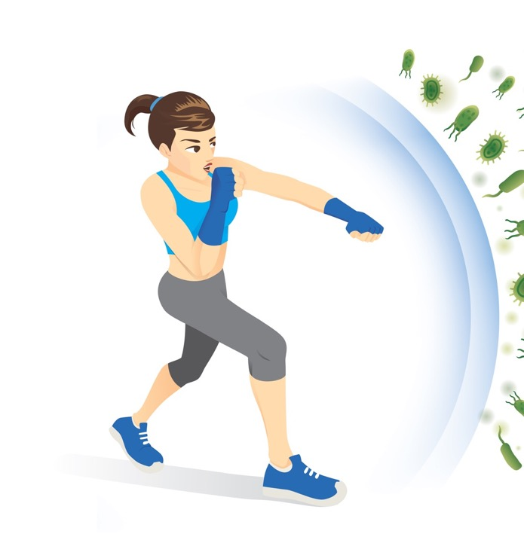
Probiotics & Athletes
In one study, four weeks of multi-species probiotic supplementation reduced markers of gut permeability and symptoms of GI discomfort during exercise-induced heat stress
May protect the intestinal barrier and crowd out the deleterious bacteria
Most studies use probiotics over an extended time for prevention
The strength of evidence for the use of probiotics to support immune function is moderate/strong
Notes:
Four weeks of supplementation with a multi-species probiotic formulation (Lactobacillus, Bifidobacterium and Streptococcus) reduced markers of gut permeability and symptoms of gastrointestinal discomfort during exercise-heat-stress in athletes
Probiotics may also protect the intestinal barrier and prevent the binding of pathogenic bacteria effectively crowding out the deleterious bacteria
The majority of studies use probiotics for an extended period of time for prevention rather than just when an athlete is ill.
Strength of evidence for the use of probiotics is moderate/strong for immune support

Slide 17
VITAMINS AND MINERALS FOR IMMUNE HEALTH

Slide 18
Vitamin A
(beta carotene)
Vitamin C
Vitamin D
Sweet potato
Carrots
Peppers
Broccoli
Butternut Squash
Citrus fruits
Potatoes
Broccoli
Strawberries
Kiwi
Salmon
Trout
Milk
Fortified cereal
Mushrooms
VITAMINS
Important for Immune Function
Folic Acid
Niacin
Vitamin B6
Green leafy veg
Fortified cereal
Liver
Black-eyed peas
Asparagus
Turkey
Salmon
Chicken
Pork
Brown rice
Fortified cereals
Chickpeas
Tuna
Salmon
Potatoes
Vitamin B12
B12-animal foods
Nutritional yeast

Slide 19
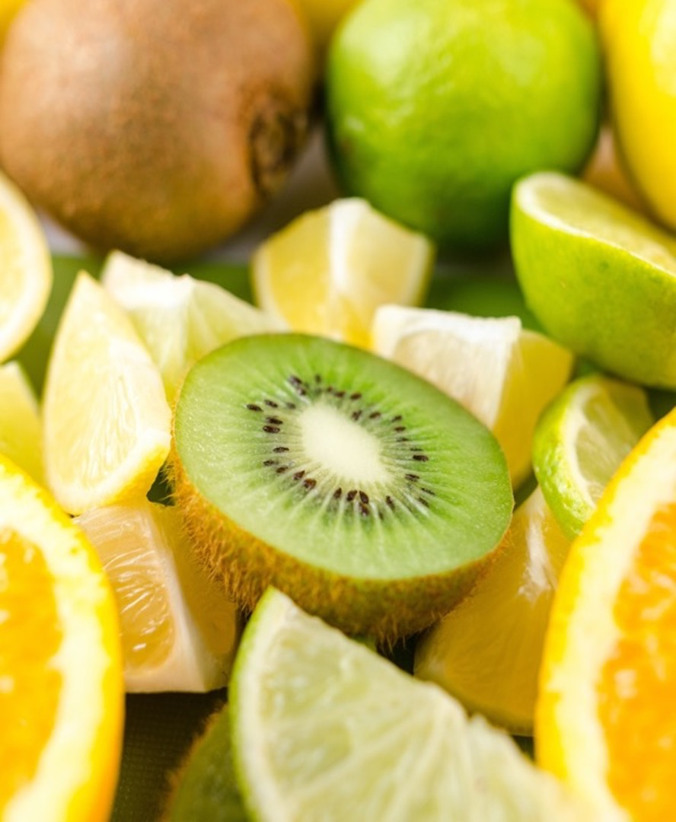
Vitamin C
Supports epithelial barrier function against pathogens and promotes the oxidant scavenging activity of the skin
Needed for the development of immune cells
Found in high concentrations in white blood cells
Levels fall significantly during a common cold
Saturating tissues requires 100-200 mg per day
During an active infection, ~1g/d may be needed with some indication for higher doses
Notes:
Vitamin C supports epithelial barrier function against pathogens and promotes the oxidant scavenging activity of the skin
Needed for the development of immune cells Vitamin C is found in high concentrations in white blood cells, but the level fall significantly during a common cold suggesting increased need requiring supplementation
Saturating tissues requires 100-200 mg per day
During an active infection, doses in the 1 gram range may be needed with some indication for higher doses

Slide 20
Food Sources of Vitamin C
Sweet Red Pepper
1/2 c
95 mg
Orange Juice
3/4 c
93 mg
Orange
1 med
70 mg
Broccoli
1/2 c
51 mg
Cabbage (cooked)
1/2 c
28 mg
Cauliflower
1/2 c
26 mg
Potato (baked)
1 med
17 mg
Tomato (raw)
1 med
17 mg
Spinach (cooked)
1/2 c
9 mg
Notes:
Vitamin C supports epithelial barrier function against pathogens and promotes the oxidant scavenging activity of the skin
Needed for the development of immune cells Vitamin C is found in high concentrations in white blood cells, but the level fall significantly during a common cold suggesting increased need requiring supplementation
Saturating tissues requires 100-200 mg per day
During an active infection, doses in the 1 gram range may be needed with some indication for higher doses

Slide 21
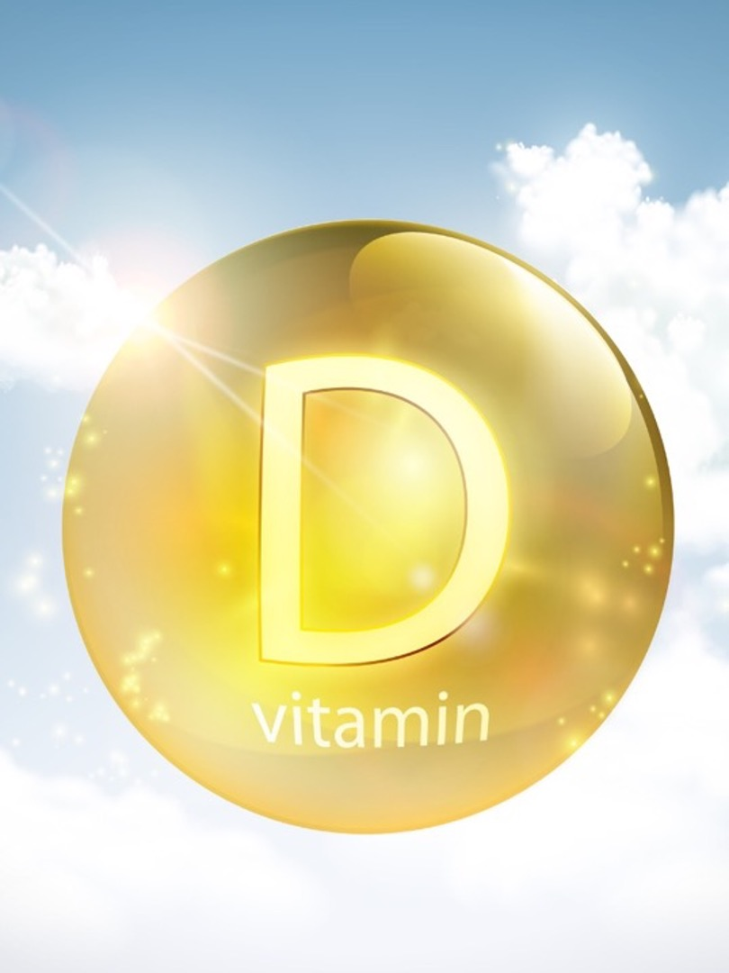
Vitamin D
Vitamin D deficiency can have a negative impact on immune health
Moderate to strong evidence that adequate levels of vitamin D supports the immune health of athletes
Decreased inflammatory cytokines, preserved epithelial function, increased antimicrobial peptides
Notes:
A vitamin D deficiency can have a negative impact on immune health
Little data exists regarding the novel coronavirus since it is new however moderate to strong evidence exists that adequate levels of vitamin D supports the immune health of athletes
Decreases inflammatory cytokines and preserved epithelial function and increases in antimicrobial peptides

Slide 22
Vitamin D Supplementation
Vitamin D3 supplement 87% more effective than prescription vitamin D2
Food is a generally a poor source but better absorbed in a meal with moderate fat
No adverse effects of vitamin D supplementation reported for daily doses <10,000 IU/d
Mega doses (70,000 IU/week) have been found to increase status in athletes, but inhibit activity of the active form
Consider 10,000 IU/day for the first week then 5000 IU/day to maintain blood level between 40-60 ng/ml
Notes:
Close paper (Owens is lead author): https://pubmed.ncbi.nlm.nih.gov/27741217/?from_term=close+vitamin+d+dose&from_pos=3
Vitamin D3 (supplement) 87% more effective than prescription vitamin D2
Food is a generally a poor source
The Institute of Medicine noted that no adverse effects of vitamin D supplementation had been reported for daily doses <10,000 IU/d
Consider 10,000 IU/day for the first week and then 5000 IU/day to maintain blood level between 40-60 ng/ml

Slide 23
Vitamin D Status of Athletes
Many would require supplementation to reach
40-60 ng/ml
Larson-Meyer, E. Sports Science Exchange. 2015;28(148):1-6
Graph used with permission from author

Slide 24
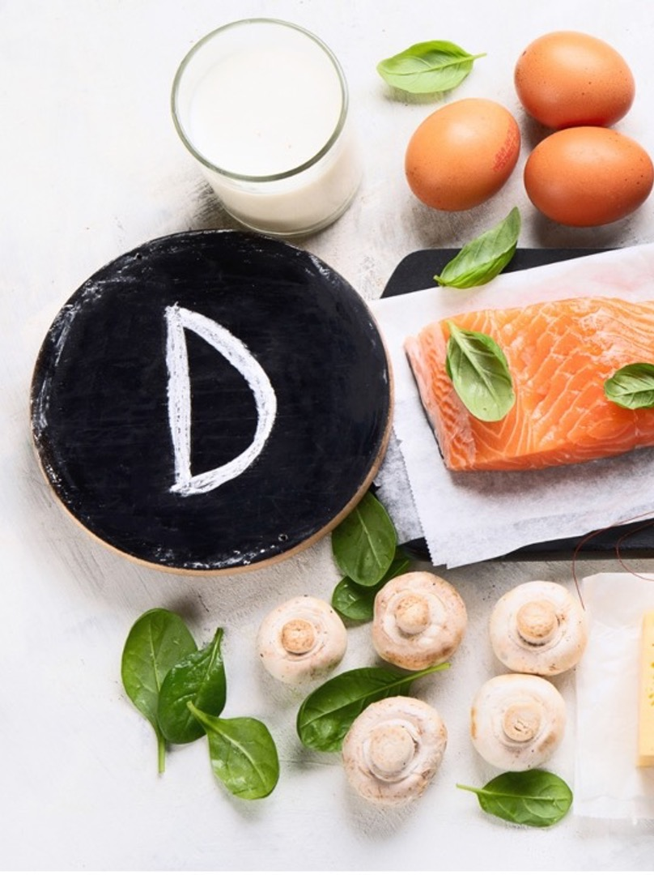
Food Sources of Vitamin D
Sockeye salmon (canned)
3 oz
716 IU
Rainbow Trout, farmed
3 oz
648 IU
Pink Salmon, canned
3 oz
492 IU
Sockeye salmon (cooked)
3 oz
444 IU
Portobello Mushrooms (exposed to UV light, grilled)
1/2 c
316 IU
Tuna (light, in oil)
3 oz
228 IU
Whole Milk
8 oz
128 IU
Tilapia
3 oz
124 IU
2%, 1%, Nonfat Milk
8 oz
116 IU

Slide 25
Iron
Beef
Lamb
Pork
Goat
Fortified cereals
Oysters
White Beans
MINERALS
Important for Immune Function
Zinc
Oysters
Baked beans
Beef
Chickpeas
Fortified cereals

Slide 26
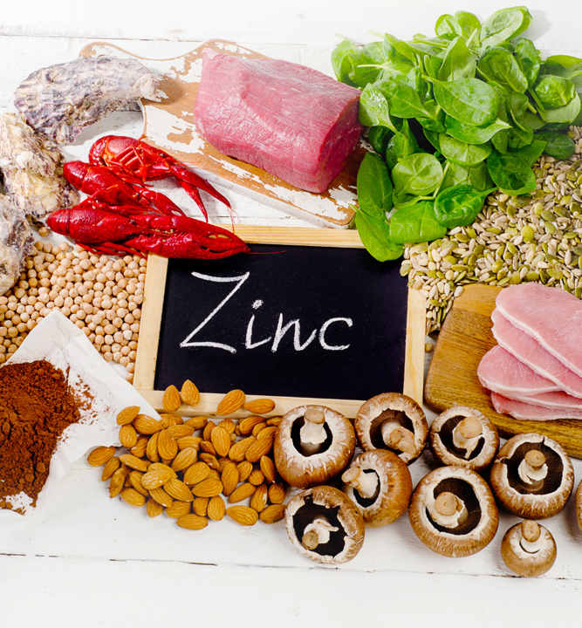
A Note on Zinc…
No Scientific Support
To prevent URI
Regular high dose zinc supplementation should be avoided
Strong Scientific Support
To treat URI
Zinc lozenges (75 mg elemental zinc/day) may reduce the duration of an URI by 3 days when taken within the first 24 hours of symptoms
Optimal composition of zinc lozenges is yet to be determined
Walsh NP. Sports Med. 2019;49(2):S153–S168
Notes:
Zinc is the second most abundant divalent cation in the human body
Critical for immune health, protein synthesis, DNA and RNA synthesis
Vegans, those with eating disorders, are at risk for zinc deficiency given limiting natural food sources and calorie restriction
Anti-oxidant and anti-inflammatory functions
Zinc deficiency is associated with immune system impairment
The use of zinc lozenges (75 mg elemental zinc/day) may reduce the duration of an upper respiratory illness by 3 days when taken within the first 24 hours of symptoms
The optimal composition of zinc lozenges is yet to be determined

Slide 27
OMEGA-3 FATTY ACIDS

Slide 28
Direct Immune Support from
Omega-3 Fatty Acids
Evidence for a direct role on immune function is not strong
May play a role in the membrane integrity of lymphocytes
May help maintain integrity of the intestinal barrier, rather than direct effect on immune response
Athletes do not consume adequate amounts of omega 3
Walsh NP. Sports Med. 2019;49(2):S153–S168
Constantini L ,Molinari R, Farinon B, et. al. International Journal of Molecular Science. 2017;18:2645-2663

Slide 29
LIFESTYLE CONSIDERATIONS
Sleep
Alcohol

Slide 30
Sleep & Immune Function
Cross talk between the immune system and sleep patterning
Fever, sickness and the mediators involved can alter patterns of sleep
Athletes who are ill report an increase in sleepiness and fatigue that may be caused by inflammation. Restoration of energy in part is driven by a decrease in inflammation
Conversely, sleep deprivation has been shown in most studies, but not all, to have a negative impact on immune health
Sleep deprivation can reduce the effectiveness of vaccines indicating some suppression of the immune response
Notes:
There is cross talk between the immune system and sleep patterning
Fever and sickness and the mediators involved can alter patterns of sleep
Athletes who are ill report an increase in sleepiness and fatigue that may be caused by inflammation. Restoration of energy in part is driven by a decrease in inflammation
Conversely, sleep deprivation has been shown in most studies, but not all, to have a negative impact on immune health
This finding is highlighted by the research that sleep deprivation can reduce the effectiveness of vaccines indicating some suppression of the immune response

Slide 31
Consequences of Short Sleep
and Solutions
Disruptions in immune function
Short sleep (< 7 hours) reduces natural killer cells by 30%
Increasing sleep duration to 8-10 hours restores white blood cell levels
Napping 30 minutes after sleep deprivation can also restore white blood cell levels
Salivary cortisol, a marker of stress, is also reduced after a nap
Notes:
Disruptions in immune function
Short sleep (< 7 hours) reduces natural killer cells by 30%
Increasing sleep duration to 8-10 hours restores white blood cell levels
Napping 30 minutes after sleep deprivation can also restore white blood cell levels
Salivary cortisol, a marker of stress, is also reduced after a nap

Slide 32
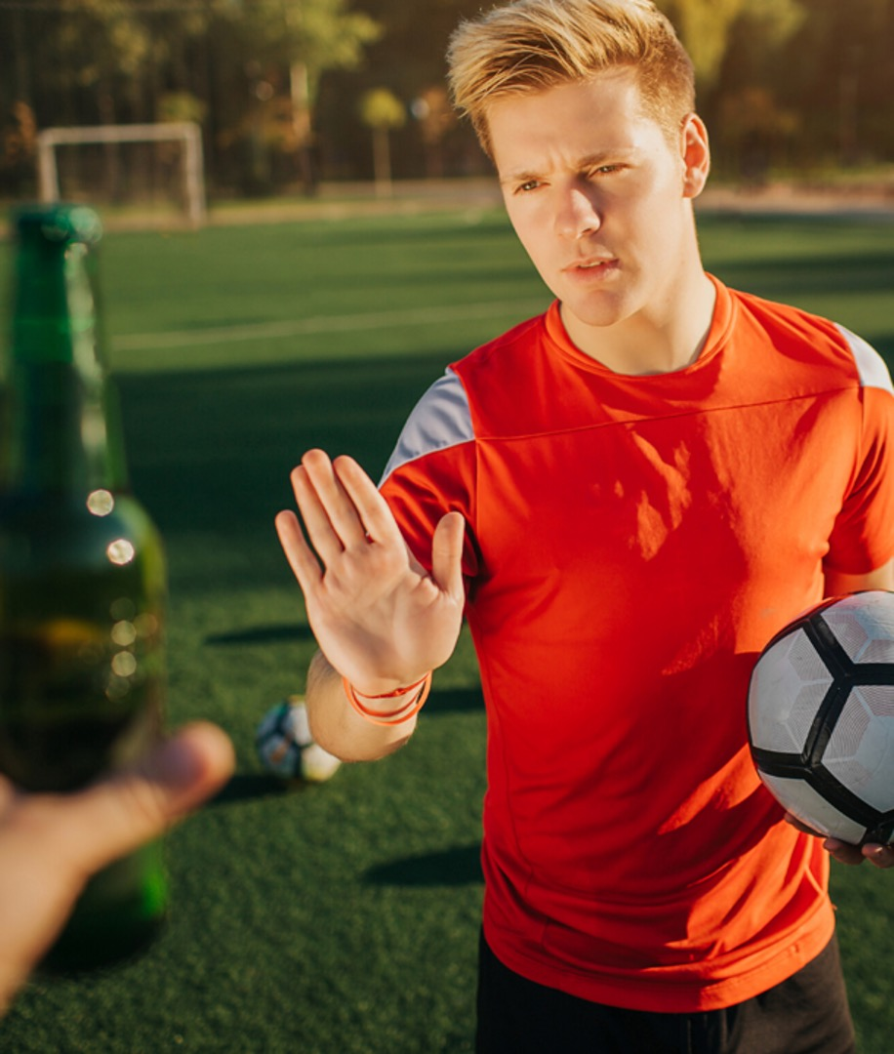
Alcohol & Immune Function
Studies of college student athletes consistently reveal that students involved in sports not only drink alcohol more often than non athletes, they are more likely to drink to excess.
Alcohol alters the normal and desirable response of the immune system to infection via altering white blood cell function
Increased susceptibility to illness and infection
Decrease in anabolic hormones may alter protein synthesis, post-exercise recovery and healing
Notes:
Studies of college student athletes consistently reveal that students involved in sports not only drink alcohol more often than non athletes, they are more likely to drink to excess.
Alcohol alters the normal and desirable response of the immune system to infection via altering white blood cell function
Increased susceptibility to illness and infection is the consequence
Decrease in anabolic hormones may alter protein synthesis and healing

Slide 33
PRACTICAL RECOMMENDATIONS REGARDING FOOD AND IMMUNE HEALTH

Slide 34
Always practice handwashing and infection control
A variety of foods is needed to increase nutrient diversity
1/4 of the plate should contain whole grains and/or complex carbohydrates such as potatoes, sweet potatoes, brown rice, whole wheat or higher fiber pasta
1/2 of the plate should contain a wide variety of fruits and vegetables.
Fiber and prebiotics for gut and immune health.
Polyphenols and colors to reduce inflammation and promote good health
1/3 to 1/4 of the plate should be a lean protein to include eggs, fish, chicken, beef, tofu, tempeh or beans

Slide 35
Nutrients for Immune Health: Summary
Nutrient | Amount needed | Best food sources | Mode of action
CHO | 40-60% of total calories 30-60 g per hour during sport | Whole grain, fruit, cereals, oatmeal, yogurt milk During sport- sport drinks- gels | Reduces stress hormones, supports gut microbiome
Protein | 0.54-0.9 grams per/lb | Lean meat, dairy, whey protein, beans, peas, nuts | Supports white blood cell formation
Vitamin D | 2000 IU per day | Sunlight, salmon, trout, mushrooms, fortified cereals | Gene expression, upregulation of B and T lymphocytes
Vitamin C | 200 mg for tissue saturation 1 gram + during illness | Oranges, peppers, broccoli, | Antioxidant, high concentration in WBC, scavenger of reactive oxygen species
Zinc | 8-11 mg DRI- 75 mg elemental zinc during infection within first 24 hours | Oysters, red meat, breakfast cereal | Anti-oxidant, protein synthesis, DNA,RNA synthesis
Probiotics | Daily intake- supplemental during season | Yogurt, kimchee, refrigerated pickles, sauerkraut, supplements | Preservation of gut integrity, blocking pathogens
Omega 3 | 500 mg EPA/DHA minimum up to 2 grams | Cold water fish, nuts, chia, | Primarily anti-inflammatory

Slide 36
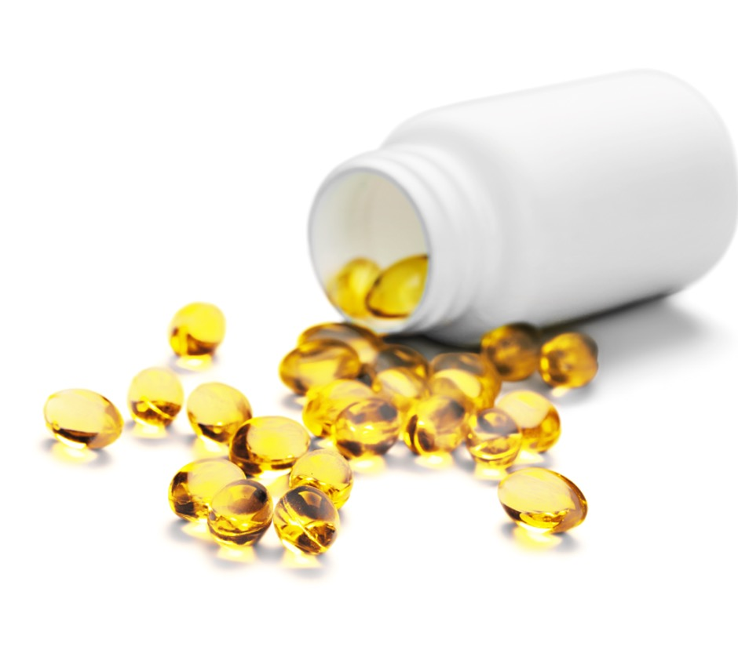
Supplement Recommendations
Vitamin C
Needed during active infection at 1 gram/d
Tissue saturation occurs at ~ 200 mg/d and can be done with food
Vitamin D
Ideally blood values would be known, should be between 40-60 ng/ml.
If the athlete is not supplementing,
consider 10,000 IU for first week, followed by maintenance of 5000 IU/day.
Omega-3 Fatty Acids
2 grams of EPA +DHA per day

Slide 37
Link to Summary Video

