Slide 1
LOW CARBOHYDRATE DIETS FOR ATHLETES

Slide 2
Carbohydrate is the predominant fuel source for most exercise But…

Slide 3
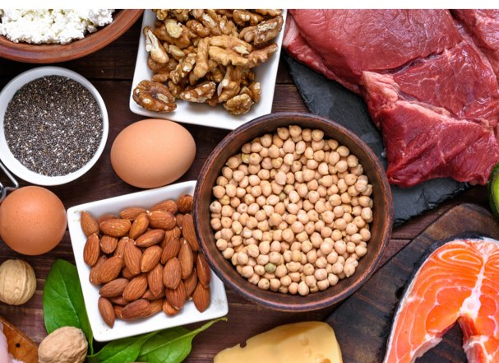
Low Carb, Keto and Paelo diet plans have become popular amongst the general population It is often confusing for athletes to understand the difference between meeting their energy demands and messages from the popular media

Slide 4
In general, team-sport athletes should eat a carbohydrate-rich diet during their competitive season to maintain glycogen stores and support performance. If an athlete is interested in one of the low-carb eating styles, the appropriate time is during the off-season, or when injured. The ideal scenario is to work with a sports dietitian to personalize carbohydrate intake through a training cycle to adequately meet energy demands and goals.

Slide 5
If you’re an endurance athlete looking to improve performance, why might you consider trying a low carbohydrate diet?

Slide 6
Endurance athletes may benefit from periods of lower carbohydrate intake during their training, still focusing on higher carbohydrate intakes to support performance This concept is often referred to as “train low” Altering amounts of carbohydrate intake should be individualized based on the training cycle and goals
Burke LM. Sports Med. 2015;45(1):S33-49

Slide 7
Traditional Approach: CHO & Endurance Training
Promotion of high CHO availability for performance and recovery
Before, during, after training sessions
Ensure adequate muscle glycogen storage
Amount based on activity, intensity, & duration
Associated with “carbohydrate loading”, or a period of greater carbohydrate intake leading up to a competition
Bartlett, Hawley, Morton. EJSP. 2015;15(1):3-12

Slide 8
Metabolic Adaptations to Endurance Training
Increased fat oxidation (lower RER)
Slower utilization of CHO substrate
Less lactate production
Increased muscle glycogen storage
Higher maximal rates of CHO oxidation
How can you manipulate nutrients to further enhance endurance performance?
‘Spare” CHO substrates
Further enhance rates of fat oxidation
Leckey & Hawley. Sport Science Exchange. 2018;29(184):1-6

Slide 9
Is there a way to alter the availability and utilization of fuels to improve endurance performance?
Fat Stores
Carbohydrate Stores
>30,000 kcal
(even in a very lean athlete)
~2 ,000 kcal
Leckey & Hawley. Sport Science Exchange. 2018;29(184):1-6

Slide 10
What Do You Think? Could training on a low carbohydrate diet promote adaptations to improve fat utilization? “Train low, compete high”: By providing carbohydrate for competition, can the combination of improved fat oxidation and carbohydrate substrate for competition improve endurance performance? What could be some of the drawbacks of this approach?

Slide 11
"Train Low”
Area of research was developed by Dr. Louise Burke at the Australian Institute of Sport
In collaboration with Dr. John Hawley and several others, the concept has been studied over the past couple of decades
The strategy of training with low carbohydrate availability and providing carbohydrate for competition does not improve performance, in fact in many cases performance is impaired.
Burke, LM. Sports Med. 2015;45(1):S33-49

Slide 12
"Train Low”
However, this area of research along with trial by practitioners working with athletes, has evolved to incorporation of periods of low carbohydrate availability during training.
Sports nutrition guidelines are not “one size fits all”, including the use of a train low strategy!
Hear Dr. Burke speak
Burke, LM. Sports Med. 2015;45(1):S33-49

Slide 13
Rationale
Training in conditions of reduced CHO availability does promote training-induced adaptations in the skeletal muscle:
Increased rates of fat oxidation
Enhanced activation of cell signaling pathways
Increased mitochondrial enzyme activities
Increased mitochondrial content
Bartlett, Hawley, Morton. EJSP. 2015;15(1):3-12

Slide 14
Limitations
Inability to maintain the desired training intensity
Lower overall training impulse (volume x intensity)
Increased susceptibility to illness
Increased muscle protein breakdown
Loss of skeletal mass
Exercising without regular exogenous CHO provision impairs ability to oxidize exogenous CHO
This means carbohydrate consumed during competition will not be effectively used and performance is likely impaired
Bartlett, Hawley, Morton. EJSP. 2015;15(1):3-12

Slide 15
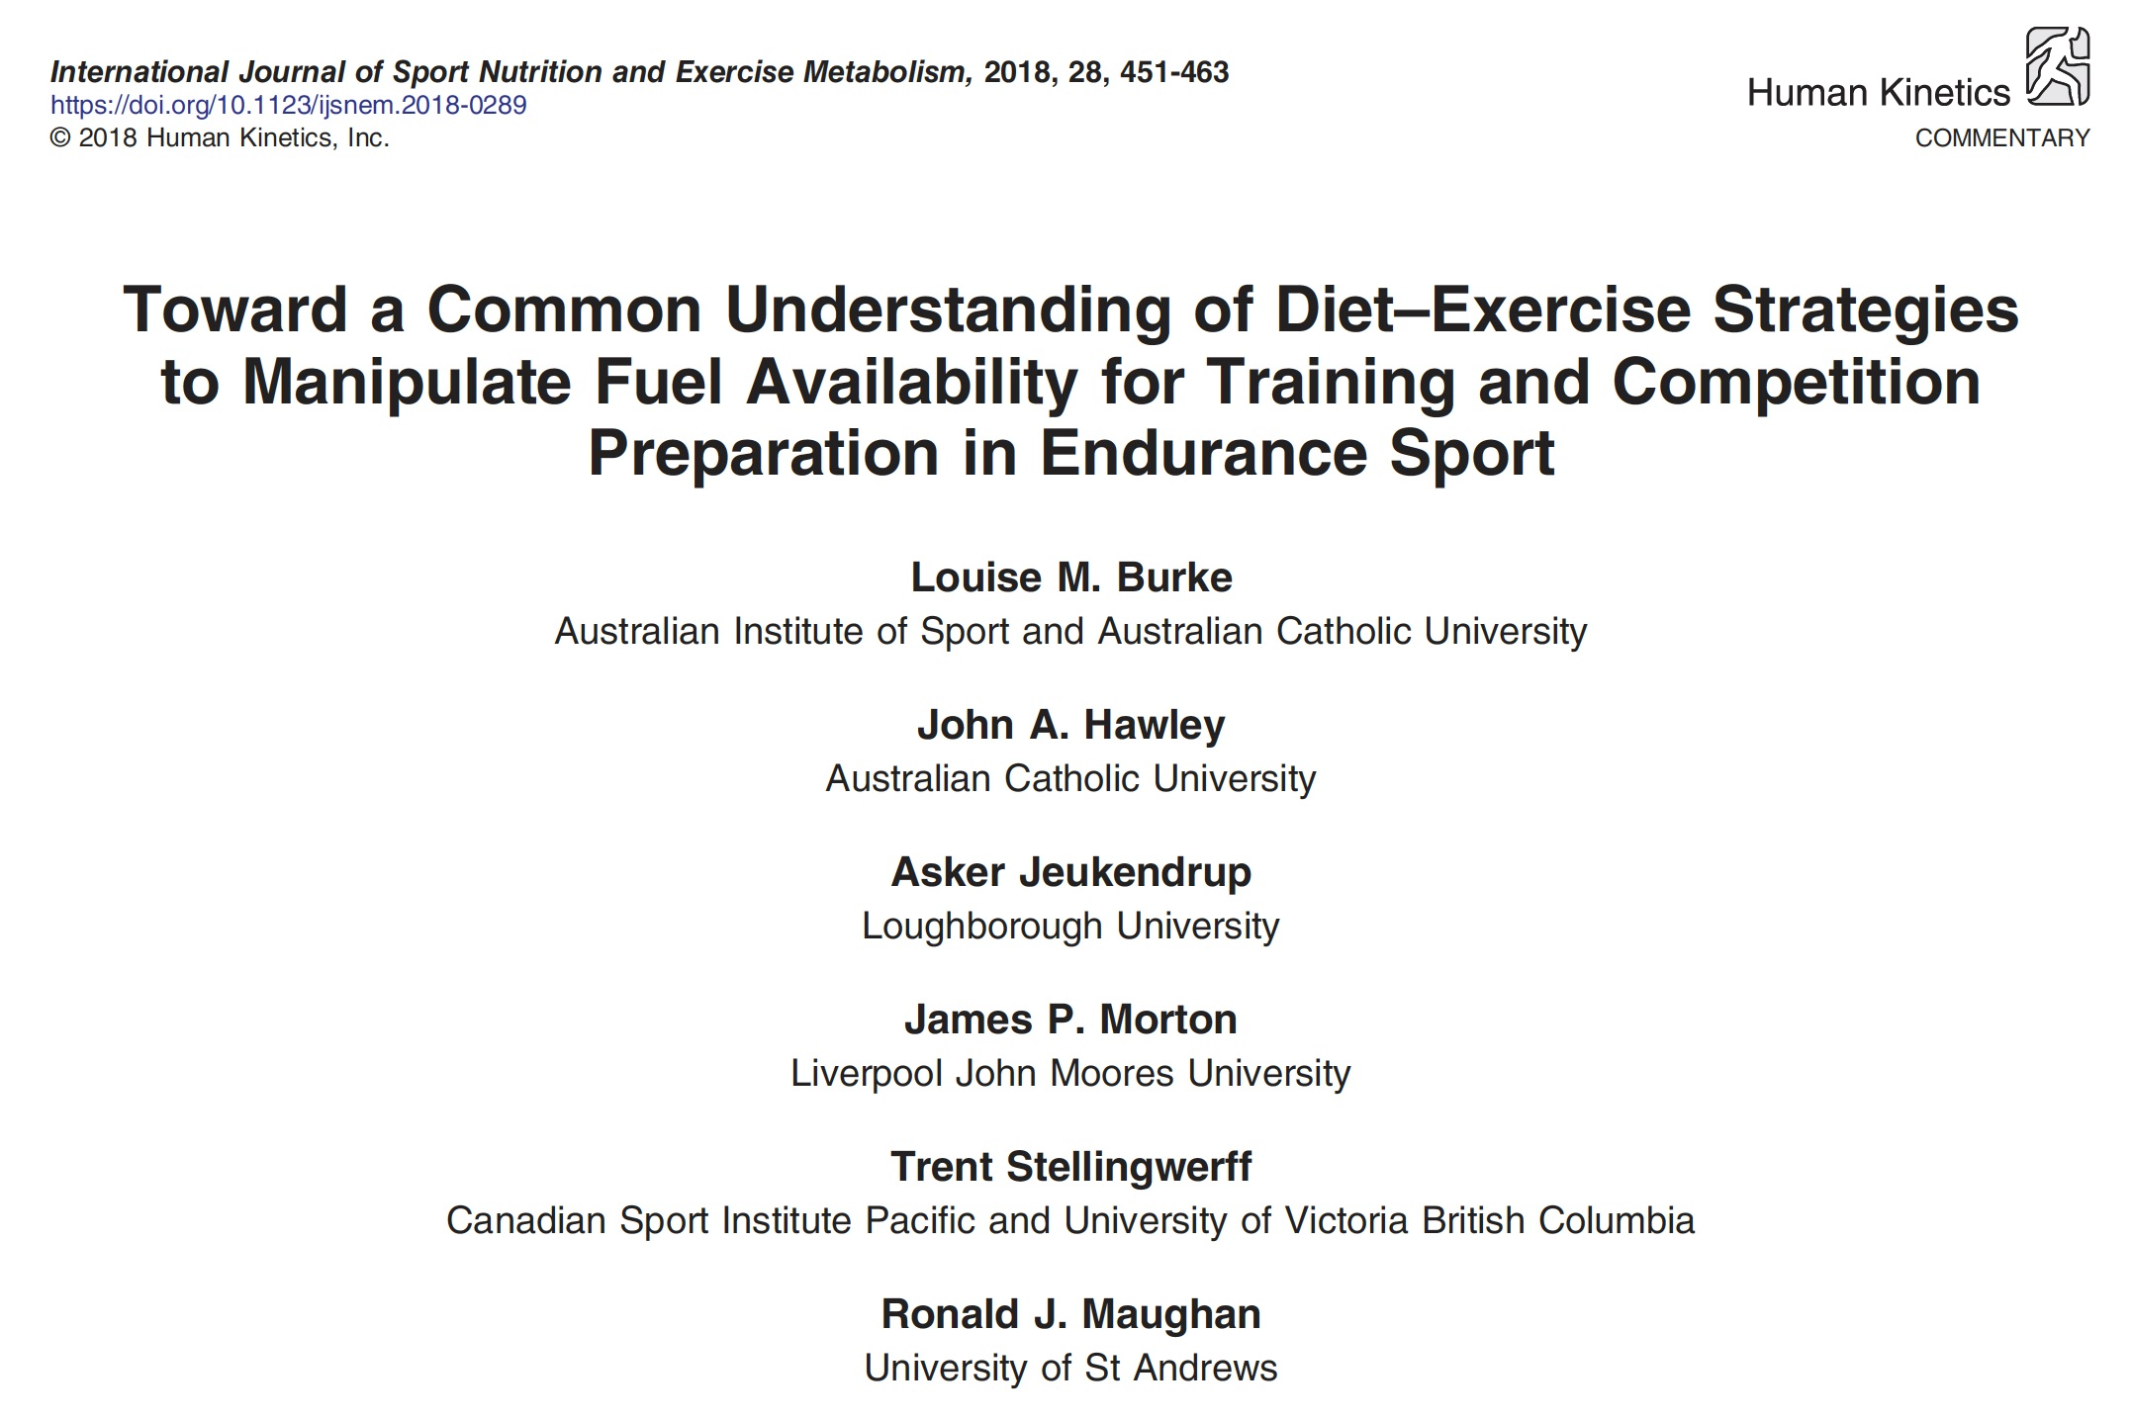
“From the breakthrough studies of dietary carbohydrate and exercise capacity in the 1960s through to the more recent studies of cellular signaling and the adaptive response to exercise in muscle, it has become apparent that manipulations of dietary fat and carbohydrate within training phases, or in the immediate preparation for competition, can profoundly alter the availability and utilization of these major fuels and, subsequently, the performance of endurance sport (events >30min up to ~24 hr).”

Slide 16
What does it mean to alter carbohydrate availability?
SSE #134
Hawley J. Sport Science Exchange. 2014;27(134):1-7

Slide 17
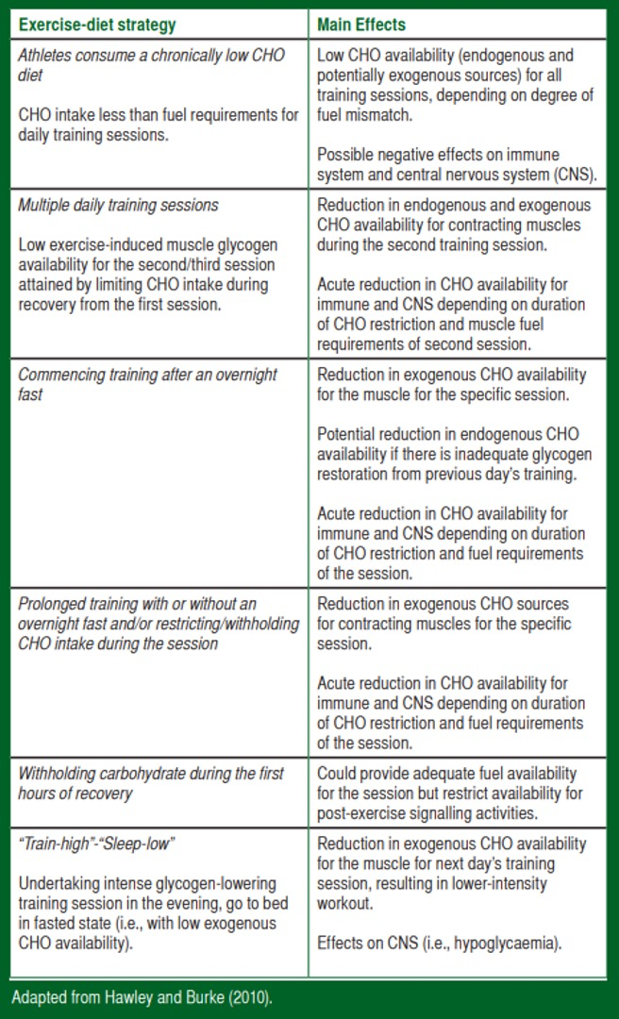
SSE #134
Hawley J. Sport Science Exchange. 2014;27(134):1-7

Slide 18
Practical Applications
Train in the fasted state or twice per day
Fasted = 6-10 h after meal
2nd session performed with
Reduced glycogen stores &/or
Restricting CHO intake in the recovery period post exercise
Incorporate when training duration & intensity are not overly compromised
Do not undertake during uncustomary training loads
Supramaximal, prolonged, or intense sessions
To offset reduced training intensity athletes may:
Ingest caffeine
CHO rinse
Bartlett, Hawley, Morton. EJSP. 2015;15(1):3-12

Slide 19
Practical Applications
Ingest protein (20-25g) before, during, or immediately after exercise
Attenuate muscle protein breakdown & promote synthesis
AAs do not down regulate beneficial adaptations
Undertaken along deliberate sessions of training high CHO
Competition fueling schedule
Simulate the demands of competition
Bartlett, Hawley, Morton. EJSP. 2015;15(1):3-12

Slide 20
Remaining Questions
How can you maintain exercise intensity?
Should sessions be focused on achieving a set training load or completing as much work as possible?
Who benefits most? Elite? Sub-elite? Recreationally active?
Is there a glycogen threshold that needs to be met to activate?
Does this strategy result in enhanced exercise performance?
Bartlett, Hawley, Morton. EJSP. 2015;15(1):3-12

Slide 21
A Method of Low Carbohydrate Availability: High Fat Diets

Slide 22
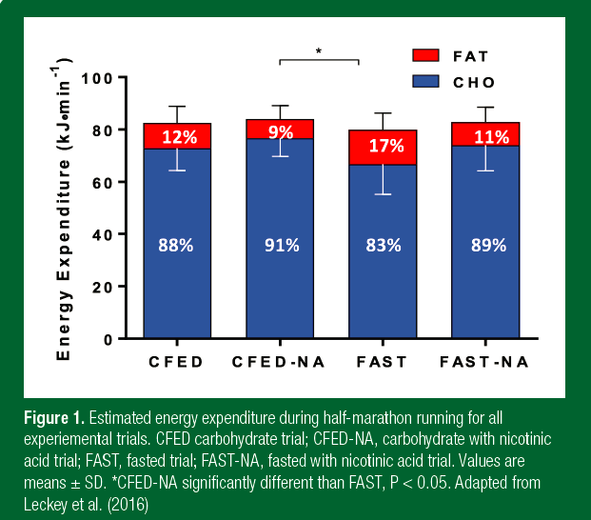
Remember
Prolonged endurance exercise (> 90 min) relies on oxidative metabolism of carbohydrate and fat, requiring high rates of carbohydrate oxidation.
SSE #184
Leckey & Hawley. Sport Science Exchange. 2018;29(184):1-6

Slide 23
Can we maximize the contribution of fat to fuel muscular work via the ingestion of a high fat diet?
Increase utilization of fat stores
“Spare” limited CHO

Slide 24
High Fat Diet (HFD) Examples
Example 1:
65% of energy intake from fat (~4 g/kg)
<20% energy from CHO (~2.5 g/kg)
Example 2:
Chronic ketogenic diet consists of
<20 g/d CHO
80% energy intake from fat
≈4.5-5 g/kg
HFD studies have demonstrated that transport, uptake, and oxidation of fat-based fuels can be increased further than training adaptations alone.
SSE #184
Leckey & Hawley. Sport Science Exchange. 2018;29(184):1-6

Slide 25
Ketogenic Diets & Exercise Performance
29
World-Class Race Walkers, given one of the following diets during 3 weeks of intensified training:
HCHO
High Carb
8.6 g/d CHO
2.1 g/d PRO
1.2 g/d Fat
Periodized Diet
Timing of macronutrient content was altered around training to ensure specific sessions were performed in a low-CHO state
LCHF
Low Carb/High Fat
< 5.0 g/d CHO
2.2 g/d PRO
4.7 g/d Fat
Measured before and after the intervention:
Graded exercise test to measure walking economy
25 km standardized walk (i.e., 20 km race pace) to incorporate both laboratory and field testing to assess changes to substrate utilization
10 km International Association of Athletics Federation sanctioned race to measure performance
Burke, L. et al. (2017) J. Physiol. 595:2785-2807.
Leckey & Hawley. Sport Science Exchange. 2018;29(184):1-6

Slide 26
Ketogenic Diets & Exercise Performance
OUTCOMES
Graded Exercise Test
LCHF: RER reduced, greater O₂ cost during all 4 stages
25 km Standardized Walk
LCHF: increased whole-body rates of fat oxidation from ~0.6 g/min to ~1.6 g/min when walking at 80% V̇O₂peak, with the latter being the highest rates of fat oxidation ever to be reported in the literature!
10 km Race Walk Time
Only the HCHO and PCHO conditions improved their 10 km race-walk time, with no improvement measured in the LCHF condition.
This lack of performance improvement measured in the LCHF condition was associated in part with the greater O₂ consumption required to sustain the same speed as prior to the intervention
Burke, L. et al. (2017) J. Physiol. 595:2785-2807.
Leckey & Hawley. Sport Science Exchange. 2018;29(184):1-6

Slide 27
Carbohydrate Restoration
Goal: maximize the capacity for fat utilization while also optimizing glycogen stores.
HFD 5-6 days w/ training (60-70% energy intake from fat)
Followed by:
24-36 h of high CHO intake (70-80% energy intake from CHO)
Several different research studies have shown that this strategy:
Increases fat oxidation
Impairs carbohydrate metabolism
Impairs exercise economy
Does not improve performance
Leckey & Hawley. Sport Science Exchange. 2018;29(184):1-6

Slide 28
HFD Summary
Longer periods of HFD consumption followed by quick carbohydrate restoration do not improve performance
BUT, short periods of HFD consumption do promote metabolic adaptations for fat metabolism
Given the current research, athletes should periodize their CHO intake based on the goal, intensity and duration of a particular training session in order to maximize skeletal muscle adaptations
Leckey & Hawley. Sport Science Exchange. 2018;29(184):1-6

Slide 29
Guidelines
No longer recommend high CHO for all training sessions and competitions
Focus on matching CHO availability to the energy demands of training, considering duration & intensity of exercise
CHO intake should be individualized to raining and competition requirements
Athletes may train with low endogenous or exogenous CHO availability or delay the replenishment of CHO post training to promote skeletal muscle adaptation & improve performance
Leckey & Hawley. Sport Science Exchange. 2018;29(184):1-6

Slide 30
KETONE SUPPLEMENTATION

Slide 31
While adaptations to a high fat diet for short-term or chronic periods has been well investigated, the effects of the resulting low carbohydrate intake have been researched less.
Ketone bodies can be used as an alternative fuel by the skeletal muscle and brain
Production of ketone bodies is stimulated after periods of low carbohydrate, high fat intake

Slide 32
Ketones
Ketone bodies:
β-hydroxybutyrate (βHB)
Acetoacetate (AcAC)
Acetone (mostly lost through breath and urine)
βHB and AcAC
Used by heart, brain, and skeletal muscle
Can be measured in the circulation
Circulating ketones are usually low, increase with:
Overnight fasting
Fasted exercise
Prolonged fasting/ starvation (5d)
Ketogenic diet
Leckey & Hawley. Sport Science Exchange. 2018;29(184):1-6

Slide 33
Will supplementing with ketones improve exercise performance?
Hot topic with endurance athletes!

Slide 34
Ketone Supplementation?
In research conducted in a fed state to simulate real world race-day conditions:
Ketone monoester supplementation may improve cycling time trial performance
Ketone diester supplementation may impair time trial performance and lead to gut discomfort
More research is needed to fully understand the potential benefit of ketone supplementation on performance and how tolerable the supplements are for athletes on race day
Leckey & Hawley. Sport Science Exchange. 2018;29(184):1-6

Slide 35
Summary
Prolonged periods of training shifts substrate utilization
Skeletal muscle still relies on CHO based fuels (≥65% VO₂ max)
Prolonged HFDs:
No improvement in exercise capacity or performance
Impaired muscle glycogen utilization
Ketone drinks (exogenous ketone esters)
Increase circulating ketones
Reduce the reliance on CHO based fuels during submaximal exercise
Further research required, some promise with ketone monoesters
Periodization of CHO intake should be based on goal, intensity, & duration to maximize skeletal muscle adaptations
CHO should be ingested before and during competition
Leckey & Hawley. Sport Science Exchange. 2018;29(184):1-6

