Slide 1
IMPLEMENTING SPORTS NUTRITION SCIENCE

Slide 2
Where to Start? Science-Based Recommendations
Research on the impact of nutrition on athletic performance has grown to the point of offering solid, evidence-based recommendations, particularly for macronutrient intake and hydration.
BUT these recommendations are just that – recommendations, providing a starting point for your work with athletes
Implementing sports nutrition science is also an art. You must listen to your athlete, understand their personal beliefs related to nutrition, pay attention to how they are feeling and responding to particular foods, understand their rituals, know their likes and dislikes, monitor their changes in performance and injury, etc.
Reminder: Examples of Recommendations from the Scientific Literature
30-60 g/h carbohydrate
0.25-0.3 g/kg protein post-exercise
Hydrate to maintain body weight losses of less than 2%

Slide 3
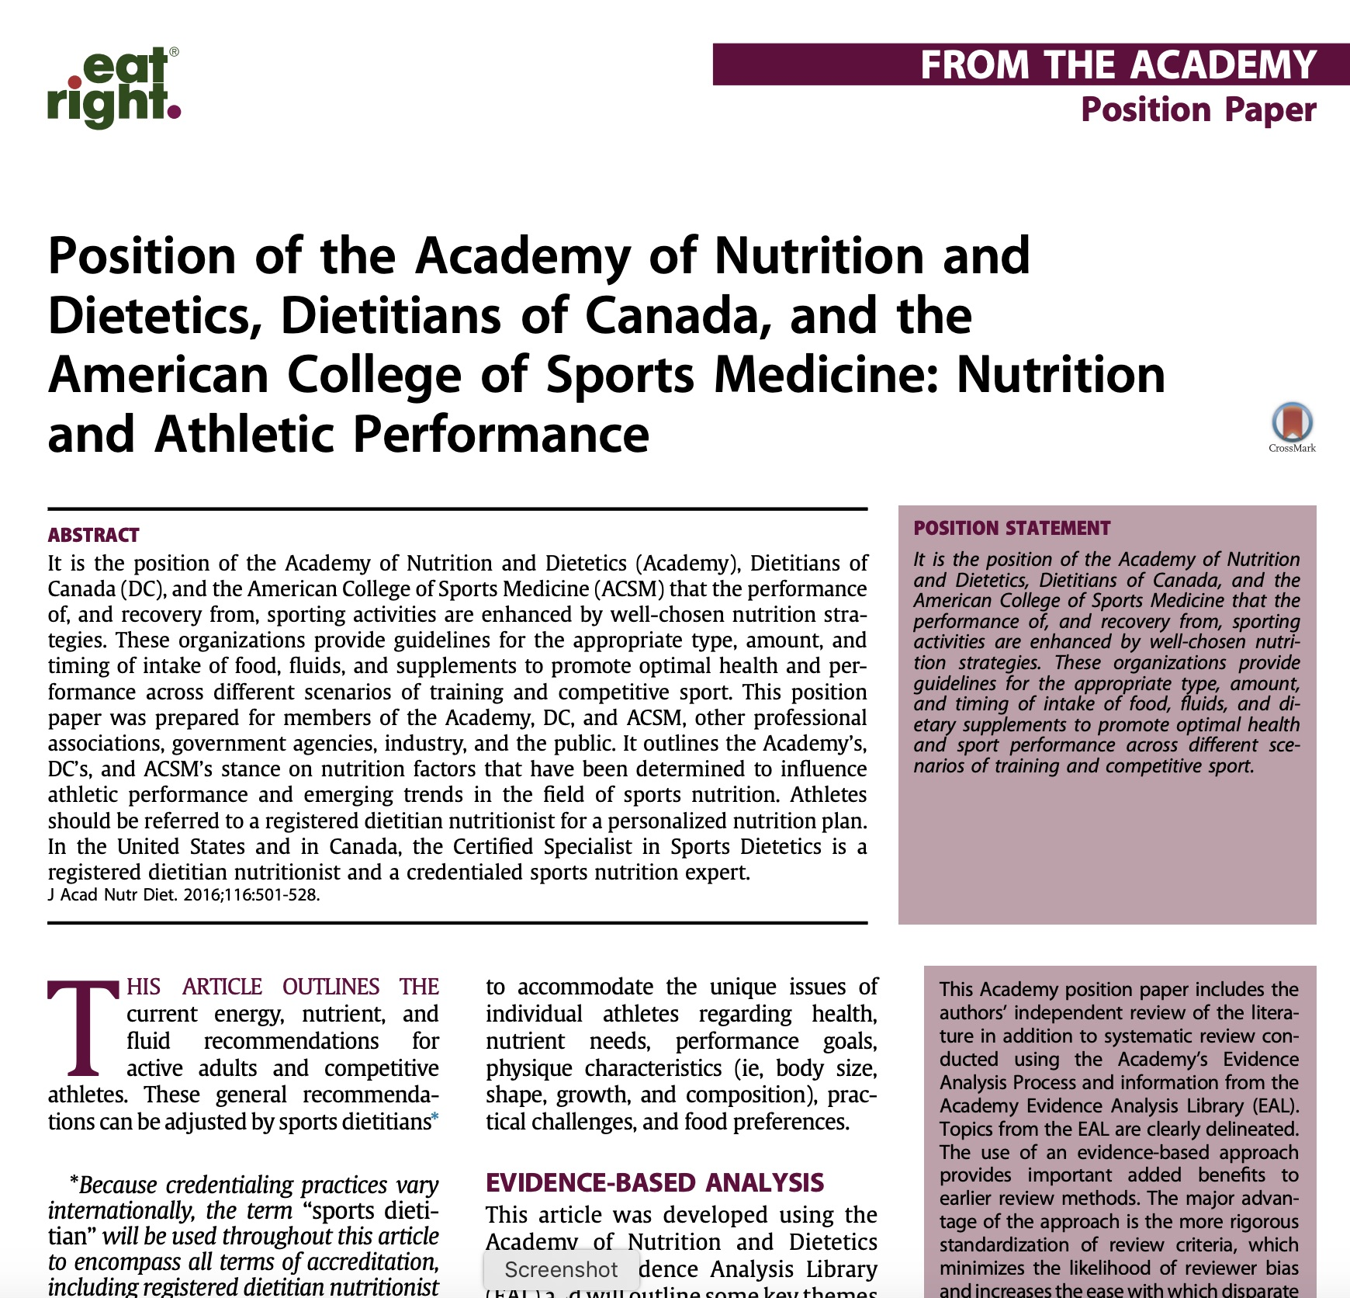
Professional groups, in this case the Academy of Nutrition and Dietetics, Dietitians of Canada, and American College of Sports Medicine, publish reviews with a summary of the literature, and grade evidence for use by their practitioner membership.
J Acad Nutr Diet. 2016;116:501-528

Slide 4
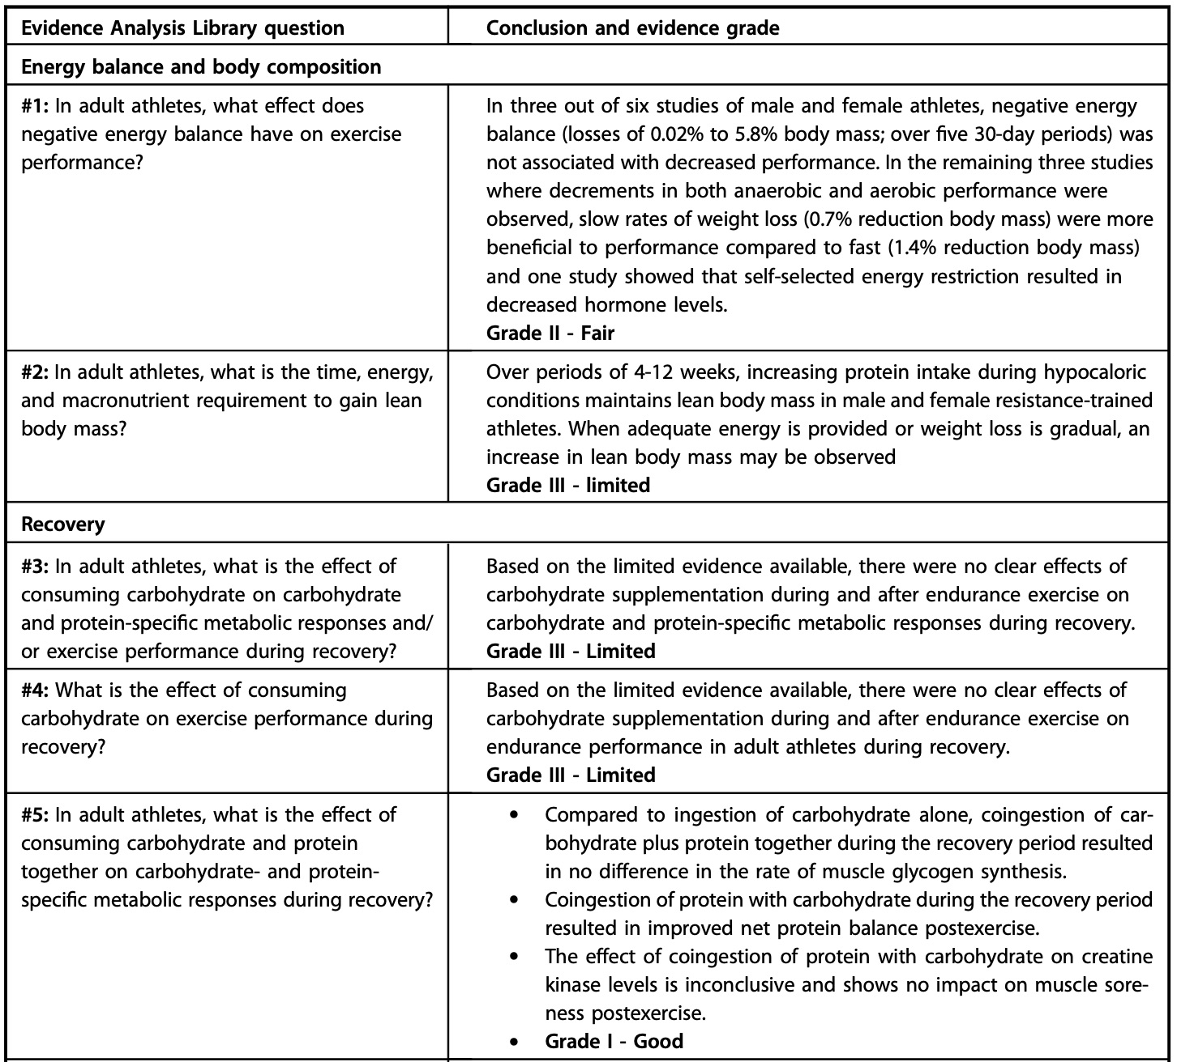
Example from the Academy of Nutrition and Dietetics Evidence Analysis Library related to sports nutrition
J Acad Nutr Diet. 2016;116:501-528

Slide 5
Using the Recommendations
Scenario 1
You are a new sports dietitian working with a basketball team. One of the star players with high minutes currently says she feels great without any fuel during a game. You want her to take in 50-60 g of carbohydrate, explaining that this is the amount shown in the scientific literature to improve performance. She is not interested. What do you do?

Slide 6
Using the Recommendations
Scenario 2
You are working with a football player to gain muscle in the off-season. He is not seeing the results he wants from his lifting program, and you realize he is not taking in enough protein, particularly after training sessions. You tell him he should increase his recovery protein to 0.25 g/kg, and he agrees. You then provide him with whey protein shakes, since the research shows this is the most effective protein source for stimulating muscle protein synthesis. He tells you he can’t have these shakes because he’s vegan. What do you to do help him achieve his goals?

Slide 7
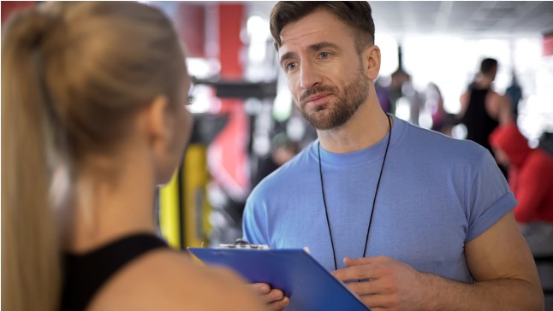
When working with an athlete who is interested in making a change to their nutrition habits, you’ll use a process of trial and error, starting with the published guidelines, to find the best plan to meet their needs. Set the ultimate goal but start small and work up to that goal in small achievable steps.

Slide 8
Sometimes you may think an athlete should make a change to their nutrition habits, but it’s difficult to convince them to follow the current guidelines. Don’t get frustrated. Plant the seed in their head and tell them what they need to hear. If they are still not interested, tell them that you will be available when they do want to commit to make the change.

Slide 9
Sometimes your athletes will want to use new supplements or foods/ingredients, some making grandiose claims. If you don’t have published guidelines, a meta-analysis, or information in the Evidence Analysis Library, you will need to evaluate the current state of the science.
As a sports dietitian, you will need to navigate each of these scenarios!

Slide 10
Let’s be honest…
Following recommended sports nutrition guidelines based on published research is not always “cool” or exciting to an athlete.
Athletes are often more interested in unusual, unproven supplements or diet patterns followed by their peers or pro athletes.
Practitioner jobs in professional sports are few and sought after. There is often pressure to find something new and different.
Waiting until something is “proven” by science is often seen as too slow and won’t be “cutting edge” or provide a competitive advantage.
Some athletes are going to do what they want regardless of what you say. Keep in mind that you can’t control everything and that education and reiteration of your foundational nutrition principles will keep your message consistent.
Even though you think you may have the best nutrition plan for an athlete based on the recommendations that are backed by scientific evidence...a plan that an athlete does not follow is just as good as no plan at all.

Slide 11
How can a practitioner balance evidence-based practice with the desire to be “cutting edge”?

Slide 12
“Issues” with Translating Sports Nutrition Research
The subject population of a research study varies, so evaluating if an intervention will translate to elite athlete performance is often difficult
Elite athletes may not want to experiment on their bodies
Coaches may not allow research using their teams
“Recreationally active” individuals are more available on a college campus
Funding may be for target populations, such as older adults
Sample sizes, especially if elite athletes are tested, are often small.
Many interventions begin with endurance-type activity (running or biking) because it’s easier to control in the lab and has clear performance outcomes. The definition of “performance” varies among studies on team sports.

Slide 13
“Issues” with Translating Sports Nutrition Research
Research in the lab may not translate to the field of play, and field research can be difficult to control.
New ingredients may be studied in isolation, but in the real world consumed as part of a food matrix.
To feel confident in the effectiveness of a nutritional intervention, a body of research must be developed. Definitive answers do not come from one research study alone.
It takes time to build a body of literature, and athletes or practitioners looking for an “edge” don’t want to wait.

Slide 14
From Paper to Podium: Evaluation of the Translational Potential of Performance Nutrition Related Research
SSE #197
Graeme Close, Andreas Kasper and James Morton, researchers and practitioners at Liverpool John Moores University, developed a framework to critically evaluate performance nutrition-related research papers: the Paper to Podium Matrix
Close, G, Kasper, A and Morton, J. Sports Science Exchange. 2019;29(197):1-6

Slide 15
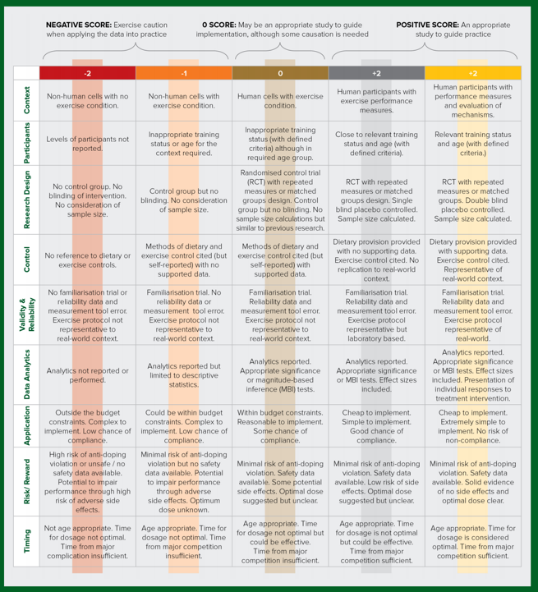
Paper to Podium Matrix
The first step in translating research to practice should be a critique of the translational potential of the existing scientific evidence
The matrix includes an evaluation and scoring of:
Context
Participants
Research Design
Control
Validity & Reliability
Data Analytics
Application
Risk/Reward
Timing
Close, G, Kasper, A and Morton, J. Sports Science Exchange. 2019;29(197):1-6

Slide 16
Example 1: Carbohydrate mouth rinse and caffeine improves high-intensity interval running capacity when carbohydrate restricted (Kasper et al. 2015)
Research Context (+1)
Dietary & Exercise Controls (+1)
Data Analytics (+1)
Human participants but no mechanisms tested
Caffeine was restricted for 24–48 h and protein provided prior to sleep low but could be considered limited application to real-world scenario given that true glycogen depletion training protocols are unlikely to be performed prior to bed
Analytics reported and individual responses plotted although effect sizes not reported
Research Participants (+1)
Recreationally active and appropriate age
Risk/Reward (+1)
Minimal risk of anti-doping violation and sufficient safety data available although optimal dose of CHO mouth rinse unknown
Research Design (+1)
Randomized, repeated measures double-blind study. Sample size commensurate with previous studies but no sample size calculations provided
Validity & Reliability (+1)
Familiarization trial cited and reference to reliability statistics. Exercise trial was a laboratory- based protocol consisting of exercise on a motorized treadmill
Timing of Intervention (+2)
Age-appropriate and time available for dosing is considered optimal to be effective and time from major competition is sufficient to warrant testing the new strategy.
Feasibility of Application (+1)
Cheap to implement and good chance of compliance
Total (+10)
An appropriate study to guide practice
Kasper, A. et al. Eur J Sport Sci. 2016;16(5):560-8. doi: 10.1080/17461391.2015.1041063
Close, G. et al. Sports Med. 2019; 49(Supp1):25-37. doi: 10.1007/s40279-018-1005-2

Slide 17
Example 2: N-Acetylcysteine’s attenuation of fatigue after repeated bouts of intermittent exercise: practical implications for tournament situations (Cobley et al. 2011)
Research Context (+1)
Dietary & Exercise Controls (-1)
Data Analytics (0)
Human participants but no mechanisms tested
Diet recorded and asked to be repeated but not formally assessed and no objective data
Analytics reported but lacked effect sizes. Lacking individual responses
Research Participants (+1)
Risk/Reward (-2)
Recreationally active and appropriate age with activity clearly defined
Validity & Reliability (-1)
Limited availability of batch- tested product and high risk of side effects that could limit performance. Optimal dosing unknown
Familiarization trials performed and described; however, no objective reliability data provided. Exercise trial was a laboratory-based protocol consisting of shuttle running
Research Design (+2)
Between-subjects pair-matched design. Sample size calculated and stated
Timing of Intervention (+2)
Age- appropriate and time available for dosing is considered optimal to be effective and time from major competition is sufficient to warrant testing the new strategy.
Feasibility of Application (0)
Total (+2)
May be an appropriate study to guide implementation, although some caution is needed
Cheap to implement but some chance of non-compliance with the loading regime
Cobley JN. et al. Int J Sports Nutr Exerc Metab. 2011;21(6):451-61. doi: 10.1123/ijsnem.21.6.451
Close, G. et al. Sports Med. 2019; 49(Supp1):25-37. doi: 10.1007/s40279-018-1005-2

Slide 18
Paper to Podium Matrix
The matrix is not exhaustive
But, use of the matrix may help practitioners evaluate a research paper, increasing their confidence in an intervention which may lead to a more enthusiastic athlete and increase the chance of effectiveness
Note: You need to find and read the entire research paper! Relying on an abstract or information found on social media is not an effective way to truly evaluate a research study.
Additional Resource: Please see the learning activity “Evaluation and Translation of Sports Nutrition Research” to practice using the matrix
Close, G, Kasper, A and Morton, J. Sports Science Exchange. 2019;29(197):1-6

Slide 19
You’ve evaluated the available research using the Paper to Podium matrix and feel confident in implementing this strategy.
Scenario: You are a new sports dietitian for a soccer team. From attending a conference, you’ve become interested in a new strategy and think it can help your team. The theory is strong, but there have only been a few published research studies.
What’s next?

Slide 20
Consider your athletes. Do any of your athletes have food sensitivities, specific beliefs, or any other issues that could hinder implementing this strategy? If so, can you alter the strategy to incorporate these individual athlete needs?
Check the regulations of your league to ensure all parts of the new strategy are permissible.
Develop a plan to implement the strategy. Be sure to consider:
Individual needs of each athlete. Is the strategy right for everyone?
Timing – begin to implement slowly and stepwise. Also plan plenty of time to adjust during practices well in advance of competition.
How to evaluate effectiveness
Cost and logistics
Develop a communication plan to the sport coaches, performance and sports medicine staff, and then the athletes. Be prepared for the staff or athletes to push back on the new ideas.

Slide 21
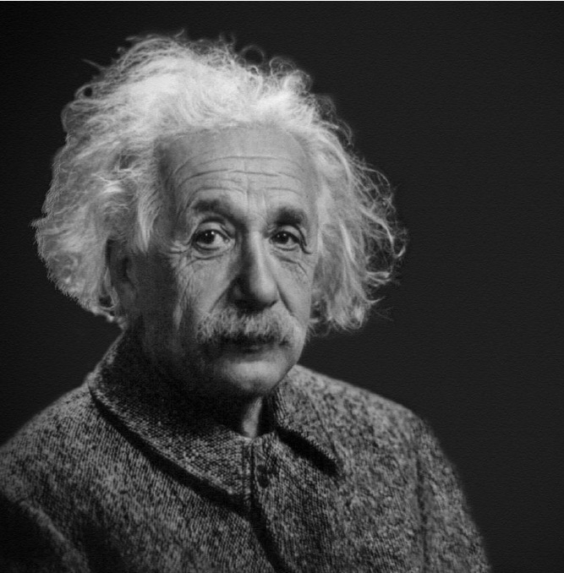
Communicating Sports Nutrition Science
“If you can’t explain it simply, you don’t understand it well enough.”
-Albert Einstein

Slide 22
Communicating Sports Nutrition Science
Keep your message to the athletes simple
Elementary is good most of the time; if you are presenting to a team, keep it short, concise, and visual
Assess their knowledge level and stay one step ahead of the athlete; if you are two steps ahead or more you will lose them
Let them know you feel confident in the science, but don’t overwhelm them with scientific details; eliminate scientific jargon like “protein synthesis” or “glycogenolysis” and replace with “muscle recovery” or “using your bodies fuel stores”

Slide 23
Communicating Sports Nutrition Science
Focus on how the plan can help support their performance or how it may improve upon their “weaknesses”
Take into account any hesitations the athletes may have when developing your communication plan
Be willing to teach your athletes the “why” behind your plan, not only the “what”. Some athletes will take better to learning your reasoning than others, but think about creative and simple ways to convey the science.
Be confident!

Slide 24
Communicating Sports Nutrition Science
Know your athletes, use a method to communicate that reaches them
Some ideas:
Text message vs email
Posters vs video boards
Do they engage with you on social media?
Do they respond better to one-on-one or group sessions?
If you’re presenting to a group of athletes, usually a Power Point-type presentation won’t engage them. Speak directly to them, if you need to use slides as visuals keep them short!

Slide 25
View a clip from Asker Jeukendrup’s webinar “Communicating Science”
Click here to find the full webinar

Slide 26
Let’s revisit our scenario…
You are a new sports dietitian working with a basketball team. One of the star players with high minutes currently says she feels great without any fuel during a game. You want her to take in 50-60 g of carbohydrate, explaining that this is the amount shown in the scientific literature to improve performance. She is not interested. What do you do?
How can you clearly and effectively communicate your reasoning for change to this athlete?

Slide 27
Summary
Bridging the gap between science and the field of play is an important role for a sports dietitian.
Understand that published recommendations are not absolute, but guides to help you customize a sports nutrition strategy for your athletes.
To help you evaluate if a new ingredient, supplement or strategy are appropriate, use an evidence-based approach.
Evaluating the scientific literature can be difficult. Look for a meta-analysis on a topic. If you are evaluating an individual study, consider the Paper to Podium matrix.
Clear communication to your peers on staff and the athletes is crucial to implementing evidence-based nutrition strategies.
Close, G, Kasper, A and Morton, J. Sports Science Exchange. 2019;29(197):1-6

