Slide 1
ERGOGENIC AIDS THAT WORK
Lecture content provided by GSSI, a division of PepsiCo, Inc. Any opinions or scientific interpretations expressed in this presentation are those of the author and do not necessarily reflect the position or policy of PepsiCo, Inc.

Slide 2
Ergogenic, adjective, ər-gə-ˈje-nik
“enhancing physical performance”
Merriam-Webster
For purposes of this presentation, only those dietary supplements recognized by the International Olympic Committee (IOC) will be included. The IOC, being a regulating body, is a trusted resource in the evaluation of nutritional supplements for individuals and athletes.
Maughan RJ, Burke LM, Dvorak J, et. al. Int J of Sport Nutr and Exerc Metab. 2018;28(2):104-125

Slide 3
In review of the literature, a team of scientists working with International Olympic Committee (IOC) has identified a short list of supplements that do show benefits on athletic performance:
The IOC is a regulating body and a trusted resource in the evaluation of nutritional supplements for individuals and athletes.
Caffeine
Creatine
Beta-Alanine
Nitrate
Sodium Bicarbonate
Maughan RJ, Burke LM, Dvorak J, et. al. Int J of Sport Nutr and Exerc Metab. 2018;28(2):104-125

Slide 4
Overview
Caffeine
Creatine
Beta-Alanine
Nitrate
Sodium Bicarbonate
Ergogenic Aid
Mechanism of Action
Ergogenic Benefit
Recommended Use & Potential Side Effects

Slide 5
CAFFEINE

Slide 6
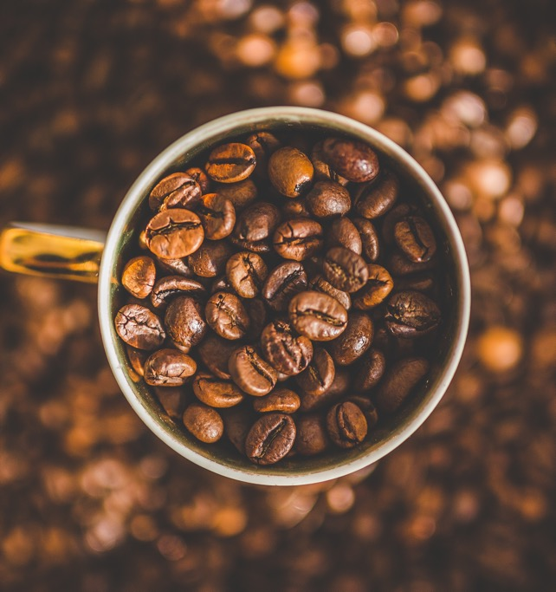
Caffeine
Caffeine (1,3,7 – trimethylxanthine) is a natural alkaloid
Present in the leaves, fruits, and seeds of a variety of plants such as coffee and tea
Most well-studied “supplement”
Most widely used
SSE#203
Spriet L. Sports Science Exchange. 2020;29(203):1-5

Slide 7
Mechanism(s) of Action
Metabolized by the liver (enzymatic action) which results in paraxanthine, theophylline, and theobromine
Following ingestion, appears in blood stream within 15 to 45 minutes, with peak levels appearing around 1 hour
Multiple mechanisms proposed due to ability to cross blood brain barrier as well as membranes of all tissues in the body
Most likely (significant) even at low doses is the effect on the central or peripheral nervous system competing with adenosine at receptor sites
Goldstein ER, Ziegenfuss T, Kalman D, et. al. J of the Int Soc of Sports Nutr. 2010;7(5)

Slide 8
Ergogenic Benefit
Enhanced endurance performance (time to exhaustion)
Improved reaction time, concentration and self-perceived energy levels (even when sleep deprived)
Enhanced glycogen resynthesis
Improved performance in repeated high-intensity exercise bouts (i.e. team sports), but only in those already conditioned
Though little to no effect on strength-based events (i.e. one-repetition maximum testing), velocity is enhanced and velocity loss attenuated over consecutive repetitions
Grgic J, Grgic I, Pickering C, et. al. Br J of Sports Med. 2020;54(11):681-688

Slide 9
Recommended Use & Potential Side Effects
Recommended Use
Potential Side Effects
Low doses of ~200 mg or ~1.5 to 3 mg/kg body mass are effective and should be used initially
Dose of ~3 to 6 mg/kg body mass safe and effective
Higher doses (≥ 9 mg/kg body mass) provide no further benefit and is accompanied by significant side effects
Consumption should occur approximately 1 hour before event for effect
Consideration: International Olympic Committee and National Collegiate Athletic Association have limits on caffeine excreted in urine
Insomnia
Headache
Nervousness/anxiety
Gastrointestinal problems
These are not common with the doses recommended, unless caffeine naive
Spriet LL. Sports Med. 2014;44(2):175-184
Goldstein ER, Ziegenfuss T, Kalman D, et. al. J of the Int Soc of Sports Nutr. 2010;7(5)

Slide 10
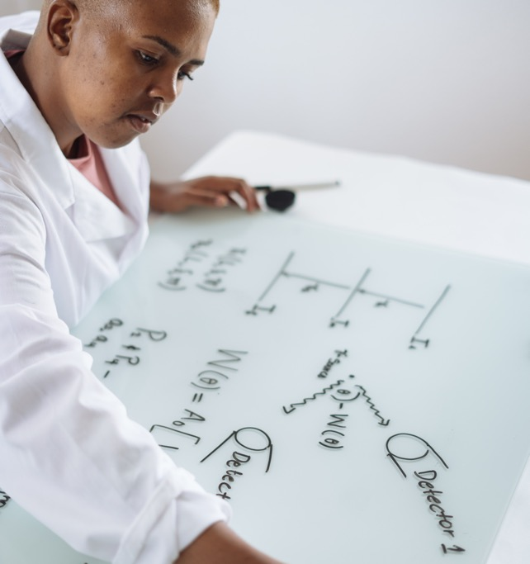
Genetics & Caffeine
Responders vs. Non-Responders
Some individuals do not experience performance benefits associated with caffeine ingestion
Recent research has emerged examining polymorphisms of certain genes
CYP1A2
AD0RA2A
Further research is necessary, but clear that some individuals do not respond to caffeine ingestion
Spriet LL. Sports Science Exchange. 2020;29(203):1-5

Slide 11
CREATINE

Slide 12
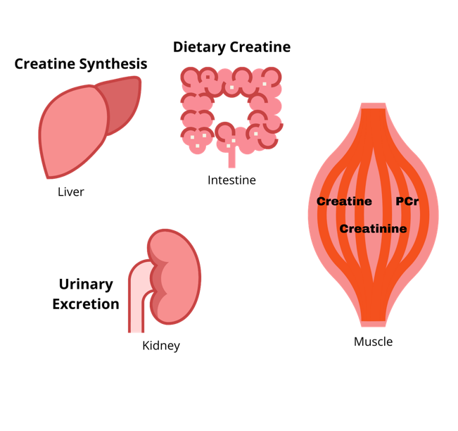
Creatine
Creatine is synthesized in the kidney, liver, pancreas, and, to a lesser extent, the brain
Synthesis is from the amino acids glycine, arginine, and methionine.
The total body creatine pool includes creatine and phosphocreatine (PCr)
Skeletal muscle is the primary site of storage accounting for up to 90% of total body pool
Total body creatine pool can be increased by ingestion of foods high in creatine (i.e. meat and fish) or nutritional supplementation
Mesa JLM, Ruiz JR, Gonzalez-Gross MM, et. al. Sports Med. 2002;32(14):903-944

Slide 13
Mechanism of Action in Muscle
Creatine + ATP
Phosphocreatine + ADP
Creatine Kinase
PCr is an important energy source for high intensity, short duration muscle contraction
Creatine is essential for the regeneration of PCr
The creatine kinase (CK) phosphocreatine (PCr) system serves as an energy buffer in cells with high and fluctuating energy requirements
Walliman T, Tokarska-Schlattner M, Schlattner U. Amino Acids. 2011;40(5):1271-1296

Slide 14
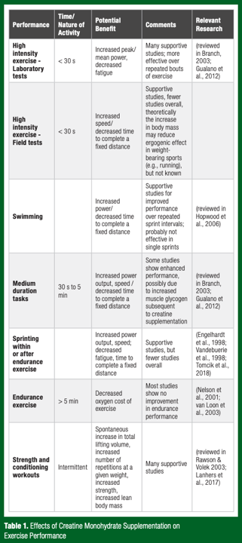
Ergogenic Effects
SSE #186
Short-term benefits following 5-7 day loading include increased
Power production
Sprint performance
Work performed (i.e. multiple sets of maximal effort)
Chronic training with elevated creatine levels
Increases lean mass gains
Improves strength
Improves power
Less common improvements noted in endurance performance, but studies limited especially with chronic training
Reduced lactate at same relative workload
Decreased oxygen cost
Rawson E. Sports Science Exchange. 2018;29(186):1-6

Slide 15
Is Supplementation Necessary?
Unlike the other ergogenic aids discussed, creatine is produced by the body. So is supplementation really necessary?
Pre-supplement muscle creatine concentration is critical to consider
However, few individuals know their baseline creatine concentrations (muscle biopsy can determine)
Genetics determines baseline concentration
Those with higher type II fibers have higher concentrations
Most individuals are below saturation levels and can benefit from supplementation
Mesa JLM, Ruiz JR, Gonzalez-Gross MM, et. al. Sports Med. 2002;32(14):903-944

Slide 16
How do you like your meat?
3 ounces of raw beef equals approximately 0.4 grams of creatine
3 to 6 grams per 2.5 lbs of raw meat (estimated)
Cooking affects creatine in meat by reducing total content
Consideration: Athletes or individuals attempting to lose or maintain weight should consider the additional calories associated with consumption of large amounts of meat or fish for creatine
Harris RC, Nevill M, Harris DB, et. al. Journal of Sport Sciences. 2002;20(2):147-151

Slide 17
Creatine Supplements
Creatine monohydrate, most common form on the market, in solution may increase whole body creatine to a greater extent than meat
Other forms (ethyl ester, etc.) have not been found to increase muscle creatine to a greater extent and in some cases have been reported to result in less muscle creatine
Harris RC, Nevill M, Harris DB, et. al. Journal of Sport Sciences. 2002;20(2):147-151

Slide 18
Recommended Use
Loading phase:
~20 g/d for 5 days OR 5 g/d for 4 weeks will similarly load (but benefit delayed accordingly)
Maintenance:
5 g/d
To cycle or not to cycle?
Cycling is not recommended
Creatine supplementation attenuates endogenous production
Consideration: Consuming carbohydrate with creatine enhances uptake
Rawson E. Sports Science Exchange. 2018;29(186)1-6

Slide 19
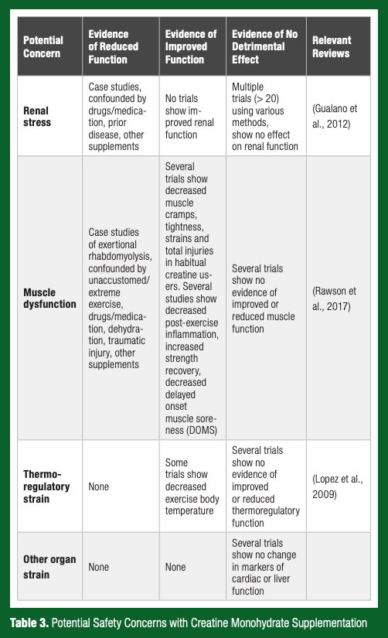
Potential Side Effects
After several decades of research, there is no persuasive evidence suggesting that oral creatine supplementation causes muscle cramps or adversely affects renal function or thermoregulation
The only potential side effect is weight gain
SSE #186
Rawson E. Sports Science Exchange. 2018;29(186)1-6

Slide 20
Genetics and Creatine
Responder vs. Non-Responder
Like caffeine, some individuals will not respond to supplemental creatine ingestion
Why?
As previously noted, individuals with a greater proportion of type II muscle fibers are more likely to have higher concentrations of creatine in muscle
Unfortunately, all tests to determine muscle creatine content are invasive and/or expensive
Most individuals are likely to benefit from supplementation
Mesa JLM, Ruiz JR, Gonzalez-Gross MM, et. al. Sports Med. 2002;32(14):903-944

Slide 21
BETA-ALANINE

Slide 22
Beta-Alanine
Non-proteogenic amino acid (not naturally encoded)
Rate limiting pre-cursor to carnosine (beta-alanine alone has little to no ergogenic benefit)
Endogenously produced in liver
Total body beta-alanine can be increased by ingesting meat, including poultry, or through supplementation
Jones AM. Sports Science Exchange. 2014;27(124):1-5

Slide 23
Mechanism of Action
Beta-alanine is a pre-cursor to carnosine
Carnosine has numerous physiological functions and is formed by the amino acids L-histidine and beta-alanine
The ergogenic benefits are due to carnosine’s intracellular proton buffering capacity
Ingestion of carnosine does not result in increased muscle concentration due to lack of a specific enzyme in the muscle which results in carnosine being metabolized prior to reaching the muscle
However, beta-alanine, being rate limiting, allows carnosine to be increased in the muscle
SSE #124
Culbertson JY, Kreider RB, Greenwood M, et. al. Nutrients. 2010;2(1):75-98
Jones AM. Sports Science Exchange. 2014;27(124):1-5

Slide 24
Ergogenic Benefits
Improved exercise capacity in high-intensity events lasting 60 to 240s
Allows for greater training volume in short event (i.e. lifting weight, sprinting)
May benefit, though modest, in longer events (> 4 min) up to 10 minutes
Attenuates neuromuscular fatigue
SSE #124
Culbertson JY, Kreider RB, Greenwood M, et. al. Nutrients. 2010;2(1):75-98
Jones AM. Sports Science Exchange. 2014;27(124):1-5

Slide 25
Recommended Use & Potential Side Effects
Recommended Use
Potential Side Effects
Acute effects not realized
Chronic loading of 4 to 6 g/d (~65 mg/kg body mass) divided in doses of 2 or less for minimum of 2 weeks produces benefit
Great benefit after 4 weeks
Single bolus not recommended due to acute paraesthesia (i.e. skin tingling) and no performance benefit
Paraesthesia (i.e. tingling) typically experienced in the face, neck, and back of hands
Dose dependent with higher doses resulting in greater effect
Time released formulations reduce paraesthesia
No long-term (> 1 yr) safety data
Trexler ET, Smith-Ryan AE, Stout JR, et. al. Journal of the International Society of Sports Nutrition, 2015;12(30)

Slide 26
NITRATE

Slide 27
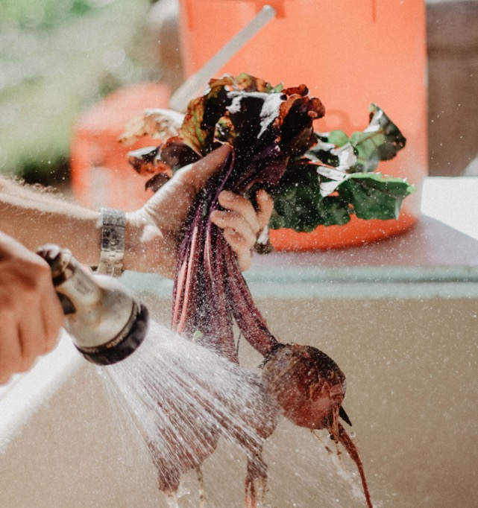
Nitrate
Nitrate (NO₃⁻) is a naturally occurring anion in the body involved in the biosynthesis of nitric oxide (NO) which has many physiological functions in the body
Green leafy and root vegetables are rich in nitrate
Ingestion of nitrate rich foods contributes to the formation of nitric oxide
SSE #110
SSE #156
Jones AM. Sports Science Exchange. 2013;26(110)1-5
Jones AM. Sports Science Exchange. 2016;28(156)1-6

Slide 28
Mechanism of Action
The ergogenic effect of nitrate is not related directly to nitrate, but to nitric oxide
Improved coupling between ATP hydrolysis and force production, resulting in reduced energy cost
Changes in redox status may also be a potential mechanism by which the ergogenic benefits are realized
Jones AM. Sports Science Exchange. 2013;26(110)1-5
Jones AM. Sports Science Exchange. 2016;28(156)1-6

Slide 29
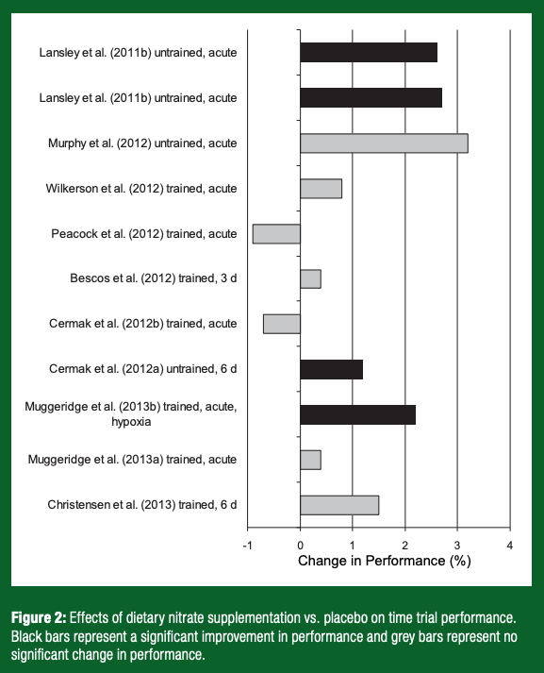
Ergogenic Benefits
Improved exercise efficiency (lower oxygen uptake at same workload), but depends on…
Training status
Dose
Duration
Intensity
Though increases capacity, results of time trial are less likely (other contributing factors)
More rapid development of muscle force
Higher intensity intermittent running & short distance sprinting
SSE #156
Jones AM. Sports Science Exchange. 2016;28(156)1-6

Slide 30
Recommended Use & Potential Side Effects
Recommended Use
Potential Side Effects
5-7 mmol nitrate (~0.1 mmol/kg body mass)
Typically peaks within 2 to 3 hours and remains elevated for 6 to 8 hours
A daily dose is required to keep NO elevated
No known side effects at recommended dose
Senefeld JW, Regimbal RJ, Wiggins C, et. al. Medicine & Science in Sports & Exercise. 2020

Slide 31
SODIUM BICARBONATE

Slide 32
Sodium Bicarbonate
The study of alkalosis to enhance performance goes as far back as 1930
Sodium bicarbonate (NaHCO₃) has been purported to be the most effective ergogenic aid
Sodium bicarbonate increases the level of bicarbonate in the blood which is a natural buffer accepting a proton from carbonic acid
H⁺ + HCO₃⁻ ↔ H2CO₃ ↔ CO₂ + H₂O
SSE #124
Jones AM. Sports Science Exchange. 2014;27(124)1-5

Slide 33
Mechanism of Action
Bicarbonate alone is a buffer and plays a role in maintaining pH and the electrolyte gradient between intracellular and extracellular space
In that role, inducing alkalosis and impacting the role of intra- and extracellular balance, contributes to the maintenance of muscle function
While recognized as the primary mechanism, recent evidence suggests that a more integrative approach is necessary as bicarbonate does not just affect metabolism, but also muscle physiology and motor pathways
Siegler JC, Marshall PWM, Bishop D, et. al. Sports Medicine - Open, 2016;2(41)

Slide 34
Ergogenic Benefit
Enhanced performance in exercise or event in which there is a reliance on anaerobic glycolysis
Most common in event > than 30 seconds, but less than 120 seconds
However, recent review highlighted no difference in effect size in medium (2 to 10 minutes) and long (>10 minute) exercise
The latter may be due to lower oxygen cost
Benefits realized in high intensity intermittent exercise (team sports)
Evidence suggests more beneficial for untrained
Peart DJ, Siegler JC, Vince RV. Journal of Strength and Conditioning Research, 2012;26(7):1975-1983

Slide 35
Recommended Use & Potential Side Effects
Recommended Use
Potential Side Effects
0.2 to 0.4 g/kg body mass ingested 60 to 120 minutes before exercise or competition
Gastrointestinal distress including….
Pain
Diarrhea
Vomiting
Gas
Nausea
The above side effects are not rare occurrences. Individuals should experiment in training prior to use in competition.
Peart DJ, Siegler JC, Vince RV. Journal of Strength and Conditioning Research, 2012;26(7):1975-1983

Slide 36
Indirect Performance Enhancing (Ergogenic)
The IOC characterizes some supplements as “indirect performance enhancing” due to their effect on return to performance (injury recovery), soreness, or training capacity

Slide 37
Creatine
In addition to performance enhancing benefits, creatine also play a vital role in recovery
Enhanced adaptive response
Reduced muscle soreness (delayed onset muscle soreness)
Improved cognitive processing
Enhanced recovery from mild traumatic brain injury (mTBI) (i.e. concussion)
Supplementation for recovery is the same as for performance
Maughan RJ, Burke LM, Dvorak J, et. al. Int J of Sport Nutr and Exerc Metab. 2018;28(2):104-125

Slide 38
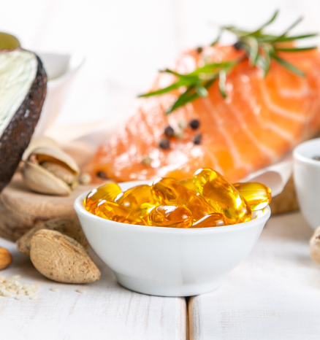
Omega-3 Fatty Acids
Like creatine, the body can produce the omega-3 fatty acids docosahexaenoic (DHA) and eicosapentaenoic acid (EPA); however, that process is limited and inefficient.
Dietary sources of DHA and EPA are limited to fish due to a diet rich in algae
Therefore, most individuals are deficient. In fact, several studies have highlighted deficiency in college athletes
Anzalone AJ, Carbuhn A, Jones L, et. al. Journal of Athletic Training. 2019;54(1):7-11

Slide 39
Omega-3 Fatty Acids
Benefits include….
Increased muscle protein synthesis
Improved cognitive processing
Enhanced recovery from mTBI
Enhanced recovery from exercise (may be due to anti-inflammatory properties of EPA)
Recommended dose is 2 g/d; though optimal ratio is unknown. 2 g/d DHA is recommended for enhanced mTBI recovery
Maughan RJ, Burke LM, Dvorak J, et. al. Int J of Sport Nutr and Exerc Metab. 2018;28(2):104-125

Slide 40
Vitamin D
Essential fat-soluble vitamin
Obtained from exposure to sun
Interestingly, even in many southern state, low vitamin D levels are observed
Vitamin D is associated with numerous important biological actions relevant to the athlete including regulating bone health, immune function, cell cycle and skeletal muscle homeostasis
SSE #147
Close G. Sports Science Exchange. 2015;28(147)1-4

Slide 41
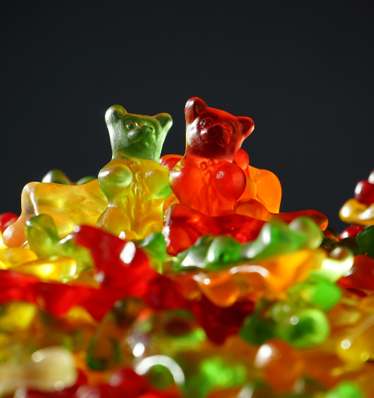
Gelatin & Vitamin C
Collagen is the primary protein in connective tissue (tendons and ligaments)
Gelatin is a food used in jellies, jello, and gummies to produce the gelatinous texture which is made from collagen from skin, bones, and tissues of animal
Increased collagen production has been observed following consumption of gelatin + vitamin C
Additionally, decreased joint pain has been observed
Recommended dosing: 15 g gelatin with 50 mg vitamin C 1 hour before intermittent activity (jump rope)
SSE #187
Baar K. Sports Science Exchange. 2018;29(187)1-6

Slide 42
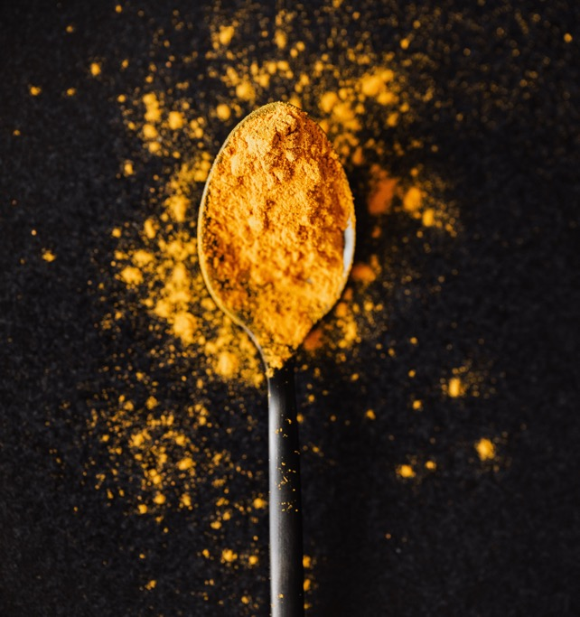
Non-Drug Anti-Inflammatories
Some foods have anti-inflammatory properties which may reduce the symptoms associated with muscle soreness and enhance recovery
Curcumin, the bioactive ingredient in the spice turmeric, has anti-inflammatory properties
Tart cherries also have bioactive ingredients purported to promote recovery
Recommended dose: 250-350 mL (30 mL concentrate) tart cherry juice twice daily for 4 to 5 days before even or 2 to 3 after to promote recovery
Maughan RJ, Burke LM, Dvorak J, et. al. Int J of Sport Nutr and Exerc Metab. 2018;28(2):104-125

Slide 43
Summary
Supplements Identified by the IOC to Have a Performance Benefit:
Caffeine
Creatine
Beta-Alanine
Nitrate
Sodium Bicarbonate
Supplements Identified by the IOC to Have an Indirect Performance Benefit:
Omega-3 Fatty Acids
Vitamin D
Gelatin + Vitamin C
Anti-Inflammatories
(Curcumin, Tart Cherry)

