Slide 1
ENERGY: FUEL SOURCES FOR THE WORKING MUSCLE
Lecture content provided by GSSI, a division of PepsiCo, Inc. Any opinions or scientific interpretations expressed in this presentation are those of the author and do not necessarily reflect the position or policy of PepsiCo, Inc.

Slide 2
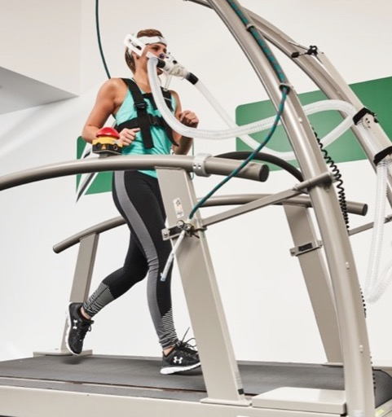
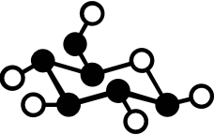

Lecture Outline
Fuel Sources
Energy Storage
Energy Systems
Review

Slide 3
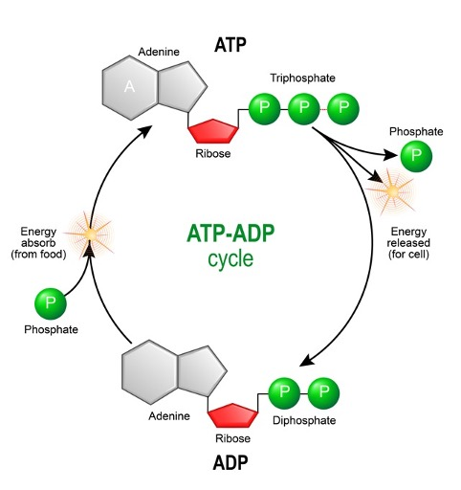
Adenosine Triphosphate (ATP)
Splitting a phosphate group from ATP supplies the energy for muscle contraction
ATP is reformed from ADP with a phosphate from phosphocreatine (PCr)
Macronutrients from food are the fuel sources metabolized to generate ATP
1234
1234
Hargreaves, M & Spriet, L. Nat Metab. 2020; https://doi.org/10.1038/s42255-020-0251-4.

Slide 4
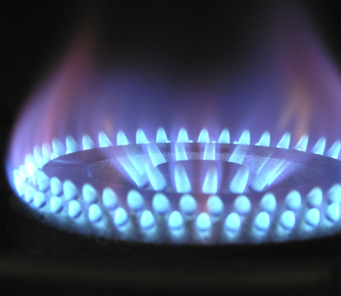
Fuel Sources metabolized to produce ATP
Carbohydrate
Fat
Protein

Slide 5
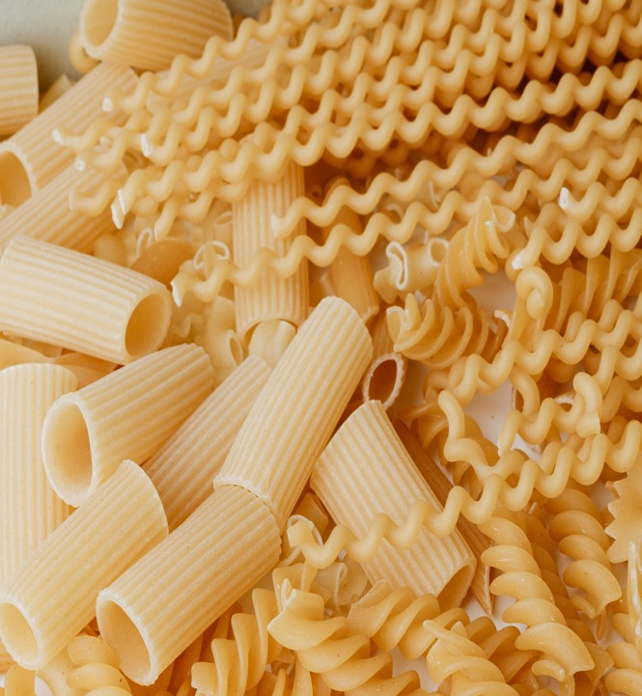
Carbohydrate
Energy: 4 kcal/g
Exists in the body as glucose
Blood glucose provides energy for the brain and tissues
Glycogen = storage form of glucose in the muscle and liver
Sport Nutrition 3rd Ed. Jeukendrup & Gleeson, Human Kinetics.

Slide 6
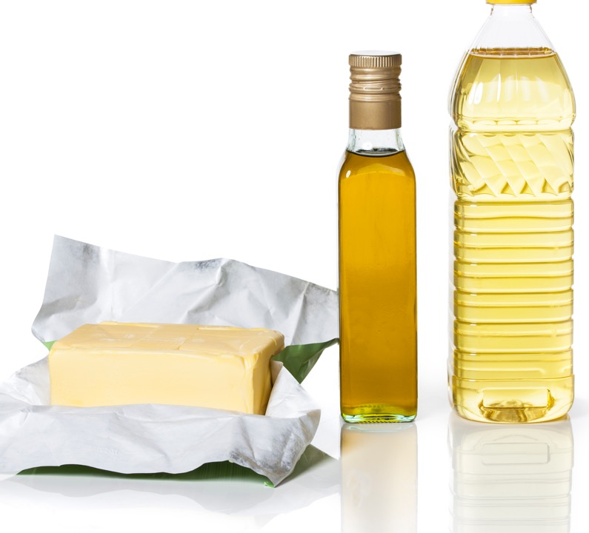
Fat
Energy: 9 kcal/g
High energy yield but ATP production process is slower than that of carbohydrates
Sport Nutrition 3rd Ed. Jeukendrup & Gleeson, Human Kinetics.

Slide 7
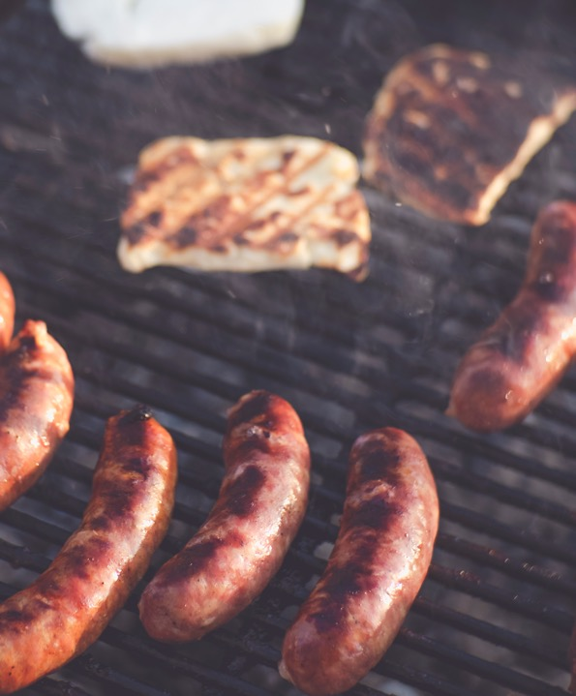
Protein
XXXXXX
Energy: 4 kcal/gram
While the amino acids from protein play a big role in the structure of various components of the body (muscle, hormones, etc.), their role for energy production is limited
Amino acid oxidation for fuel mostly occurs only when other fuel sources are not available
Sport Nutrition 3rd Ed. Jeukendrup & Gleeson, Human Kinetics.

Slide 8
Phosphocreatine (PCr)
Phosphocreatine (PCr) is primarily found in the muscle, the phosphate group (P) is used to generate ATP from ADP
Used for very short duration (~5 s or less) high intensity muscle contraction
Creatine is produced in the body (~1-2 g/d)
Meats, particularly red meat, and fish such as
salmon and tuna are rich in creatine
Creatine can also be consumed from supplements
P
Cr
Cr
P
ADP
ATP
Hargreaves, M & Spriet, L. Nat Metab. 2020; https://doi.org/10.1038/s42255-020-0251-4.

Slide 9
A Note on Micronutrients
Many micronutrients are involved in energy-producing processes
Examples:
Iron helps deliver oxygen to the muscle for aerobic metabolism
B Vitamins are cofactors in the aerobic metabolism process
Vitamins and Minerals do not provide energy themselves, but they are critical to enable the energy-producing processes
Sport Nutrition 3rd Ed. Jeukendrup & Gleeson, Human Kinetics.

Slide 10
A Note on Caffeine
Caffeine provides “energy” primarily by acting on the nervous system and binds to receptors in the brain to alter the release of neurotransmitters
Caffeine does have ergogenic benefits for exercise performance, but it is not an energy source to provide fuel for muscle contraction
Hargreaves, M & Spriet, L. Nat Metab. 2020; https://doi.org/10.1038/s42255-020-0251-4.

Slide 11
Fuel Sources Myths
Nuts are an excellent source of quick energy
All types of carbohydrate should be avoided
B-vitamin supplements will provide a quick boost of energy before a workout
Low carbohydrate, high protein and/or high fat diets provide the energy needed to improve performance

Slide 12
FUEL STORAGE

Slide 13

LIVER
ADIPOSE TISSUE
Liver glycogen
~80 grams
320 kcal
GLUCOSE
Fat
>100,000 kcal
GLUCOSE
FATTY ACIDS
BLOOD
MUSCLE
PCr
Fat (IMTG)
Muscle glycogen
~460-520 grams
1849-2,080 kcal
Hargreaves, M & Spriet, L. Nat Metab. 2020; https://doi.org/10.1038/s42255-020-0251-4.
van Loon LJ. Appl Physiol. 2004;97(4):1170-1187 https://doi.org/10.1152/japplphysiol.00368.2004.
Notes:
Diagram to illustrate fuel sources- locations and amounts
Main point – lots of fat, but it’s slow. Carb stores are limited, eating carb helps support glycogen stores

Slide 14


Glucose Storage
Glycogenesis = process of converting glucose into glycogen
Glycogen can be stored in the liver and the muscle in limited capacity
Muscle glycogen (~460-520 g) – only used by the muscle for energy
Liver glycogen (~80 g) – can leave the liver as blood glucose to be used by the brain and other tissues
Hargreaves, M & Spriet, L. Nat Metab. 2020; https://doi.org/10.1038/s42255-020-0251-4.
van Loon LJ. Appl Physiol. 2004;97(4):1170-1187 https://doi.org/10.1152/japplphysiol.00368.2004.

Slide 15
Glucose Storage
Lipogenesis = process of converting excess glucose into triglycerides (fat)
This typically occurs once glycogen stores are full and excess carbohydrate is consumed
Fat can be stored in several locations throughout the body including subcutaneous adipose, visceral adipose and muscle
Hargreaves, M & Spriet, L. Nat Metab. 2020; https://doi.org/10.1038/s42255-020-0251-4.

Slide 16
Manipulating Fuel Stores with Exercise Training & Diet
An adaptation that occurs with exercise training, particularly endurance exercise training, is an improved capacity to store glycogen
To fully take advantage of this adaptation, athletes must consume adequate carbohydrate
Sport Nutrition 3rd Ed. Jeukendrup & Gleeson, Human Kinetics.

Slide 17
Fat Storage
Fat can be stored in several locations throughout the body including subcutaneous adipose, visceral adipose and muscle
Intramuscular Triglycerides (IMTG) are a source of fuel for muscles to generate ATP, primarily during endurance exercise
~200 g (1800 kcal) stored in the muscle
The breakdown of IMTG provides free fatty acids for oxidation during low and moderate intensity exercise, sprinting and resistance exercise
van Loon LJ. Appl Physiol. 2004;97(4):1170-1187
Spriet L and Randell R. Sports Science Exchange. 2020;29(205):1-6

Slide 18
ENERGY SYSTEMS

Slide 19
ATP-PCr
  Utilized during very short duration, high intensity activities
    Restores ATP stores after ATP depletion or during recovery
    Allows for the constant replenishment of stored ATP
    Does not require oxygen
P
Cr
Cr
P
ADP
ATP
Sport Nutrition 3rd Ed. Jeukendrup & Gleeson, Human Kinetics.

Slide 20
Anaerobic Glycolysis
Overview
Glycolysis
Glucose
-1 ATP
Glycogen
  Utilized during short duration, high intensity activities
  Glucose or glycogen converted into glucose-6-phosphate
    2-3 ATP generated (2 for glucose, 3 for glycogen)
  Anaerobic: does not require oxygen
    By products: Lactate and Hydrogen Ion (H⁺)
glucose-6-phosphate
1234
1234
2-3 ATP
Sport Nutrition 3rd Ed. Jeukendrup & Gleeson, Human Kinetics.

Slide 21

Limits to Anaerobic Energy Production
SSE #171
H⁺ production reduces muscle pH
Improving the buffering capacity of the muscle to better handle the changes in pH helps promote anaerobic energy production
Training: high-intensity interval training increases muscle buffering capacity and high-intensity exercise performance
Nutrition:
Bicarbonate loading can improve performance during exhaustive exercise lasting between 1 - 7 minutes. Gastrointestinal distress has limited the use of bicarbonate, but repeated doses over several days prior to competition may reduce the problems.
Beta-alanine can improve muscle buffering capacity and high-intensity exercise performance
Creatine not only provides substrate to the ATP-PCr system but improves buffering capacity
The improved performance after interventions that increase buffering capacity demonstrates that the acidosis associated with high glycolytic rates is an important factor in fatigue
Sahlin K. Sports Science Exchange. 2017;28(171):1-4

Slide 22
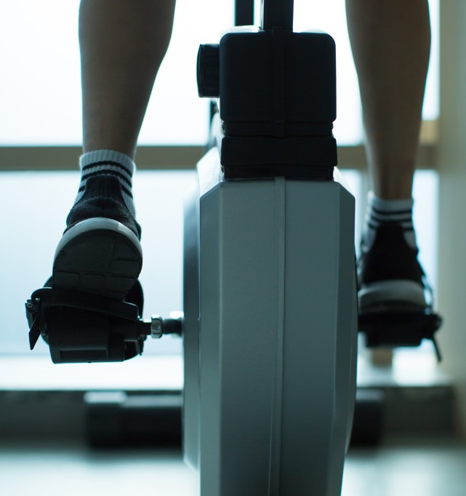
Oxidative Systems
  Utilized during longer duration activities
  Uses oxygen to generate energy from the breakdown of glucose/ glycogen and fat
  2 pathways based on substrate:
    Carbohydrate Oxidation
    Fat Oxidation
1234
Sport Nutrition 3rd Ed. Jeukendrup & Gleeson, Human Kinetics.

Slide 23
Carbohydrate Oxidation
Overview
Glycolysis
H⁺
    Glycolysis: 2-3 ATP generated
    Pyruvic Acid converted to Acetyl-CoA
    Acetyl-CoA enters the Krebs cycle: 2 ATP generated
    H⁺ ions are transported through the Electron Transport Chain (ETC): 28 ATP generated
    32-33 ATP generated in total for each Glucose/ Glycogen molecule
3 ATP
H⁺
ETC
2 Pyruvate
1234
2 Acetyl-CoA
H⁺
28 ATP
Krebs Cycle
2 ATP
Sport Nutrition 3rd Ed. Jeukendrup & Gleeson, Human Kinetics.

Slide 24
Fat Oxidation
Overview
Fatty Acid
Glycolysis
Fats follow a similar mechanistic path to carbohydrate with a few exceptions:
- Fat (triglyceride) stores are broken down to yield fatty acids through lipolysis
- The fatty acids are converted into Acetyl-CoA through β-Oxidation
The total energy yield will vary depending on the fatty acid however the ATP production will be very high (~100+), but the process is slower than carbohydrate
Beta-oxidation
ETC
1234
Acetyl-CoA
H⁺
100+ ATP
Krebs Cycle
2 ATP
Sport Nutrition 3rd Ed. Jeukendrup & Gleeson, Human Kinetics.

Slide 25
PCr Resynthesis: Interaction of Anaerobic and Aerobic Energy Systems
The ability to rapidly resynthesize PCr is an important aspect of metabolism for stop-and-go sports
Occurs when intensity falls to low levels or the athlete rests
Continued aerobic production of ATP fuels regeneration of PCr
PCR can be completely recovered in 60-120 s
Hargreaves, M & Spriet, L. Nat Metab. 2020; https://doi.org/10.1038/s42255-020-0251-4.

Slide 26
Limits to Aerobic Energy Production
The term “hitting the wall” often refers to glycogen depletion
Enough fat is stored in the body, even in a lean individual, to provide energy. But ATP production from fat alone is too slow to sustain performance

Slide 27
Lactate
Historically, lactate was thought to be simply a waste product of aerobic metabolism and led to fatigue and muscle soreness
It is now understood that the lactate produced from aerobic metabolism becomes an energy source itself for the heart, brain, kidneys and liver, and can be converted to glucose
Brooks G. Cell Metab. 2018;27(4):757-785 https://doi.org/10.1016/j.cmet.2018.03.008

Slide 28
Protein Oxidation
Protein is not a primary fuel source
Oxidation of amino acids contributes <5% of ATP synthesis
Oxidation of branched chain amino acids may increase during endurance exercise; however this seems to only be the case if sufficient carbohydrate is not ingested
When they are used for energy, amino acids are converted to glucose through gluconeogenesis or converted to intermediates of the Krebs cycle
Hargreaves, M & Spriet, L. Nat Metab. 2020; https://doi.org/10.1038/s42255-020-0251-4.
Gibala MJ. Sports Med. 2007;37(4-5):337-40

Slide 29

Sex Differences in Metabolism
At the same relative intensity, females use a larger percentage of fuel from fat
Females have a lower maximal capacity of glycolytic enzymes and greater reliance on IMTG during exercise
Likely related to estrogen levels
Hargreaves, M & Spriet, L. Nat Metab. 2020; https://doi.org/10.1038/s42255-020-0251-4.

Slide 30
Review
Macronutrients→ ATP
Glycogen→ Liver and Muscle
Fat→ Adipose and Muscle
Fast→ ATP-PCr, Glycolysis
Slow→ Carbohydrate Oxidation
Slowest→ Fat Oxidation

